Slide 1
How to Drill Down into your Results using Settings and Filters
Reporting System Training Module #2
Notes:
Welcome to the second training module in the Reporting System series, How to Drill Down into Your Results Using Settings and Filters. These features help you customize your reports with precise and specific data so that you see exactly what you need.

Slide 2
Objectives
Use Settings to Customize Results
  Teachers: Select Tests to Include on Reports
  Other Users: Use Teachers’ Test Selections
Use Filters to Customize Results
  Filter by Test Group
  Filter by Roster
  Filter by Test Reason
See Results from Previous Years
2
Notes:
In this training module we cover the settings and filters specifically related to drilling down into data. First we show teachers how to eliminate unnecessary test reports from their results. Then we show other users how to mirror those teacher selections in their results. Then we cover the three filters that eliminate even more reports from your results. Finally, we show you how to go back in time to see your previous students results from previous years AND your current students results from precious years.

Slide 3
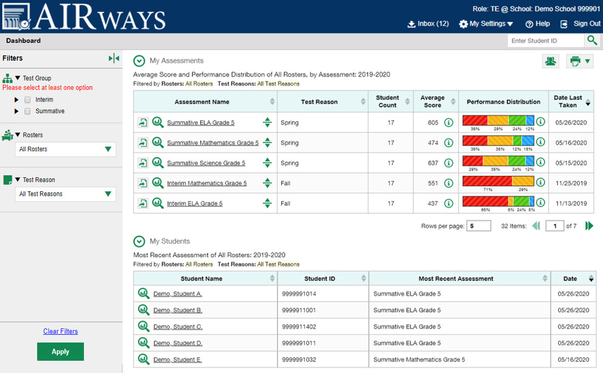
Where are Your Settings and Filters Located?
Manage Access
Change Role
Reporting Options
Manage Test Reasons
Select Tests to Include on Reports
Change Reporting Time Period
Set Student Settings on Item View
Roster Settings
Add Roster
View/Edit Roster
Upload Rosters
Notes:
Setting and filters are both accessed from the dashboard page. The My Settings button is located in the banner and includes several options, depending on your district or state configurations. A generic menu is shown here.
The Filters panel, on the left side of the dashboard, provides options to temporarily limit the results that display in your report tables. Typically you can select to filter by Test Group, Rosters, and Test Reason. Use the expansion arrows in the panel to open each drop-down list. The options available to you will be listed.
In this training module we cover the settings and filters specifically related to drilling down into data. There are additional training modules in the series for training on other features like roster settings, test reasons, and student settings.
The next slide shows a collection of settings and filters used by most teachers and other users, in a step-by-step process.

Slide 4
6 Ways to Drill Down into Your Reports
Select Tests to Include on Reports
For teachers
My Settings menu
Filter by Test Group
For all users
Filter by Roster
Filter by Test Reason
Change Reporting Time Period
Omits tests that are NOT relevant to your needs
Setting will persist until you change it
Filter panel
Temporarily hides selected tests in all reports
For teachers and school-level users
Filter panel
Temporarily hides selected classes in all reports
Filter resets when you log out
For all teachers, school- and district-level users
Filter panel
Filter resets when you log out
For all users
My Settings menu
School Year and Current or Past Students; allows you to view previous year’s results for current OR past students
Setting resets when you log out
Use Teachers’ Test Selections
For school, district, and state users
My Settings menu
Omits those teachers’ rosters from the tests the teachers have omitted
Setting will persist until you change it
Filter resets when you log out
Temporarily displays results from a specific category of test reasons, like Spring or Fall
FIRST…
THEN…
OTHER YEARS
Notes:
We cover the drill down settings and filters in this order, as this is the way you will most likely move through your reports. The dark blue header boxes are choices from the My Settings menu, while the light blue header boxes are options from the Filters panel. This chart provides an overview of the drill down features. Teachers start by selecting tests to include on reports while other users start by choosing to use the teachers’ test selections in their own reports. Then users may choose to filter by test group, by roster, or by test reason. After you have looked at your current year’s results, you may want to change the reporting time period to view results from a previous year or from a group of students you taught in a previous year. If you know in advance that you want to look at last year’s results, you can start with that setting and drill down using the same process.
Now we start drilling down into test results.

Slide 5
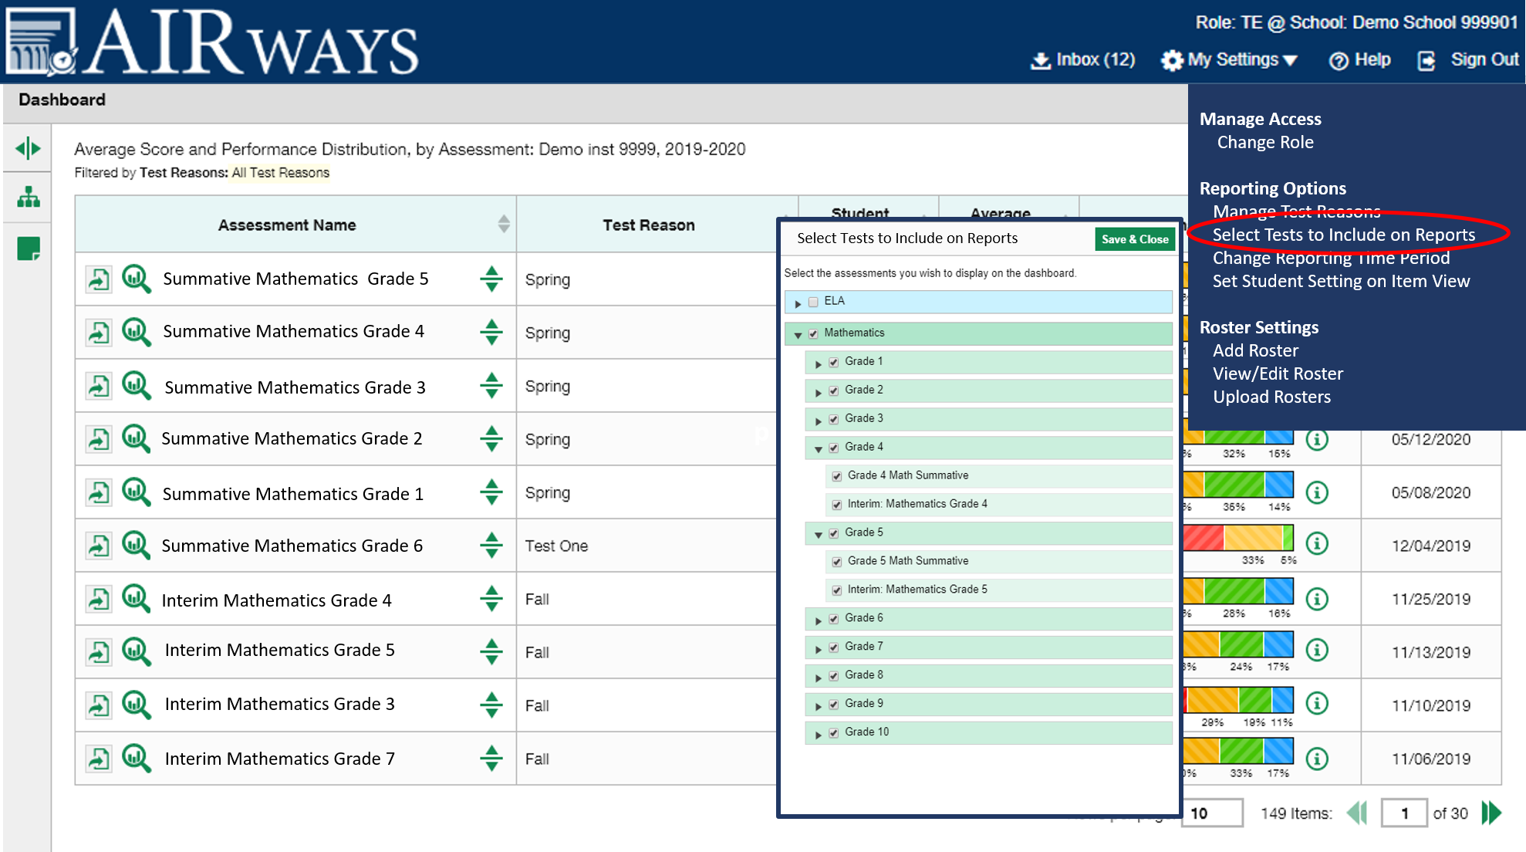
Teachers: Select Tests to Include on Reports
5
Notes:
To begin, teachers choose the tests they want included in their reports and omit those that do not apply to their needs. For example, if you are a Math teacher you can omit your students English Language Arts test scores. By default, all of the tests taken by your students, in the current school year, appear in your reports. Removing some of them will trim your reports to exactly the results you need to see. Click the My Settings menu in the banner and choose Select Tests to Include on Reports. Select the checkboxes beside the tests or groups of tests you want included in your reports. Here you can see that Math tests are selected, and ELA tests are omitted. Click Save & Close. This setting remains in place until you change it and your reports will include only the tests you selected.

Slide 6
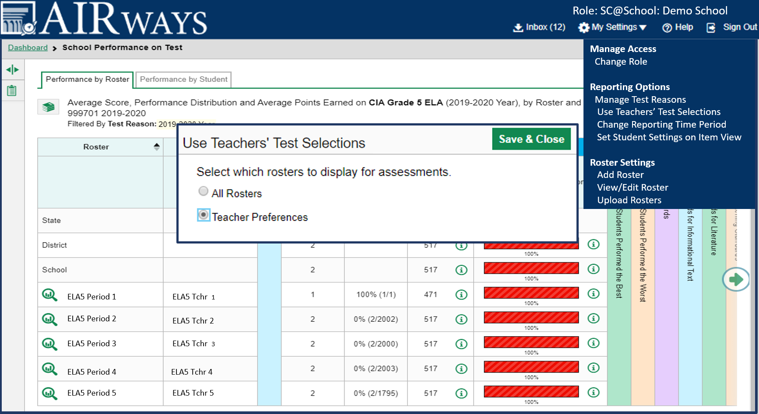
School & District Users:
Use Teacher’s Test Selections
Notes:
If you are a school- or district-level user, you can use your teachers’ test preferences to eliminate rosters that aren’t relevant to a test. For example, suppose a math roster belongs to a math teacher who has excluded ELA tests from their reports. By using teacher preferences, you can view a set of ELA test results without that math teacher’s roster. All students who took the ELA test will still appear in the report, whether or not they belong to the math teacher’s roster, but the Performance by Roster tab will not list them as belonging to that math teacher’s roster. By hiding rosters that are not relevant to the test, and by preventing a student from appearing more than once in the same report, this setting makes reports easier to read and more subject appropriate. To turn this setting on, open the My Settings menu and choose Use Teachers’ Test Selections. In the pop-up box, select the Teacher Preferences radio button and click Save & Close. To turn this setting off and view all rosters regardless of teacher preferences, select the All Rosters radio button and click Save & Close. This setting persists until you change it. Now we will explain the Filter panel options. They can be used to temporarily hide certain elements of your reports that you don’t need to see.

Slide 7
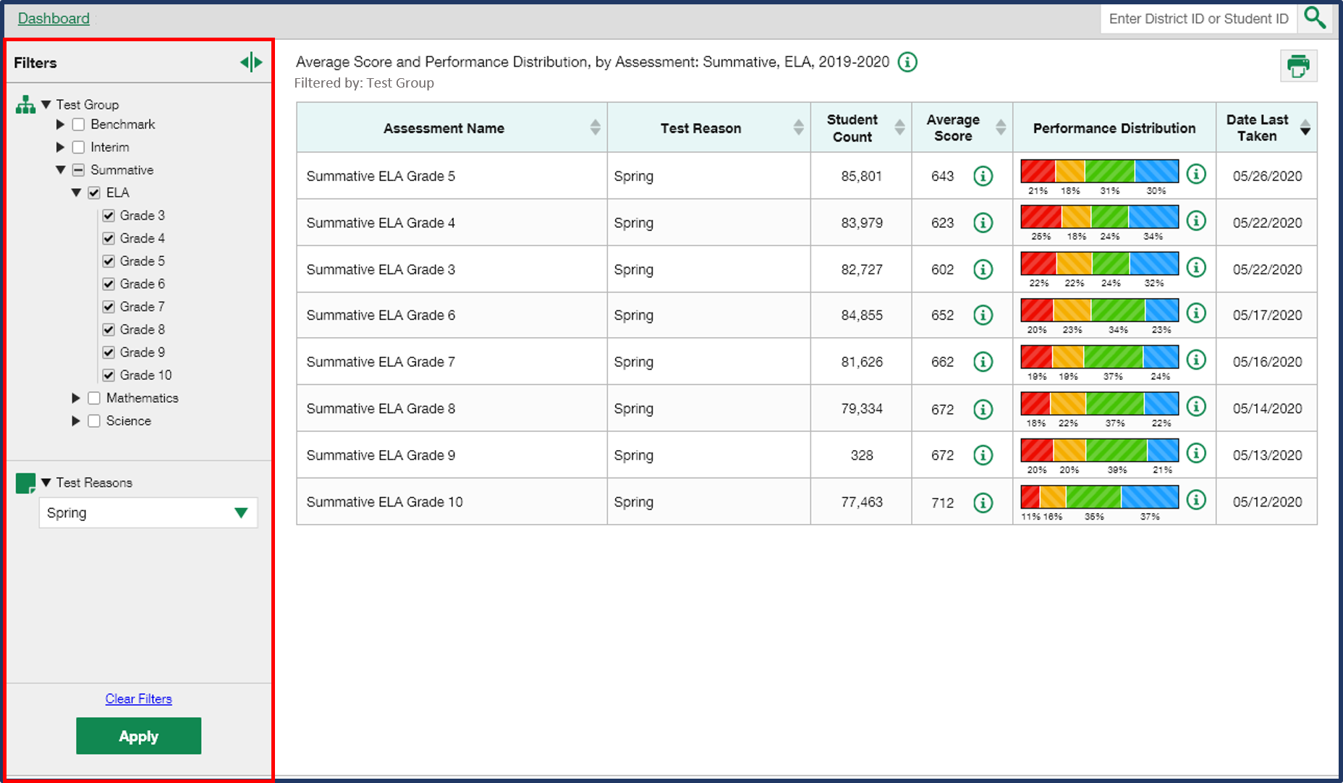
Test Group Filter
Notes:
Another way to focus on your most relevant reports is to use the Test Group filter located in the Filters panel. It is similar to the teachers’ Select Tests to Include in Reports option in My Settings, except that it will not persist or mirror in other users’ results. Tests in this filter menu are organized by test type, subject, and grade. Click the down arrow next to the type of test results you need to view. Mark as many selections as you like from the options displayed and click Apply. You see here that the ELA Summative tests for grades 3-10 have been selected. The table and the header reflect these selections. To revert all filters to their default settings, click Clear Filters and Apply. Filters also revert when you log out, switch user role, or switch systems.

Slide 8
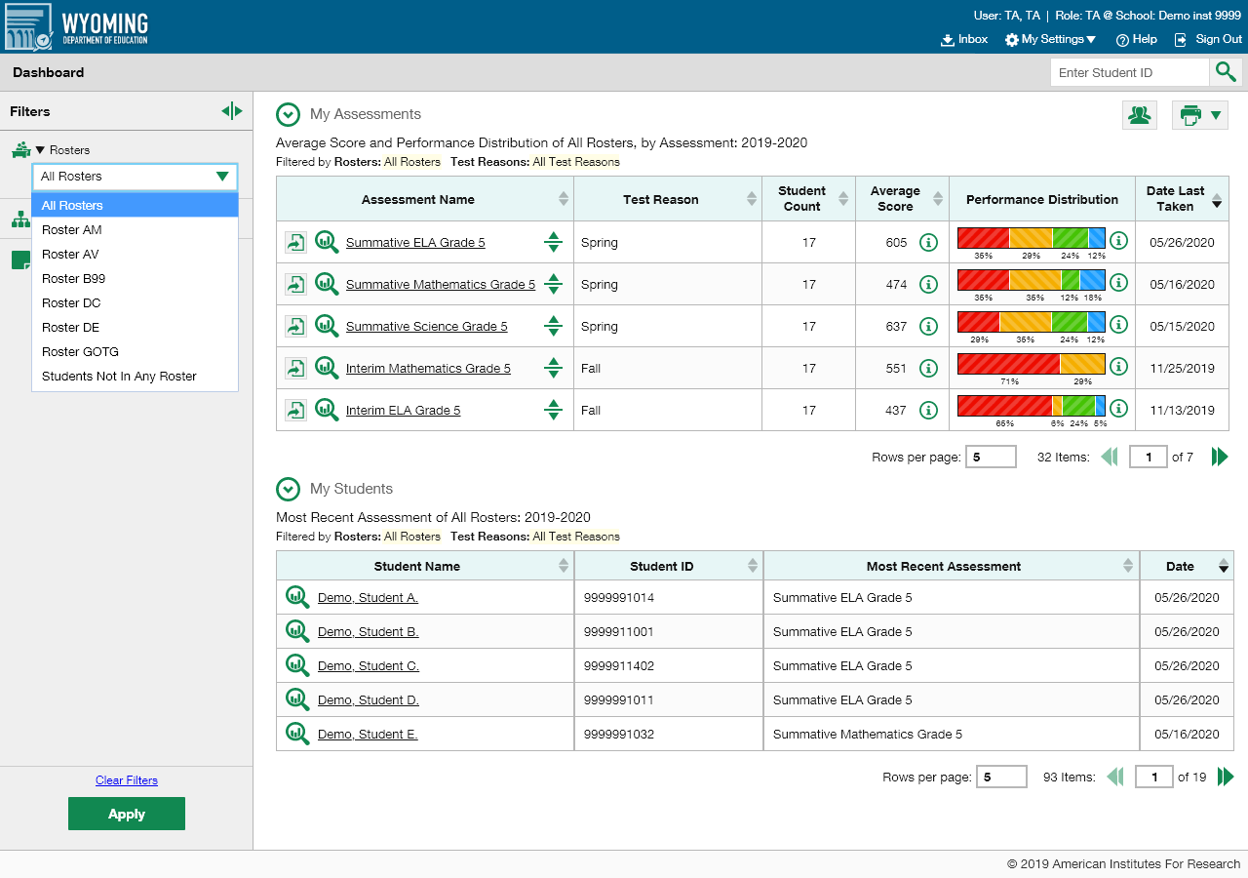

Roster Filter
Notes:
Teachers can drill down even further into their reports by using the Roster filter. Rosters generally represent classes but can also represent students who have been grouped together because of having something in common, such as needing extra help on a particular assessment standard. Open the Rosters filter from the panel. Make a single selection from the Rosters drop-down list. Click Apply. The report updates to show data for the roster you selected. You can see that Roster AM has been selected and applied. The dashboard report shows only the tests taken by the students on that roster in the My Assessments table and only the students on the AM roster in the My Students table. When you navigate away from the dashboard this roster filter will apply to all your reports. All filter options will revert to the default when you log out, switch user roles, or switch systems.

Slide 9
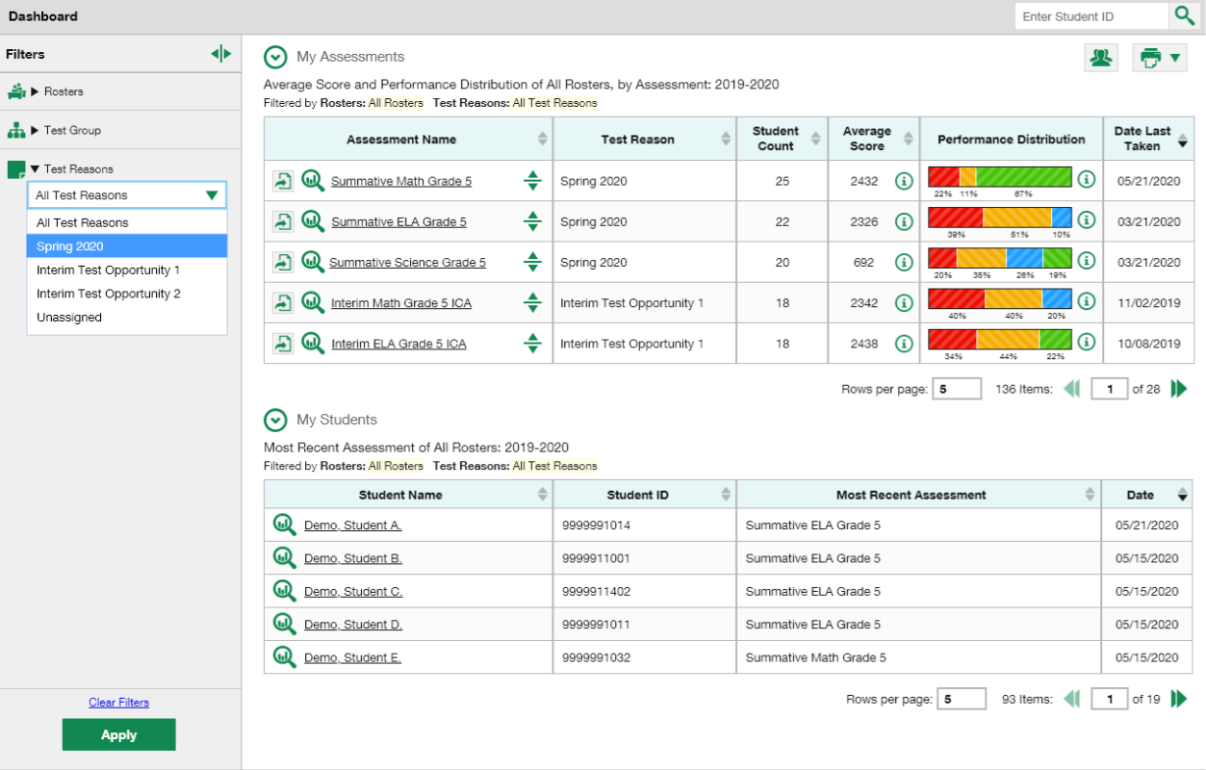
Test Reasons Filter
Notes:
Test reasons are categories used to classify test opportunities for reporting purposes. They typically indicate the timeframe in which interim and benchmark tests were taken, and they can be a good way to focus on specific groups of tests. For summative assessments, test reasons are simply test windows and are not useful. Open the Test Reasons menu from the Filters panel. Make a selection from the drop-down list and click Apply. The affected report updates to show only data for that test reason. All the reports accessible from this page will be filtered the same way.

Slide 10
6 Ways to Drill Down Into Your Results
Select Tests to Include on Reports
For teachers
My Settings menu
Filter by Test Group
For all users
Filter by Roster
Filter by Test Reason
Change Reporting Time Period
Omits tests that are NOT relevant to your needs
Setting will persist until you change it
Filter panel
Temporarily hides selected tests in all reports
For teachers
Filter panel
Temporarily hides selected classes in all reports
Filter resets when you log out
For all users
My Settings menu
School Year and Current or Past Students; allows you to view previous year’s results for current OR past students
Setting resets when you log out
Use Teachers’ Test Selections
For school, district, and state users
My Settings menu
Omits those teachers’ rosters from the tests the teachers have omitted
Setting will persist until you change it
Filter resets when you log out
For all teachers, school- and district-level users
Filter panel
Temporarily displays results from a specific category of test reasons, like Spring or Fall
Filter resets when you log out
Notes:
To review, we have covered how to reduce the number of tests in teacher’s reports and the number of rosters in school and district users’ reports. We then covered the Test Group filter which is a quick, non-permanent way to view only the test results you need to see. The Roster filter allows teachers to focus on the performance of a single group of students. The Test Reason filter is helpful for the number benchmark and interim tests that can be filtered to omit the ones you do not need to see.
The Change Reporting Time Period setting allows you to “go back in time.” When you are looking at individual or group results you can choose to look at their performance from a previous year, or you can look at a previous year’s group of students and compare their results to the students you currently have. You use the Change Reporting Time Period setting to do this. These two tools are explained in the next several slides.

Slide 11
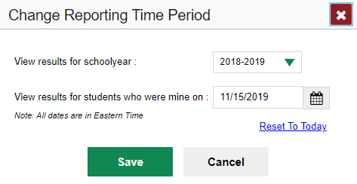
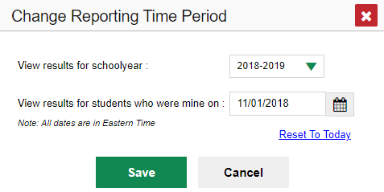
Change Reporting Time Period
Current Students: Previous Year’s Results
To view your current students' past performance, select the previous school year and leave the calendar date set to today.
Manage Access
Change Role
Reporting Options
Manage Test Reasons
Select Tests to Include on Reports
Change Reporting Time Period
Set Student Settings on Item View
Roster Settings
Add Roster
View/Edit Roster
Upload Rosters
Former Students and Their Results
(for comparison to current students)
To view the performance of classes you taught in previous years, choose the previous school year and set the calendar date to a day within that year when the students had started testing.
Notes:
A final way of drilling down into your results is to use the Change Reporting Time Period setting. Reporting is designed to show test results from the current school year, by default. When you want to go back in time to compare previous data with current data you use the Change Reporting Time Period from the My Settings menu. You can use this setting to do two things:
You can view your current students’ test performance from previous school years.
You can view the performance of your former classes so that you can compare their scores to the scores of the students you currently have.
At any time and from any page of reports you can open the My Settings menu in the banner and click on the Change Reporting Time Period option. A pop-up window with the same name will appear. The Change Reporting Time Period pop-up window displays with two boxes: one for returning to a previous school year and one to use for returning to students who were assigned to you, as of a specific date, usually a time from a previous school year. You use one of the boxes or both of them, depending on the data you want to return to. To see your current students’ previous results select a previous school year from the drop-down list. Leave the calendar date set to today or reset it, if necessary. The top pop-up window in this image displays those settings. Click Save. Your reports now show your current students’ test results from the year you selected. Sometimes you may want to contrast the results of your current classes with classes you had in the past. To do this, set the school year option to the desired year and then enter a calendar date within that particular year when you know the students had started testing. This will take you “back in time” to see the results of your former classes. The bottom pop-up window displays these settings. Set like this, a teacher will see his or her students from last year and their results from that year. As mentioned previously, you can start the drilling down process with this step when you know that you want results other than your current schoolyear results for your current students. Over time you will learn the many configurations possible with the Change Reporting Time Period setting and you’ll be an expert at returning to exactly the results you want to see.

Slide 12
The Reporting System Training Module Series
How to Navigate the Dashboard and Generate Reports
How to Drill Down into Your Results Using Settings and Filters
How to Track Student Performance Over Time Using the Longitudinal Report
How to Print ISRs and Student Data Files
How to Print and Export Data You Can See in Your Reports
How to Use the Roster Manager to Add, Modify, and Upload Rosters
Interim and Benchmark Assessments Only
How to Analyze Item-Level Reports
How to Hand-Score Unscored Items and Modify Machine Scores
Notes:
More training modules are posted on your state or district portal. You may also consult the Reporting System User Guide.

