Slide 1
How to Print and Export Data you can See in your Reports
Reporting System Training Module Series #5
Notes:
Welcome to training module #5 in the Reporting System series: How to Print and Export Data You Can See in Your Reports. In this training module we show you how to print and export your reports directly from the dashboard and any page of test results.

Slide 2
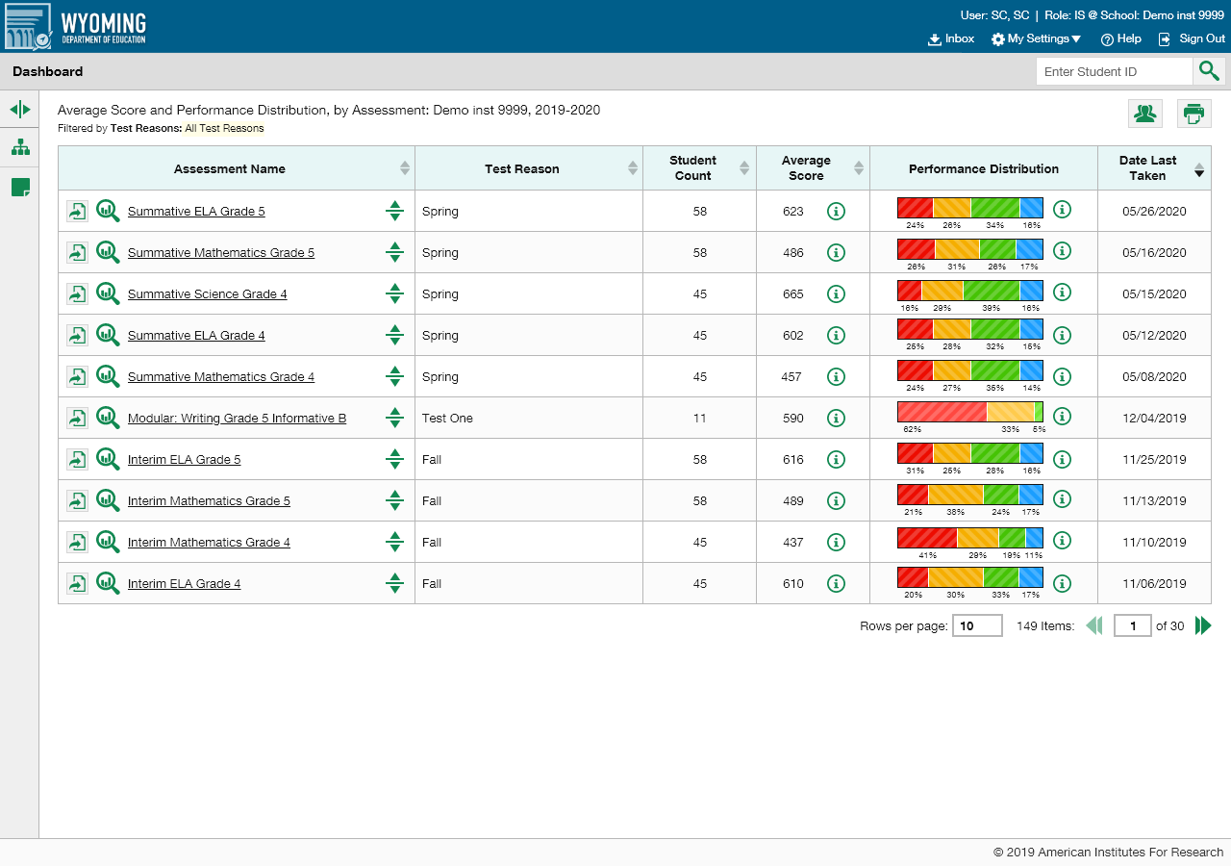
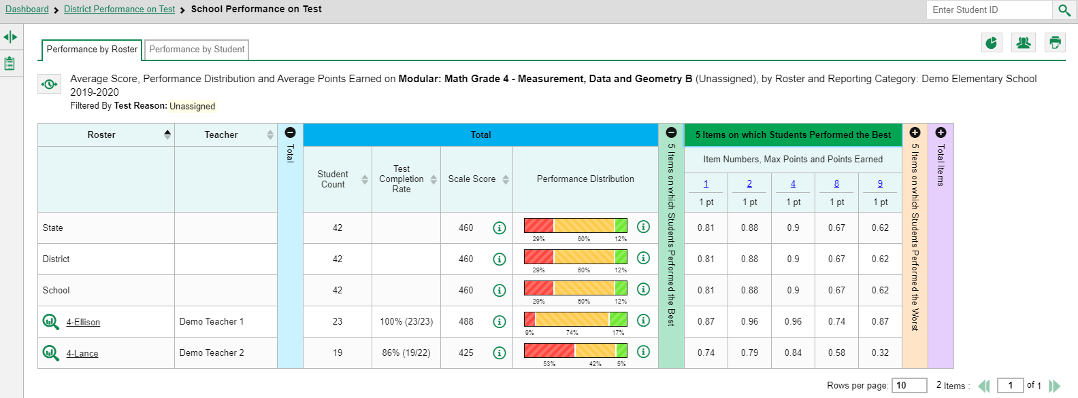
Print or Export the Report You Need
From the Dashboard: Print & Export
From a Report Page: Print
Notes:
Providing two buttons with similar options makes it convenient, no matter where you are in the Reporting System, to print or convert the report you need. The Export button allows you to convert a test report into a PDF or CSV format and save it to your Inbox. The Print button allows you to print a hard-copy of the dashboard tables and any report pages, AND it allows you to convert the report to PDF or CSV, just like you can with the Export button. The Export button only appears on the dashboard, to the left of the name of the assessments in your dashboard table, as shown here. The Print button appears on the dashboard and on all test report pages in Reporting. First, we show you how the Print features work, including the file conversion options under that button. Then we show you the pop-up windows that appear under the Export button.
To print a page you are seeing on your screen, click the print button in the upper-right corner.

Slide 3
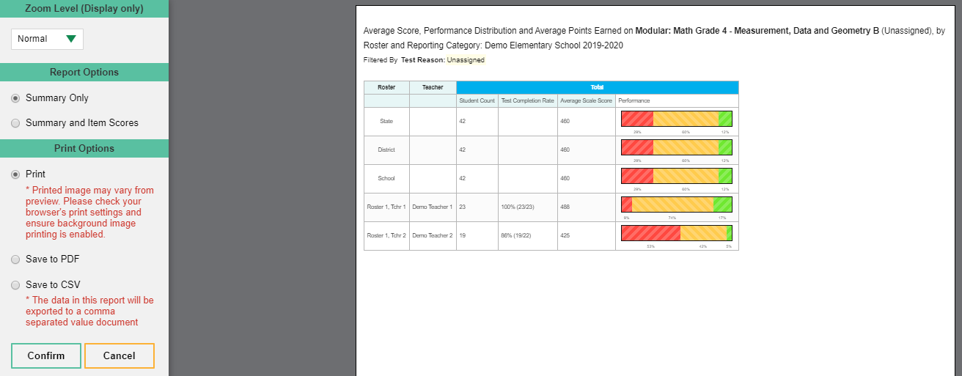
Print Preview—Summary Only
Notes:
To print a page you are seeing on your screen, click the print button in the upper-right corner. A print preview page opens, with an options panel on the left. The options include Zoom Level, Report Options, and Print Options. For example, here you see a School Performance on Test report for the Grade 4 Math Modular test in Measurement, Data, and Geometry. There are two rosters on the report. The print preview page displays exactly what will print if you confirm the selections in the options panel. To zoom in on the print preview, use the Zoom Level section in the option panel on the left. This setting affects the preview only, not the printed report. When the report includes data for individual assessment items like this one, the Report Options section displays two selections, Summary Only and Summary and Item Scores. Select either Summary Only or Summary and Item Scores. The Summary Only includes the data performance from the blue Total column of the test report, as shown here.

Slide 4
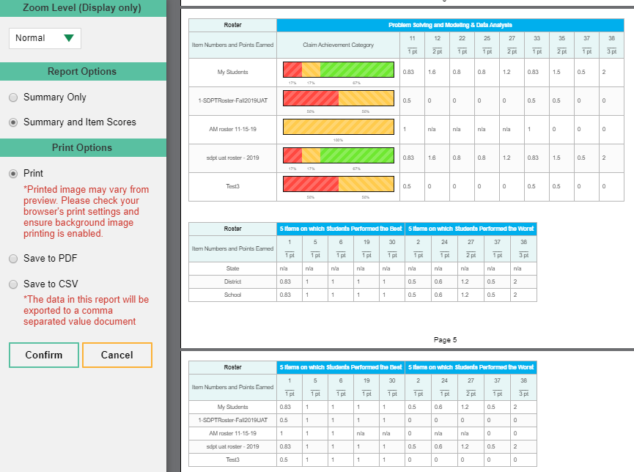
Print Preview—Summary and Item Scores
Notes:
The Summary and Item Scores option includes data for the individual assessment items, like the one shown here. As you scroll thru the report all the items for the four rosters are displayed. This is a report for the Grade 11 Math Interim test, reported with categories and the 5 Items on which Students Performed the Best and 5 Items on which Students Performed the Worst.

Slide 5
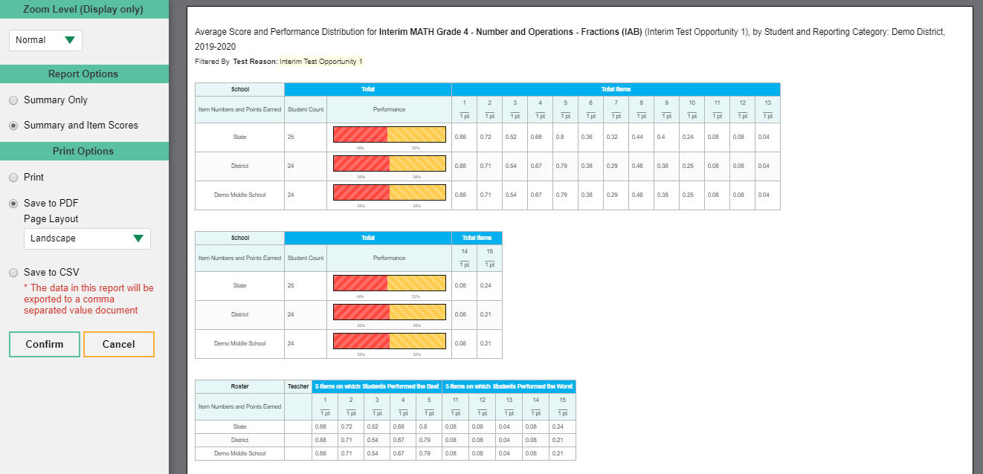
Print Options—District Performance on Test Report—Summary and Item Scores
Notes:
You can choose from three report formats under the Print Options section: a quick print, save to PDF, or save to comma-separated values (CSV). A PDF file is a picture of the report and is compatible with all platforms. Your PDF choices include portrait or landscape layout and several ledger sizes. The CSV file is a workbook application, like Excel, which allows you to sort and organize large amounts of data. The next slide shows a sample csv file.
Make your selections and click Confirm. Your print preview window will display, updated with your selections. If you saved the report as a PDF or CSV, the Inbox appears, displaying the generated report.

Slide 6
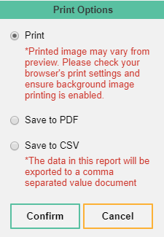
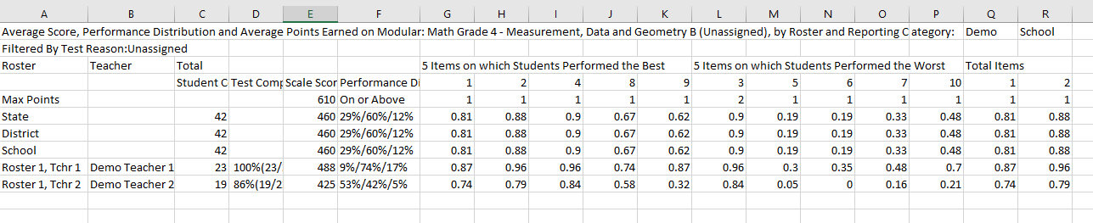
Save to CSV/Excel File
Notes:
Here is a sample of a .csv file of the test report. Use it to organize and sort large amounts of data.
Now we show you how to convert your files using the Export button on the dashboard.

Slide 7
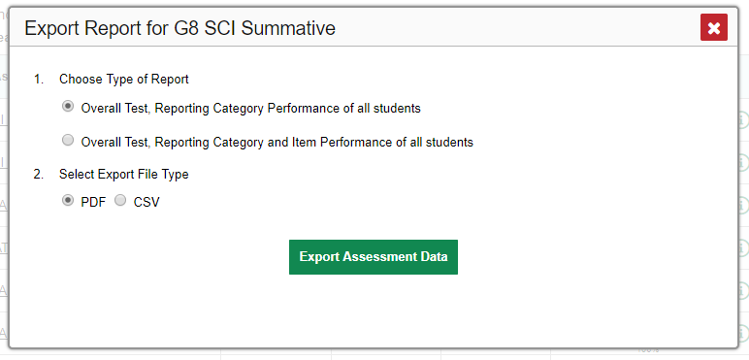
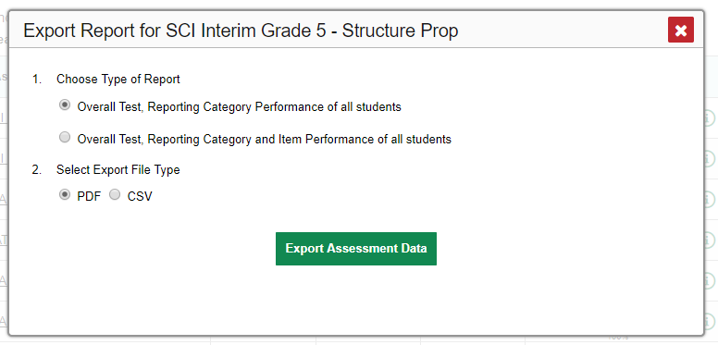
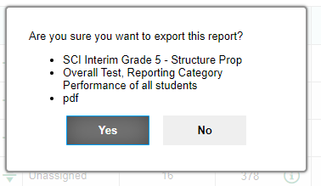
Export Options for Teachers and School Users
Reports Without Item-Level Data
Reports With Item-Level Data
Select Export File Type
PDF CSV
Notes:
As mentioned previously, the export function is available on the dashboard. When a report includes item-level data, teachers and school-level users have a choice of short summary reports or reports including item performance data. This slide shows the pop-up windows that teachers and school users see. Click the export button to the left of the magnifying glass. One of two Export Report pop-up windows will open. If the test results are not reported with item-level data, like the image on the left, simply choose a PDF or a CSV file type and click the green Export Assessment Data button.
If the test results do include reporting categories and/or item performance data, like the image on the right, choose to export a smaller overall report or one showing the item performance of all students. Make your selections and click the Export Assessment Data button. A confirmation window appears. Review your selections and click Yes to send the report to your Inbox or No to return to the Export Report options window. Now we show you the pop-up windows for district users.

Slide 8
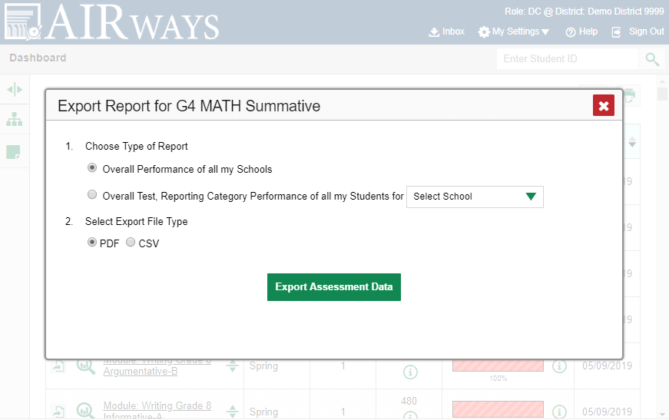
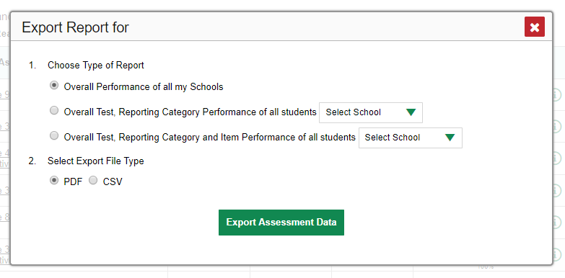
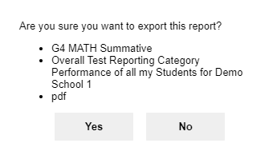
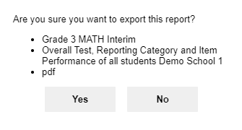
Export Options for District Users
Without Item-Level Data
With Item-Level Data
Grade 3 Math Interim
Notes:
District users see a school drop-down menu on their Export Report windows, allowing them to select a single school in the district. Export Report windows display as two different versions, one for reports without item-level data and one for reports with item-level data. Reports without item-level data display two choices under section #1: a report for all the schools in the district or a report for a specific school in the district. Reports with item performance data display three choices: the two just described and an additional option to generate a detailed school report including item-level results. Choose to export a PDF or CSV file and click the Export Assessment Data button. The process then proceeds as we explained it for teachers.

Slide 9
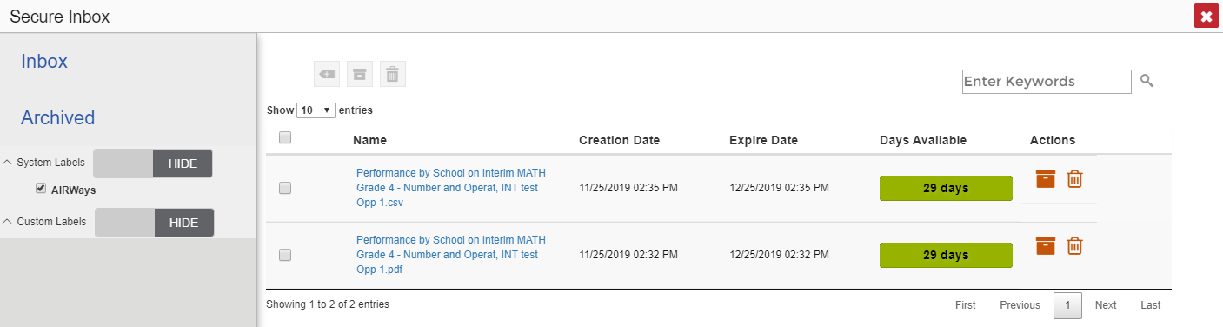
Inbox
Notes:
Here is a sample of the Inbox, which stores your PDF and CSV files. These files automatically expire after a designated period. To access the Inbox click the icon in the banner. Click the name of the file to download it. For more information on the functions of the Inbox, refer to the appendix section of the Reporting System User Guide, posted on your state or district assessment portal. A sample Excel file is shown on this slide.

Slide 10
The Reporting System Training Module Series
How to Navigate the Dashboard and Generate Reports
How to Drill Down into Your Results Using Settings and Filters
How to Track Student Performance Over Time Using the Longitudinal Report
How to Print ISRs and Student Data Files
How to Print and Export Data You Can See in Your Reports
How to Use the Roster Manager to Add, Modify, and Upload Rosters
Interim and Benchmark Assessments Only
How to Analyze Item-Level Reports
How to Hand-Score Unscored Items and Modify Machine Scores
Notes:
More training modules are posted on your state or district portal. You may also consult the Reporting System User Guide.

