Slide 1
Educator Career Fair
Technical Assistance
Notes:
WELCOME!

Slide 2
Agenda
Hiring Requirements
  Background Investigation Checks & Certification
Best Practices
    Hiring and Candidate Support
    Limited Occupational Specialist
Alternative Authorizations, Emergency Provisional and Non-Traditional Routes
  Application Timelines, Types and the Qualifications
Guidance Resources
    Assignment Reporting Guidance
    Assignment Credential Manuals & Report
Notes:
Today we are going to provide an overview of the following information: Hiring Requirements/Best Practices, Guidance Resources, Alternative Authorizations, the Emergency Provisional and the non-traditional routes to certification.
Our objective is to provide you information to ensure best practices in hiring, discuss resources that will provide guidance how to address deficiencies on your Assignment Credential Report and ensure compliance with Idaho code and funding.
We also hope to have time to give a brief overview of changes from the recent legislative session and allow time for QandA at the end of the presentation and hopefully have a chance to cover real scenarios you might have.
Please jot down your questions and we will answer any questions that are not addressed during the presentation

Slide 3
Hiring Requirements
Background Investigation Check and Certification
Notes:
The first section will cover some important Idaho code requirements regarding background investigation check and also certification.

Slide 4

Background Investigation Check
Idaho Code §33-512(15) Governance of Schools
  A fingerprint card or scan must be submitted to the Department of Education no later than five (5) days following the first day of employment or unsupervised contact with students in a K-12 setting, whichever is sooner.
Employment decisions are made by the local education agency
  Review identity history summaries for all hires, certificated and classified
  Just because an individual holds a certificate doesn’t mean they don’t have arrests or convictions
Notes:
Idaho code requires all certified and non-certified employees to undergo a criminal history check.
The fingerprint card or scan must be mailed or submitted to the Department of Education no later than five (5) days following the first day of employment OR unsupervised contact with students in a K-12 setting, whichever is sooner.
IMPORTANT: Unsupervised contact includes online/virtual.
Keep in mind we might issue a certificate but it is a hiring decision if you want to hire a person who may have something on their background check. We have included Annette Schwab’s contact information at the end of this presentation for questions.

Slide 5

Certification is Required!!!
Idaho Code §33-1201 Idaho certification is required!
Proper certification and endorsement is required for all instructional staff, pupil service staff and administrators, valid for the services being rendered.
Idaho Code 33-1207
Local Education Agency (LEA) shall keep a copy of the Idaho Education Credential on file for each of their employed certificated staff.
Notes:
This next section will cover the law/requirements regarding certification.
There are two important laws.
The first law we refer to often is Idaho Code 33-1201 which states that certification is required for all instructional staff, for most pupil service staff (SOME CHANGES), and administrators for the services being rendered.
Another related law is Idaho Code 33-1207 which requires LEA’s to keep a copy of the credential on file for each employed certificated staff.
It is very important for the individual responsible for those duties to understand a copy must be kept on file.
NOTE: This law is the reason we mail two certificates to individuals so that they can provide LEAs with one to comply with this law.
Also, pay attention to the type of certificate. If the certificate is valid for less than five years (three years or one year), the individual has conditions that must be met. We will cover this in more detail later in the presentation.

Slide 6
Certificated Staff – Past Job Performance and
Certificate Verification
Idaho Code §33-1210 Information on past job performance
Before hiring an applicant, an LEA shall request the applicant to sign a statement authorizing the applicant's current and past employers:
  to release to the hiring LEA all information relating to the job performance and/or job related conduct,
  to release copies of all documents in the previous employer's files which may include personnel files, investigative files, and any other file
No later than twenty (20) business days after receiving a request an LEA within Idaho shall provide the information requested.
An LEA shall not hire an applicant who does not sign the statement.
Idaho Code §33-1210 (5) verification of certification status and past disciplinary action for every new certified staff hired
Notes:
The last law I will refer to regarding hiring practices is Idaho Code 33-1210 which requires the LEA to obtain a statement authorizing the applicant's current and past employers to release information relating to the job performance, job related conduct, and request documents in the previous employer’s files.
Review these files as it has important information that may impact your hiring decision, but also can be provided to the educators supervisor.
Sharing this information with the principal allows them to know the previous evaluations of new hires and help to develop an individual professional learning plan and provide support and a mentor teacher based on the person’s specific needs on day one.
Another important law is Idaho Code 33-1210 subsection 5 which requires the hiring LEA to verify certification status and disciplinary action for ever new certified staff hire.

Slide 7
The Certification Lookup Tool
  Certification Lookup Tool
    Credential Status
      Endorsements and Assignments
      Public version
    Any Idaho disciplinary action taken against an educator certificate
      LEA authorized login required
    Last known Career Ladder placement
      LEA authorized login required
Notes:
So, how can you see all the information in one place for those who hold or have held a certificate in Idaho.
The certification lookup tool provides you the ability to view this information at any time.
There is a public version and an LEA authorized version.
The public version shows current credential status, assignments, etc.
The LEA authorized version additionally shows any Idaho disciplinary action taken against an educator as well as the last known Career Ladder placement.
The next two slides will show you an example of each version.

Slide 8
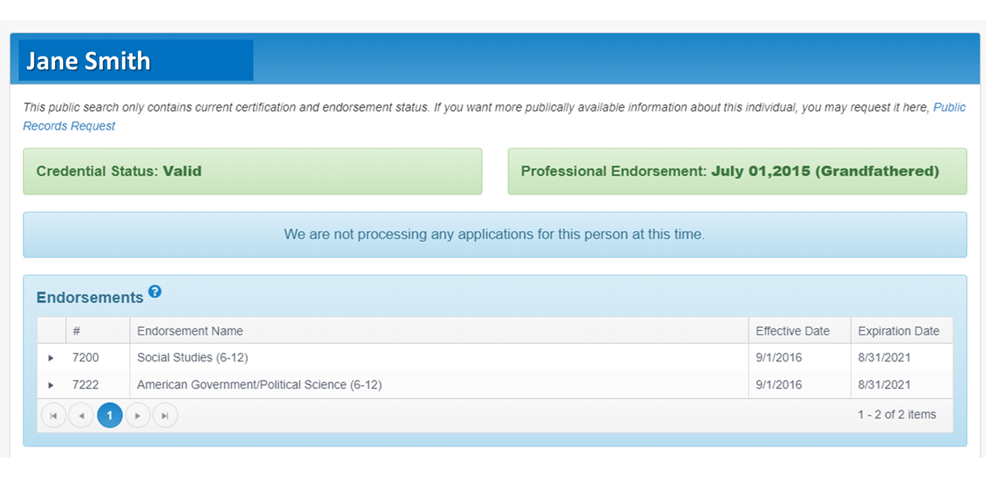
Certification Look-up Tool - Public
Notes:
This one is the public version.
You can see the individual’s certificate is valid, they have the professional endorsement, and we are not processing any applications for them.
In addition, it lists their endorsements and when they expire.

Slide 9
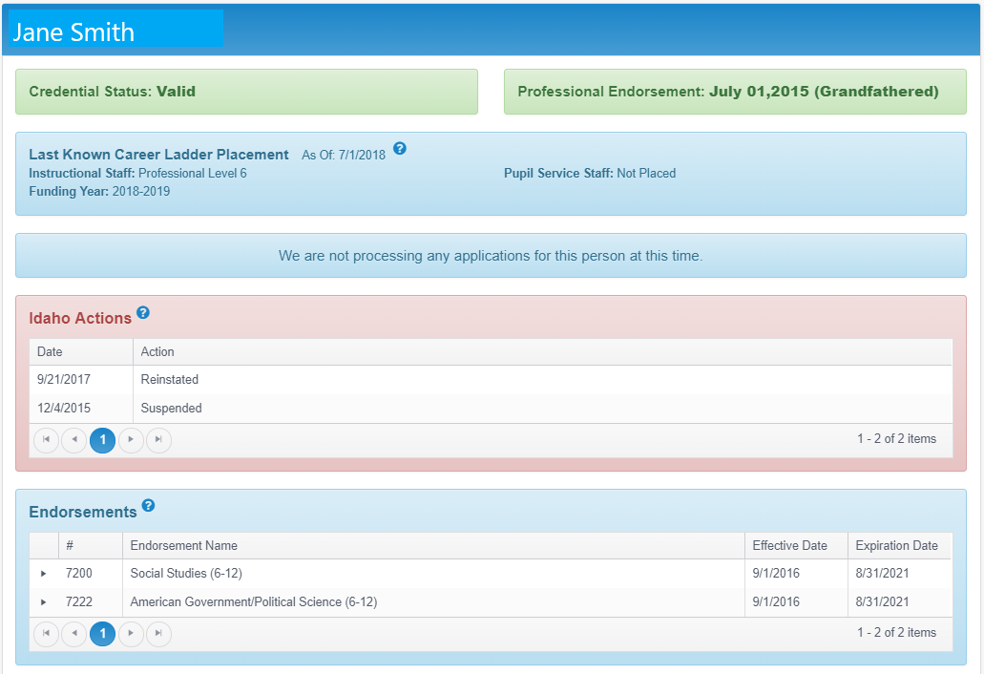
Certification Look-up Tool – LEA Authorized
LEA Authorized
Notes:
This LEA authorized version for the same individual shows the last known Career Ladder placement as well as any disciplinary action.
Her certificate was suspended on December 4, 2015 and then reinstated on September 21, 2017.
It is up to the LEA to inquire about this disciplinary action.
You may want to consider including a question on your applications as well.
If you have additional questions about Idaho Actions, etc. please contact Annette Schwab. Her contact information is located at the end of this PowerPoint

Slide 10
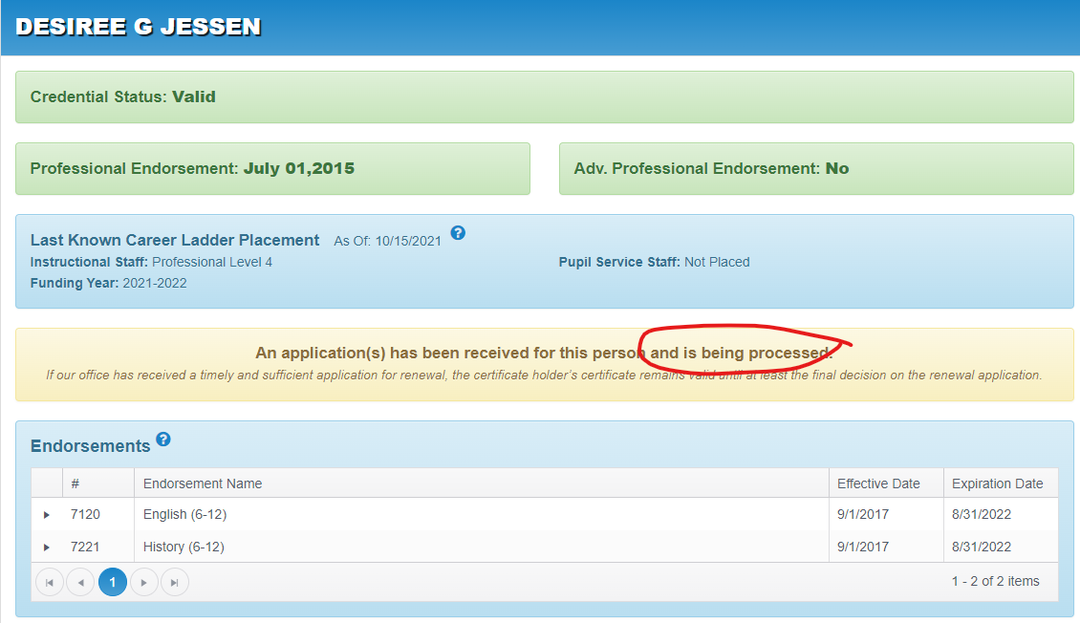
Certification Look-up Tool - Applications
Christopher Watkins
Notes:
In addition to verification of certification and disciplinary action, you can verify that your certified employee has submitted an application to our office.
As you can see, this individual’s credential status indicates it is valid but note the expiration date.
However, it also shows we have received an application and it is being processed.
Please note the statement “If our office has received a timely and sufficient application for renewal, the certificate holder’s certificate remains valid until at least the final decision on the renewal application”. MAY WANT TO KEEP A LIST OF WHO NEEDS TO RENEW AND NOTIFIY THEM.
Also, remember, you are responsible to get a copy of their newly issued certificate.
If you don’t get one, check with the candidate.
We may have their application on hold because they submitted an incomplete application.
This has funding implications because the district may look at the certification lookup and note an application has been received for this person and is being processed when in fact an incomplete application was submitted and although we will contact the candidate they may not have provided the requested items.
NOTE: only those that hold or have held an Idaho certificate will appear in the look-up tool.
New applicants or those you have submitted an authorization for that have never held one in the past will not show up until we have issued the certificate.

Slide 11
Best Practices
Hiring and Candidate Support
Notes:
This section will cover best practices and candidate support

Slide 12
Best Practices
Prior to posting a position, determine the certification/endorsements required for the assignments
    Assignment Credential Manuals (https://www.sde.idaho.gov/cert-psc/cert/) under Resource Files
Prior to hiring a candidate, ensure they hold the appropriate certification/endorsements
    Certification Lookup Tool
LEA should do everything possible to hire an appropriately certified/endorsed person for the services to be provided.
If difficulty finding candidates for an open position, review certification/endorsements of current staff and see if movement might be beneficial
Reach out to local college/universities to see if they have a candidate who will be completing their teacher prep program soon.
If you have an applicant(s) for a certified position that does not hold appropriate certification/endorsement for the assignment, ensure they can met the qualifier(s) for Alternative Authorizations or Emergency Provisional Certificate.
Notes:
Now that I have covered all the laws pertaining to hiring, I would like to review some best practices.
First, prior to posting a position, determine the certification/endorsement required for the specific assignment/position.
The ACMs are great resources as well as the certification lookup tool.
The certification tool will allow you to look up assignments to endorsement and also specific certificate staff and what their endorsements are. NOTE: the look-up tool does not include the assignment descriptions.
When you are notified that there is an open position, ask the administrator questions about what the open position is going to teach.
The certification lookup tool is a great resource for this. Knowing what they have before interviewing also provides you with information regarding potential authorizations if you are having difficulty finding candidates who have the appropriate certification and endorsement for the open position.
That leads us to our next best practice which is if you are having difficulty finding candidates, look at your current staff’s certificates and endorsement to see if movement might be beneficial.
Many times principals do not know all the endorsements their staff has, let them know because they may make a different decision if they area aware of how they might be able to move staff around.
Next best practice is to consider assigning veteran/effective teachers in assignments with the highest need students and/or multiple assignments.
Lastly, if you have an applicant for a certificated position that doesn’t hold the appropriate certificate and endorsement, ensure they can meet the qualifier for the authorizations or Emergency Provisional Certificate.

Slide 13

Interim Certificates (Valid – three years)
An Interim Certificate is for individuals that have not “fully” met current Idaho certification requirements.
Interim Certificates have conditions that need to be completed by the individual in order to convert to a five (5) year renewable certificate – have a process in place where you can track these.
  Alternative Authorization ( most are now valid for three years)
  Non-Traditional Routes – (ABCTE, CSI, LCSC, TFA) (applicable to SDE only)
  Out of State
  Reinstatement
Interim Certificates have conditions.
Interim Certificates are NOT renewable
Annually review progress of these individuals to ensure that they are completing their required conditions.
  Share the conditions with their school principal (evaluator) and include as part of their Individualized Professional Learning Plan.
Notes:
Now I would like to take a few minutes to talk about the Interim Certificates.
There are essentially four types of interim certificates:
Alternative Authorization – CS and TNC are now three (3) year interim certificates (Teacher to New Endorsement is the exception – it is not a certificate)
Non-Traditional Routes (ABCTE, CSI, LCSC, TFA) are three (3) year Interim Certificates
Out of State – Anyone who has a current renewable certificate in another state can apply for reciprocity (may get a five year if they meet all of Idaho requirements) Praxis II is not longer a condition
Reinstatements – Anyone who has held a renewable Idaho certificate can reinstate
The three-year interim is non-renewable.
As a reminder Idaho Code 33-1207 requires LEAs to keep a copy of the Idaho Education Credential on file for each of the employed certificated staff. And the conditions they have to meet are written directly on the certificate which means you have the list of conditions.
It is a good practice to include the conditions as part of their Individualized Professional Learning Plan to ensure the individual is making progress

Slide 14
Limited Occupational Specialist Certificate
The LOS Certificate is a three-year certificate
  Honors industry experience as route to certification
  For individuals that have not “fully” met current teacher pedagogy requirements
Must qualify for both the certificate and endorsement
  Certificate Qualifications:
    Hold or have held an IDCTE-approved industry certification in a field closely related to the content area
    Demonstrate minimum of 6,000 industry hours in closely related content area
    Hold a baccalaureate degree and a minimum of 2,000 industry hours in closely related content area
  Endorsement Qualifications:
    Per language in State Board of Education policy, Section IV.E.8
Notes:
The Limited Occupational Specialist Certificate is a three-year certificate that has conditions on it.
Recall that an Occupational Specialist honors the related industry experience and education as the content knowledge. The LOS teacher most often lacks training in teaching pedagogy.
Uniquely, the Occupational Specialist must qualify for both the certificate and the endorsement.

Slide 15
Limited Occupational Specialist Certificate (continued)
LOS Certificates always have conditions.
To move to renewable five-year SOS or AOS:
  Complete Pre-Service Academy, First Camp, and Second Camp
  Declare route through Professional Development Plan
    Coursework through ISU or UI
    Coursework through InSpIRE Ready!
  State CTE mentor will support candidate
Annually review progress of these individuals to ensure that they are completing their required conditions.
  Share the conditions with their school principal (evaluator) and include as part of their Individualized Professional Learning Plan
Notes:
Limited Occupational Specialist Certificates always have conditions that the district must be aware of.
Most often, these are the ones listed on this slide.
It is important that district administration know and support completion of the required conditions.

Slide 16
Alternative Authorizations, Emergency Provisional and
Non-Traditional
Notes:
Now lets talk more about the Alternative Authorizations, Emergency Provisional and Non-Traditional routes

Slide 17
Application Quick Info
Applications for Alternative Authorizations and Emergency Provisionals are a joint application between the LEA and candidate.
All sections must be completed and signed.
Review and follow the guidelines in the SDE and CTE application packets.
Include all necessary documents required for a complete application.
Complete alternative authorization applications are now approved by Teacher Certification staff.
Emergency Provisional applications are approved by the State Board of Education.
Applications that are still incomplete at the end of the school year will not be approved.
Notes:
All Alternative Authorizations and Emergency Provisional applications are joint applications – it takes the candidate and an LEA.
The hiring of a candidate that requires an Alternative Authorizations or an Emergency Provisional, new and renewal, must be approved by your local school board. The one exception to this rule is the certified teacher that is adding a new instructional endorsement. Please remember, we no longer require the submission of the board minutes with the application. Board chair, Sup and candidate must sign application.
Approval process is now faster. Complete applications are approved in-house. Only complete, atypical applications will be taken to the committee for review.

Slide 18

Application Timelines
Complete alternative authorization applications can be approved by the certification staff throughout the year regardless of the PSC meeting dates.
Atypical alternative authorization applications must be received by specific due dates (coming soon) in order to be vetted by the teacher certification staff. These will be reviewed by the Authorization Committee at the Professional Standards Commission’s (PSC) meeting, which meets five times per year.
Emergency Provisional applications are now approved by the State Board of Education. The applications must be received by specific due dates (coming soon) in order to be vetted by the teacher certification staff in time for the State Board of Education agenda.
The annual Alternative Authorization/Provisional Submission Schedule (coming soon) is located at: https://www.sde.idaho.gov/cert-psc/cert/apply/alt-auth.html.
IMPORTANT: Emergency Provisional applications received after January 1 of the school year must be due to the school district or charter school loosing a staff member after January 1 of the school year.
Notes:
All completed applications are reviewed five times per year by the Professional Standards Commission’s sub-committee called the Authorization Committee.
In order to expedite the process… SBOE requires 6 week timeline prior to their meeting agenda Emergency Provisional applications that are reviewed at the Professional Standards Commission meeting, are recommended from the Authorizations Committee in the next available State Board of Education meeting, for final approval. SCHEDULE/DATES WILL PLACED ON THE AUTHORIZATION WEBSITE.
The submission calendar is available on the Alternative Authorizations webpage of the SDE. At the top you will see the due dates for the applications to arrive to the SDE and the date of the PSC meeting. In the middle, there is a list of the State Board of Education meeting dates and the turnaround time information – Example: An Emergency Provisional application that was in the September PSC meeting will go to the December State Board of Education meeting. These dates are important to watch as it could impact funding for the LEA. This process is lengthy and timelines are critical.
Please note – there was a change to the Emergency Provisional applications as of the 2021-2022 school year. All Emergency Provisional applications that are received after January 1 must be due to the loss of a staff member that occurred after January 1.

Slide 19
Alternative Authorizations
  Content Specialist
  Teacher to New
    - Certificate
    - Endorsement
  Pupil Service Staff
Notes:
The Content Specialist application is for instructional endorsements only and are intended for candidates that do not hold Idaho certification.
The Teacher to New application is an option for candidates that are already certified in Idaho and would like to add a new certificate (teacher to principal) or a new endorsement (English and adding Math).
Pupil Service Staff applications are only for School Counselor and School Social Worker. Other Pupil Service Staff should qualify for an Interim Certificate – see the Pupil Service Staff Certificates page on the SDE site.
The Emergency Provisional application is intended for emergency hires only. Must be declared in your school-board minutes. Is prohibited for special education instructional endorsement areas per IDEA.

Slide 20

Alternative Authorization - Content Specialist Qualifiers and Routes
Content Specialist (SDE)
This authorization grants an interim certificate that allows individuals to serve as the teacher of record while pursuing standard certification.
  Will be issued a three-year interim certificate
  Application versions for SDE and CTE
Application Qualification Requirement
    All candidates must hold a minimum of a baccalaureate degree, OR
    Will be doing student teaching during the requested school year, AND
Meet one of the following Content Area Knowledge Qualifiers
    Baccalaureate degree in the content area (not applicable to all endorsement areas)
    Content specific Praxis II passing score report
    ABCTE content or Professional Teaching and Knowledge passing score report, OR
    Qualifying score on the Uniform Standard for Evaluating Content Competency (rubric)
  Route Options
    College/University
    ABCTE (non-traditional)* - SDE ONLY
Notes:
For Content Specialist application candidates
The minimum requirement for this application is a baccalaureate degree, or the candidate must be in their student teaching year of their preparation program
Once you have a candidate that qualifies for the application, they will need to meet the content area knowledge qualifier
Do they have a BA in content area
Have they passed the content area Praxis assessment
If they are enrolled in ABCTE, have they passed the PTK (Professional Teaching and Knowledge) or a content area assessment
Have you vetted the candidate on the Uniform Standard for Evaluating Content Competency rubric – with the rubric a candidate gets five points for every credit in the content area, two points for every year working in a paid position working with kids, one point for every year volunteering with kids. Encourage hiring staff to incorporate this into the interview process to properly vet a non-certified candidate’s certification eligibility.
ABCTE route candidates. Change – because the AA-CS is now a three-year interim, a person who will be the teacher of record while completing the assessments will not be issued a non-traditional three-year interim and all requirements must be done during the three year Content Specialist interim.

Slide 21
Alternative Authorization - Content Specialist For CTE
Content Specialist (CTE)
  CTE-endorsed applicant routes
      9000-level endorsements (Degree Based Career Technical)
        Must follow EPP plan of study – require IR to add endorsement
      0000-6999 endorsements (Occupational Specialist)
        Contact CTE to develop Route Plan
  Route Plan for Occupational Specialist Possibilities
      Externships
      Coursework
      Industry Certifications
Notes:
For Content Specialist application candidates
The CTE Alternative Authorization – Content Specialist application packet can assist an individual who is close to being certified LOS to get the rest of the way to renewable certification
Perhaps they’re short on industry experience – additional externships (with the district’s help) or working through industry certification may be a solution
Perhaps their industry experience isn’t comprehensive enough in content – externships or additional coursework may be a solution

Slide 22
Alternative Authorizations -Teacher to New Certificate Routes
Teacher to New – Certificate
The candidate holds a valid Idaho credential and would like to add another certificate.
Application Versions for SDE and CTE
    Will be issued a three-year interim certificate
    College/University (traditional or non-traditional)
      State Board-approved program
        Out of state accredited
        Idaho approved
        ABCTE
Notes:
Teacher to New Certificate application candidates must hold a valid Idaho certificate and they have multiple routes to choose from
Teacher to New route options
college/university (traditional or non-traditional)
Traditional program requires completion of a minimum of 9 credits (include in their IPLP)

Slide 23
Alternative Authorizations -Teacher to New Endorsement(s) Routes
Teacher to New – Endorsement
The candidate holds a valid Idaho credential and would like to add another endorsement.
  Authorization is valid for one (1) year and may be renewed for two (2) additional years with evidence of satisfactory progress for Option I.
  Route Options
    Option I - College/University (traditional or non-traditional)
    Option II – Master’s Degree in specific content area. Candidates will need to complete a state approved mentoring program.
    Option III – Successfully completing a state board-approved content areas assessment and a one-year, state board-approved mentoring program within the first year of authorization.
Notes:
Proof of progress is completing nine credits annually.
Option II – Already hold a master’s degree. If they need to finish a masters degree, that is option I
Not every candidate is a great candidate for Option III. Know your candidate and set them up for success.
Do they have knowledge/experience in the content
Encourage the candidate take the practice Praxis II assessment or rubric
If they aren’t comfortable, look at another route (college/university) or another candidate.

Slide 24
Alternative Authorizations - Pupil Service Staff Qualifiers and Routes
Pupil Service Staff – School Counselor or School Social Worker
The candidate has a baccalaureate degree and is enrolled in state-approved School Counselor or School Social Worker program.
    Will be issued a three-year interim certificate
    College/University (traditional or non-traditional)
      State Board-approved program
        Out of state accredited
        Idaho approved
Note: This application is not applicable to School Nurse, Speech Language Pathologist (SLP), School Psychologist, or Audiologist (see the Pupil Service Staff Certificates webpage)
Notes:
Pupil Service Staff Alternative Authorization application candidates must hold a baccalaureate degree and is only for candidates seeking School Counselor and School Social Worker certificate and endorsements. The candidate must be enrolled in a program that will lead to certification. Must include proof of plan. Non-CACREP will require a certificate from the state the program is located.
There are 3-year interim certificate options for School Nurse, School Psychologist and Speech Language Pathologist.
School Nurse – RN and transcript without a baccalaureate degree. To convert from the 3-year interim, the candidate will need to obtain a Bachelor’s Degree in Nursing, Education, or health-related field
School Psychologist – master’s degree in Psychology and enrolled in an education specialist degree program. To convert to the 5-year renewable certificate, the candidate will need to and official transcript with verifying master’s degree or higher in School Psychology and receive an institutional recommendation verifying completion of a state-approved school psychologist program; including verification of a 1200 hour practicum in school psychology OR copy of current National Certification for School Psychologist certificate.
Speech Language Pathologist – baccalaureate degree in Speech Language Pathology and enrollment in a master’s degree program for Speech Language Pathology. In order for the candidate to convert to the 5-year renewable certificate, the candidate will need to complete a master’s degree program for Speech Language Pathology.
If you have a candidate for School Nurse, School Psychologist or Speech Language Pathologist that does not qualify for the interim certificate, the LEA will need to apply for an Emergency Provisional.
NOTE: In additional to certified social workers, licensed professional counselors and licensed clinical professional counselors now meet the requirements for school counselors (basic).

Slide 25
Emergency Provisional Qualifiers
Emergency Provisional
  Candidate must have an Associate’s Degree or 48 semester-credits.
    Cannot be used for Special Education instructional assignment as per IDEA
  Must-Haves
    Date the school district or charter school declared an emergency.
    Date applicant was hired to serve in the position that requires certification/endorsement.
    Summary of recruitment efforts which led to the emergency.
Note: Applications received after January 1 of the school year must be due to the school district or charter school loosing a staff member after January 1 of the school year. No more than two Emergency Provisionals can be issued per candidate.
Notes:
This certification process is generally used when there is a sudden loss of a certified staff member. This candidate may not have an interest in becoming certified. The candidate must have a minimum of an associate’s degree or 2 years of college training (48 semester credits).
Important things to know:
This application cannot be used for special education instructional endorsements per IDEA.
This application is non-renewable and does not lead to certification. The Emergency Provisional Certificate is approved as a one-time basis per individual except under extenuating circumstances. An explanation must be included with the second-year application.
The LEA must declare an emergency exist and record it in the official minutes of their school board.
The endorsement requested must align to the assignments of the candidate.
This application process is counted as a year of certification or initial certification.
Remember to pay attention to the submission timelines.

Slide 26
Non-Traditional (SDE Only)
Non-Traditional
An individual may acquire interim certification through a state board approved non-traditional route to teacher certification program. The non-traditional route may be used for first-time certification, subsequent certificates, and additional endorsements.
  Will be issued a three-year interim certificate
State Approved Non-Traditional Programs
  ABCTE (American Board)
  CSI (College of Southern Idaho)
  LCSC (Lewis Clark State College)
  TFA (Teach for America)
Notes:
Letters from CSI , LCSC and TFA must be included within non-traditional applications
Certificate must be included with ABCTE application

Slide 27
District/Charter Mentor Checklist
Who needs a mentor?
  All beginning teachers…including
  Content Specialists, Teacher to New, PSS, Emergency Provisional and Non-Traditional Candidates
Who is required to complete the state-approved mentor program?
  Alternative Authorizations-Teacher to New Endorsement Candidates
    One year mentoring
    District/Charter Mentoring Checklist Option II or III Completers
  Non-Traditional Candidates
    Two years mentoring
    District/Charter Mentoring Checklist for Non-Traditional Completers
Include signed checklist in revision/interim completer applications, not alternative authorizations or non-traditional applications.
Notes:
Best practice for new teacher is to provide a mentor.
Alt Auth requires one year-the validity period of the cert
Non-traditional requires two years.

Slide 28
Mentoring (continued)
Candidates
  develop and revise a classroom management plan to include managing classroom procedures for efficient operation of the classroom and responding to student behavior to maximize instruction.
  develop a variety of instructional strategies to engage students in learning, meet the needs of diverse learners, and differentiate instruction.
  create, revise, implement, administer, and interpret student performance data from a variety of assessment types, including but not limited to formative, interim and summative assessments.
  achieve one successful evaluations in the assignment area which aligns to the endorsement(s) being sought
  develop an Individual Professional Learning Plan (IPLP).
Educator Career Fair Technical Assistance | 28
Notes:
The mentor standards can be found on the Board of Education’s website.
By the end of their year or two years, the candidate should be able to successfully complete their requirements of the mentor program.

Slide 29

Best Practices for Non-Traditional &
Alternative Authorization Candidates
Important for retention!
The LEA is part of the candidates preparation/training!
The LEA is required to provide mentoring and support
  The Idaho State Board of Education approved Idaho Mentor and Induction Program Standards provides guidelines to design and implement a high-quality mentor program for beginning teachers.
Minimize number of assignments!
Assign veteran/effective teachers in assignments with the highest need students, and/or multiple assignments.
THINK…
grow your own!
Notes:
It is important that administrators and evaluators understand that these candidates complete their preparation/training while employed as the teacher of record.
THINK GROW YOUR OWN!!!!!
They have not met all the standards for full certification, they are receiving the remainder of their preparation while employed as the teacher of record.
As a result, the hiring LEA is signing up to provide this final preparation through mentoring and support, which includes having in place a high quality mentor program.
The Idaho Mentor and Induction Program Standards are a set of standards that were created as a tool for LEAs to design a mentor program to ensure all beginning teacher have the support needed.
A bit later in the presentation, Mandy will talk about what the candidate is required to do during the mentor program.
Also important is to minimize the number of assignments for these individuals and the number of endorsements you ask them to obtain. This will set them up for success so that they have a positive impact on students and have a higher chance of staying in the profession.

Slide 30
Guidance Resources
Assignment Reporting Guidance
Assignment Credential Manual & Report

Slide 31


Using the Guidance Resources will…
Ensure compliance with Idaho Code §33-1201
Ensure LEA funding – Idaho Code §33-1002 (6c) (6d)
Notes:
Utilizing the Guidance Materials will help LEA’s stay in compliance with Idaho Code 33-1201, which states that an educator must hold the proper certification and endorsement for the services being rendered.
This will also maximize funding for your LEA and help to avoid decrease in funding due to assignment deficiencies.

Slide 32
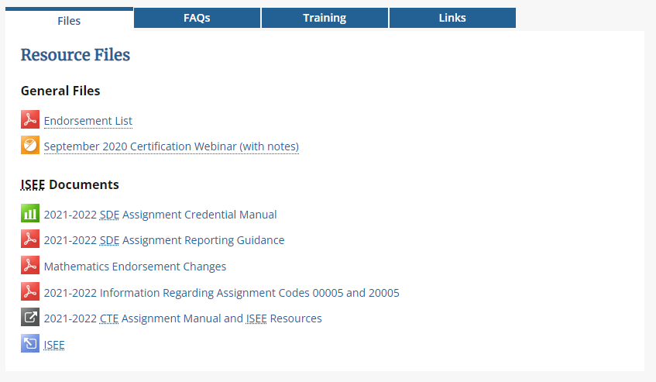
Resources
Please access the helpful resources under Resource Files at the bottom of the following website:
https://www.sde.idaho.gov/cert-psc/cert/

Slide 33
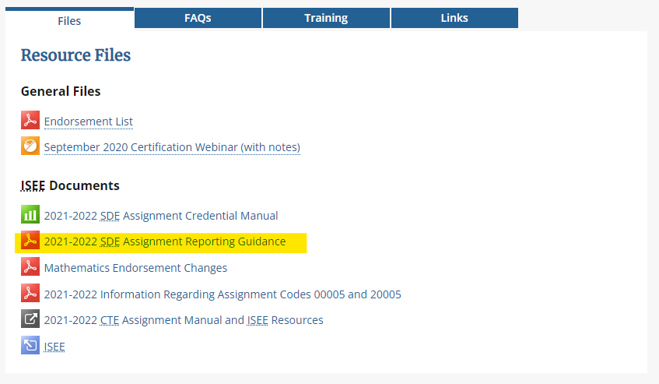

SDE Assignment Reporting Guidance Document
READ THIS DOCUMENT!

Slide 34
Assignment Reporting Guidance - overview
The Assignment Reporting Guidance document provides information about:
SDE & CTE Assignment Credential Manuals
  Use the manuals to determine the alignment between the assignment and the required endorsement BEFORE you post for the open position
  Please read the assignment descriptions and use an assignment code that most closely aligns to the intended content instruction to be delivered.
  Think content level not grade/age of student
LEA Assignment Credential Report
  The LEA Assignment Credential Report can be used as a resource to verify proper alignment after EVERY ISEE upload.
  Teacher certification generates a statewide Assignment Credential Report to identify who is not appropriately certificate and or endorsed for assignment(s).
Notes:
The SDE Assignment Reporting Guidance document contains information about:
Changes in the Assignment Credential Manual worth noting or reiterating
Important dates, tips for accurate reporting, and ways to reconciliation assignment deficiencies to help ensure funding.
It includes instruction about how to run, access and review the LEA’s Assignment Credential Report – which is a very important tool to help you identify deficiencies.
RUN YOUR ACR AFTER EVERY UPLOAD
We use the big statewide generated “Assignment Credential Report,” to verify proper alignment between assignments and the required certification/endorsement. If an educator is coded for an assignment they do not hold the appropriate certificate and/or endorsement, funding will be reduced for the applicable assignments.
The two appendices in the guidance document contain additional information regarding assignment codes 00005 and 20005 and also changes to the mathematics endorsement codes. This information is also posted as separate documents on the ISEE website. NOTE: The CTE manual has guidance within their manual.

Slide 35
2022-2023 Assignment Credential Manuals
State Department of Education (SDE) Assignment Credential Manual
2022-2023 SDE Assignment Credential Manual
Career Technical Education (CTE) Assignment Credential Manual
2022-2023 CTE Assignment Manual and ISEE Resources
The State Department of Education (SDE) Assignment Credential Manual and the Career and Technical Education (CTE) Assignment/Course Manual will be mutually exclusive. SDE endorsements will not align to ANY six (6) digit assignment codes; CTE endorsements do not align to ANY five (5) digit assignment codes and vice versa.
Notes:
First, there are two Assignment Credential Manuals. The SDE manual is for “academic” assignments, such as English, Math, Science and Social Studies. The other manual is for CTE or career and technical type of courses, such as Welding, Business Technology Education, Family and Consumer Science, Construction, etc.
The SDE Assignment Manual is intended to be used to identify an assignment that most closely aligns to the content being delivered and is not intended to be a course catalogue whereas the CTE manual is more in line with a course catalogue.
Important!!!! The Assignment Credential Manual is NOT a course catalog it is an assignment manual. For example: The assignment might be 03008 Earth and Space Science but the course or then name of the class might be “Astronomy”
These manuals are mutually exclusive – meaning that, a person who holds a CTE endorsement can only teach a 6 digit assignment code outlined in the CTE Manual and visa versa, for example: a person who holds a Standard Instructional Certification with an SDE endorsement can only teach a 5 digit SDE assignment. CTE endorsements require a person to have industry experience in the endorsement area.
Also, please note: the manual contains a tab which shows all SDE endorsements and another tab with assignments for classified/non-certified staff

Slide 36
Accurate Data Reporting
Idaho Code requires accurate data reporting!
  Do NOT enter false data simply to clear deficiencies.
  The superintendent/administrator is responsible for ensuring the accuracy of the data
Pay attention to errors and warnings!
  Check to make sure the correct assignment code was used
  Apply for Alternative Authorization, Emergency Provisionals, when a person does not hold the proper certificate/endorsement.
LEAs who are in the process of applying for Alternative Authorization and/or Emergency Provisional for a candidate should coded them as certified. Assignments and endorsements must align to the submitted application. Once the application is approved the deficiency will clear.
Applications that are left incomplete will not be approved and will result in loss of funding.
If an educator does not hold the appropriate certificate/endorsement or have an authorization or provisional in place for an assignment, funding may be reduced per Idaho Code §33-1002 (6c) (6d) for the applicable assignment(s) regardless of the funding source.

Slide 37
Other Points of Interest

Slide 38
Teacher of Record & Online Curriculum
Teacher of Record (TOR)
  The certificated instructional staff who is primarily responsible for planning instruction, delivering instruction, assessing students formatively and summatively, and designating the final grade.
Online Curriculum
  PLATO, OddesseyWare, Edguenity, NovaNet are forms of curriculum and must be facilitated by a teacher of record who is appropriately certificated/endorsed for the assignment and cannot be taught by a proctor/parapro. This is true for any online curriculum.

Slide 39
Paraprofessionals & Long Term Substitutes
Paraprofessionals (Parapros)
  Should never be the teacher of record. They cannot be used as physical education teachers, music teachers, school librarians, study skills teachers, etc.
Long-term substitute (LTS)
  Is a person who has taken over an assignment for a teacher of record (TOR) for ten (10) consecutive days or more.
  Must be tied to a TOR. Lesson plans and student progress, etc. are the responsibility of the TOR.

Slide 40

Changes to Note
Reciprocity with out-of-state certificates - no longer will require Praxis II as a condition
Alternative Authorization – Content Specialist three year interim
SLPs and Audiologist can now be coded as certificated or classified (like Occupational Therapist and Physical Therapist) but must hold a BOL!
School Counselor
Charter Teacher Certification
Dyslexia Credit Requirement for Recertification
PE/APE (forms ready May 15th)

Slide 41
HB 654- Updated Requirements for School Counselor Endorsement
House Bill No. 654
Idaho Code 33-1212
“The state board of education shall adopt rules to implement the provisions of this section and shall specifically provide that certified social workers, licensed professional counselors, and licensed clinical professional counselors meet the requirement for school counselors.
  Standard Pupil Service Staff Certificate: School Counselor-Basic Endorsement IDAPA 08.02.02.015(02)(b)
Notes:
In addition to the IDAPA changes, the 2022 Legislative Session brought a handful of modifications to the current practices and procedures in the Certification and Professional Standards department:
House Bill 654 provides a change to the language in Idaho Code 33-1212 specific to the requirements for school counselors endorsements.
In additional to certified social workers, licensed professional counselors and licensed clinical professional counselors now meet the requirements for school counselors. These individuals are eligible to apply for a standard Pupil Services Staff Certificate.

Slide 42
SB 1291- Charter Teacher Certification
Senate Bill No. 1291
Idaho Code 33-5206
Allows for school-specific charter teaching certificates
  ONLY valid for teachers teaching at a public charter school.
  Charter certificates are not transferable to a traditional public school district, but may be transferrable to another public charter school.
Standard Instructional Certificate (5 years)
Credit renewal requirement = 6 credits
  Charter school may substitute its own ongoing education and professional development requirements.
Notes:
Senate Bill 1291, known at the Charter-Specific teacher Certification Bill, allows…

Slide 43
SB 1291- Charter Teacher Certification
  CRITERIA for charter school-specific teaching certification
  Hold a bachelor’s degree from an accredited institution or, if instructing students in the fields of CTE, hold a bachelor’s degree or satisfy the provisions of section 33-2205(6)(a), Idaho Code
    Industry experience for teaching CTE is still a requirement
  Recommendation from individual charter school
  Per FEDERAL law, all special education assignments must be held by individuals certified pursuant to the requirements set forth in chapter 12, title 33, Idaho Code, pertaining to traditional public school districts.
!

Slide 44

SB 1291- Charter Teacher Certification
Charter Teacher Certification APPLICATION

Slide 45
HB 731- Dyslexia Credit Requirement for Recertification
Recertification credit requirements applies to all Idaho teachers or administrators with the following certificates/endorsements
  All Subjects (K-8)
  Exceptional child generalist endorsement
  Blended early childhood/early childhood special education endorsement
  Administrator certificate
  School counselor certificate (serving students in K-5)
The PLAN:
  State Department of Education will provide districts with “approved” course lists

Slide 46
SDE Helpful Contacts
Annette Schwab – Program Specialist (Background and Ethics)
aschwab@sde.idaho.gov
(208) 332-6864
Cina Lackey – Coordinator, Certification & Professional Standards (Assignment Reporting Guidance)
clackey@sde.idaho.gov
(208) 332-6936
Helen Henderson – Coordinator, Professional Standards (Professional/Advanced Endorsement)
hhenderson@sde.idaho.gov
(208) 332-6879
Mandy Fulbright – Program Specialist (Alternative Authorizations)
mfulbright@sde.idaho.gov
(208) 332-6885
Melissa Knutzen – Technical Records Specialist II (Fingerprinting)
mknutzen@sde.idaho.gov
(208) 332-6883

Slide 47
CTE Helpful Contacts
Kristi Enger - Director, Career and Technical Education
  kristi.enger@cte.idaho.gov
  (208) 429-5528
Nathan Hobbs - Technical Records Specialist II
  nathan.hobbs@cte.idaho.gov
  (208) 429-5513

Slide 48
ISEE Helpful Contact
Amy Sigler - ISEE Technical Coordinator (Regions 1, 2 & 3)
asigler@sde.idaho.gov
(208) 332-6981
Roger Evans - ISEE Technical Coordinator (Regions 4, 5 & 6)
revans@sde.idaho.gov
(208) 332-6982
Todd King - Education Data Systems Reporting Manager
tking@sde.idaho.gov
(208) 332-6937

Slide 49

Thank you!
Cina Lackey | Coordinator, Certification & Professional Standards
Mandy Fulbright | Program Specialist, Alternative Authorizations
Idaho State Department of Education Kristi Enger| Director, CTE Educator Certification
650 W State Street, Boise, ID 83702
208.332.6800 Idaho Division of Career Technical Education
www.sde.idaho.gov 650 W State Street, Boise, ID 83702
208.429.5528
https://cte.Idaho.gov

