Slide 1
2021-2022 Economically Disadvantaged Data Collection Round Table Discussion
Title Programs and Special Education
2022-2023 Allocation Calculation
Federal Programs and Special Education
Lisa Pofelski-Rosa
Alexandra McCann

Slide 2

Programs that use Economically Disadvantaged Data Collection as part of their allocation calculations
Title I-A Improving Basic Programs is a federal program that helps students who are most at risk meet state academic standards and be proficient on state assessments.
Title II-A Supporting Effective Instruction is a federal program to increase student achievement and improves teacher quality and effectiveness.
IDEA Part B are federal grants designed to support LEAs pay excess costs of providing special education and related services to children with disabilities including that children with disabilities have access to a free appropriate public education (FAPE).
Notes:
Title I-A Improving Basic Programs is a federal program that helps students who are most at risk to meet academic standards. It provides funding that can be used for several strategies to increase achievement.
Title I-A requires accountability of SEAs and LEAs.

Slide 3

Background
The U.S. Department of Agriculture issued an additional waiver providing for free meals for the 2021-2022 school year. As a result of all students receiving free meals this 2021-2022 school year, the National School Lunch Applications for free and reduced priced school meals will not be available.
The U.S. Department of Education has developed a Fact Sheet to support states in determining alternate methods of allocating Title I funds when school meal data is unavailable. FNS encourages LEAs to consider the options outlined in the Fact Sheet for data purposes .The Fact Sheet can be found on the FNS website. Issued Jan.4, 2021.

Slide 4
Census poverty estimates
The ESEA requires that an LEA’s eligibility and allocations under each Title I formula and its allocations for Title II be determined, in part, based on Census LEA poverty estimates.
To derive a special LEA’s Census poverty estimate, an SEA needs alternative poverty data that are available for the special LEA and for LEAs in the State for which Census data are available.

Slide 5
Alternative Data Collection Options
To the extent that NSLP data from SY 2020-2021 are not available, to derive a Census poverty count for a special LEA, options available to an SEA include using:
➢ Poverty data other than NSLP data (e.g., Medicaid counts or other poverty data available to an SEA for State purposes);
➢ The best available NSLP data, which may be from SY 2019-2020;
➢ NSLP data from SY 2020-2021 that may be accessible (e.g., counts of children identified through direct certification); or
➢ Data from a poverty survey conducted by the SEA or LEA that replicate NSLP or other poverty data.

Slide 6

Direct Certification (DC) Overview
  WHAT IS DIRECT CERTIFICATION? Under direct certification, information from the State welfare agency is used to directly certify children receiving SNAP/TAFI/foster benefits without requiring them to complete applications. Direct certification was designed primarily to improve program access and administrative efficiency.
  Direct certification (DC) involves matching school enrollment records against the most current available Supplemental Nutrition Assistance Program (SNAP), Temporary Assistance for Families in Idaho (TAFI), foster care data, or through several other allowable categorically eligible designations. This also includes Head Start children or children certified by the proper liaison to be a homeless, migrant, or runaway child.
  LEAs need to capture students eligible for direct certification at building levels as this may impact Title I-A rank and serve (in the absence of students counts)

Slide 7
Rank and Serve & the Grandfather Clause
Grandfather Clause:
For one additional year only, section 1113(b)(1)(C) of the ESEA authorizes an LEA to allocate Title I funds to a school that is no longer eligible but was eligible and served in the preceding year.
This provision applies to a newly ineligible school and not to an eligible school that has fallen in the poverty ranking compared to the previous year’s ranking and does not receive a Title I allocation from its LEA because the LEA allocates its Title I funds to other eligible schools with higher poverty percentages.

Slide 8
Forecasting Potential Allocation Impact
If we only use direct certification data, what population sets may be missed as part of the low income count, and how will that impact my allocations?
Things to factor for analysis:
What is my area poverty rate (general census data)?
What was my LEA direct certification for last year?
What is my total enrollment? Compared to prior years.
Do I have any LEAs that were barely qualifying at the 35% low income building rate for Title funding? (will they qualify under the Grandfather clause?)

Slide 9
McKinney Vento and Migrant Education
How do I capture a more accurate population of students that may qualify under McKinney Vento and Migrant Education?

Slide 10
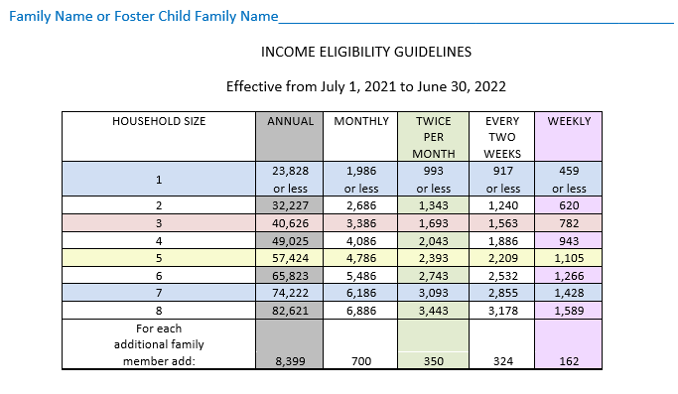
Alternative Data Sets Discussion
Thoughts on an alternative data collection other than direct certification.
What about my own LEA Income Survey?
Could we develop a survey similar to the Income
Determination Form.

Slide 11
Income Survey Logistics
LEA capacity
Collection rates (when, how to get surveys out)
Student information security
Reporting to SDE
Other ideas or concerns regarding collecting LEA Income Surveys.

Slide 12
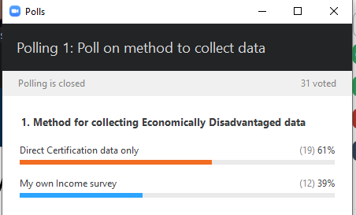
Zoom Poll Time
Poll response total data will be shared live

Slide 13
Next Steps
We (SDE) will use the details shared and discussed from today in a recap email, and post the recording to our webpage.
Final decisions for data sets to come

Slide 14
Thanks for all you do!
Federal Programs and Special Education Departments
Idaho State Department of Education
650 W State Street, Boise, ID 83702
208.332.6800
www.sde.idaho.gov
Karen Seay
Director, Federal Programs
kseay@sde.idaho.gov
(208) 332-6978
Charlie Silva, PhD
Director, Director Special Education
csilva@sde.idaho.gov
(208) 332-6806
Lisa Pofelski-Rosa
Financial Specialist, Principal
lpofelskirosa@sde.idaho.gov
(208) 332-6916
Alexandra McCann
Financial Specialist, Principal
amccann@sde.idaho.gov
(208) 332-6900

