Slide 1
Supporting Students Experiencing Homelessness in the _____ School District
McKinney-Vento Annual Training

Slide 2

1. I know what the living situations qualify under McKinney Vento
2. I can identify the process our district has in place to meet the educational needs and provide supports for stability to students/families experiencing homelessness
3. I better understand the issues around homelessness in the state of Idaho and our district.
4. I am aware of how homelessness can affect educational outcomes.
5. I know who to contact regarding the Homeless Education Program in our district
Learning Targets

Slide 3
What is McKinney-Vento?

Slide 4
McKinney-Vento Definitions
Children or youth who lack a nighttime residence that is:
    Fixed - Stationary, permanent, not subject to change
    Regular - Predictable, routine, consistent
    Adequate - Lawfully and reasonably sufficient
  Important question: Can the student go to the SAME PLACE (fixed) EVERY NIGHT (regular) to sleep in a SAFE and SUFFICIENT SPACE (adequate)?

Slide 5
Living Situations
  Sharing the housing of other persons due to loss of housing, economic hardship, or a similar reason
  Living in motels, hotels, trailer parks, or camping grounds due to the lack of alternative adequate accommodations
  Living in emergency or transitional shelters
  Living in a public or private place not designed for or ordinarily used as a regular sleeping accommodation for human beings
  Living in cars, parks, public spaces, abandoned buildings, substandard housing, bus or train stations, or similar settings
  (42 U.S.C. § 11434a(2)

Slide 6
Helpful Considerations
  How did the shared housing come about?
  What is the intention of the residents?
  What are the family’s or youth’s housing options if not sharing housing?
  Does it meet the fixed, regular, and adequate definition?

Slide 7
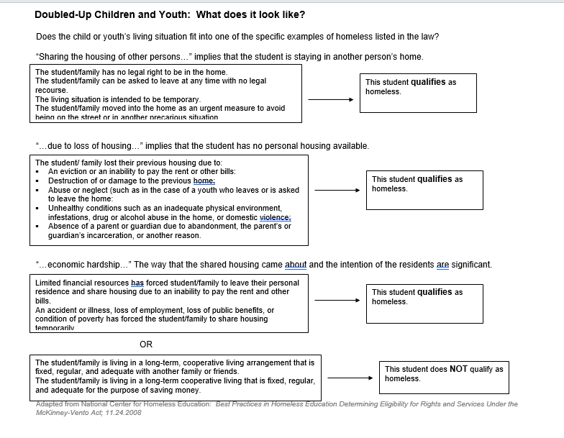
Doubled-Up Definition Flow Chart

Slide 8
Special Situations
Migratory children living in these circumstances
Unaccompanied Youth – any youth who is not in the physical custody of a parent or guardian
[42 U.S.C. § 11434a(6)]

Slide 9
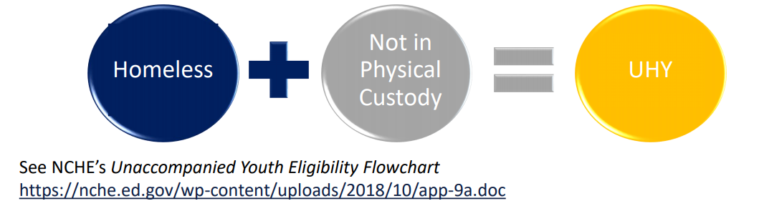
Unaccompanied Homeless Youth
1. Student’s living arrangement must meet the definition of homeless
AND
2. Student must be considered unaccompanied, defined as “not in the physical custody of a parent or guardian.”

Slide 10
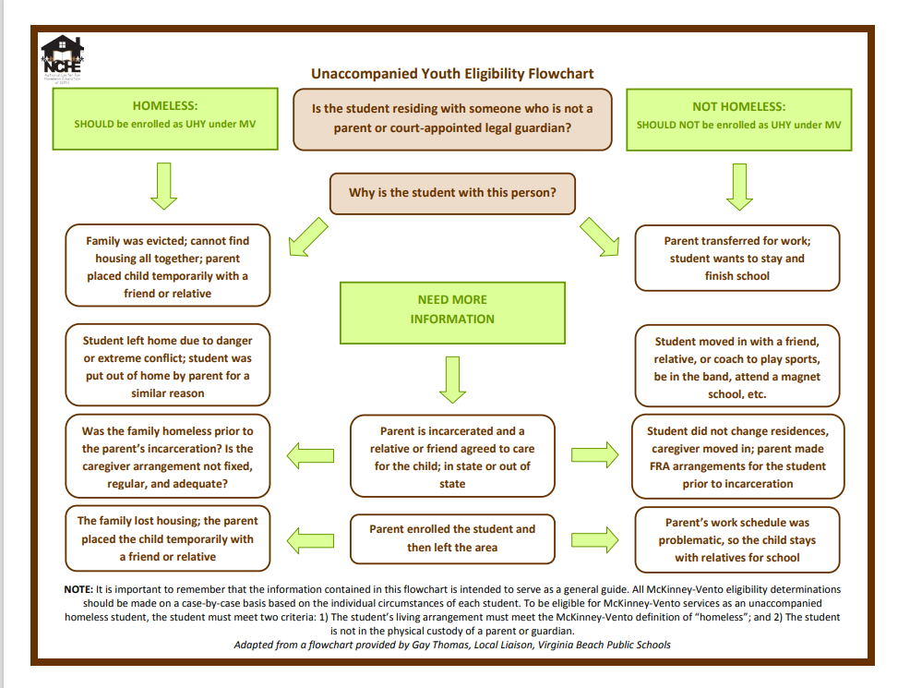
Unaccompanied youth eligibility flow chart

Slide 11
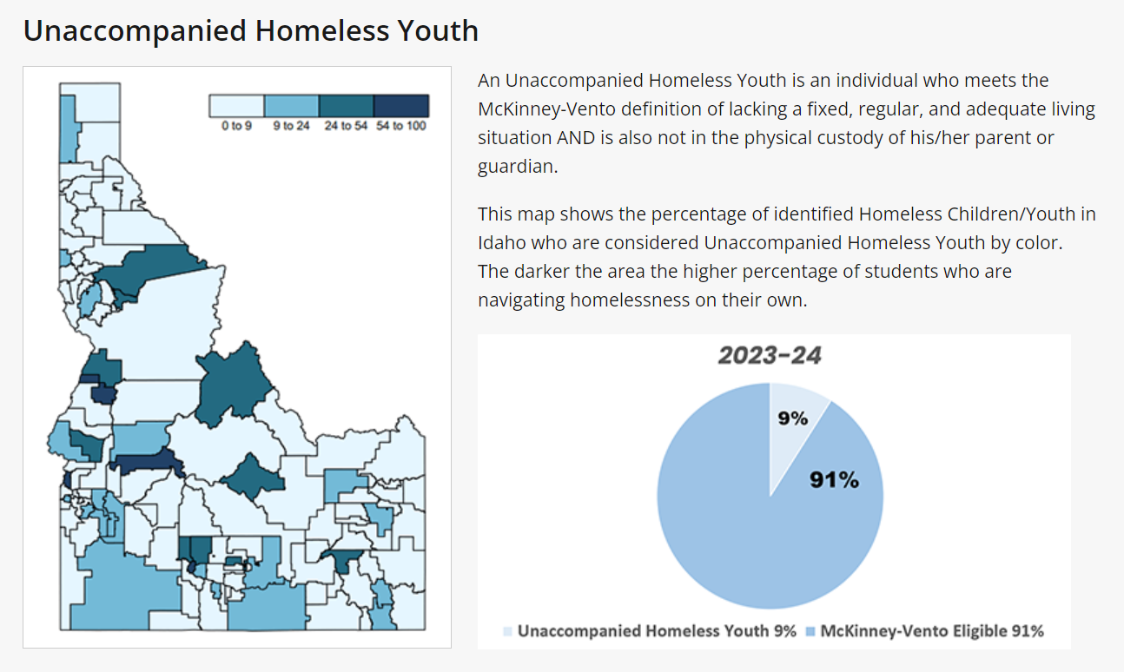
Unaccompanied Homeless Youth map of Idaho

Slide 12
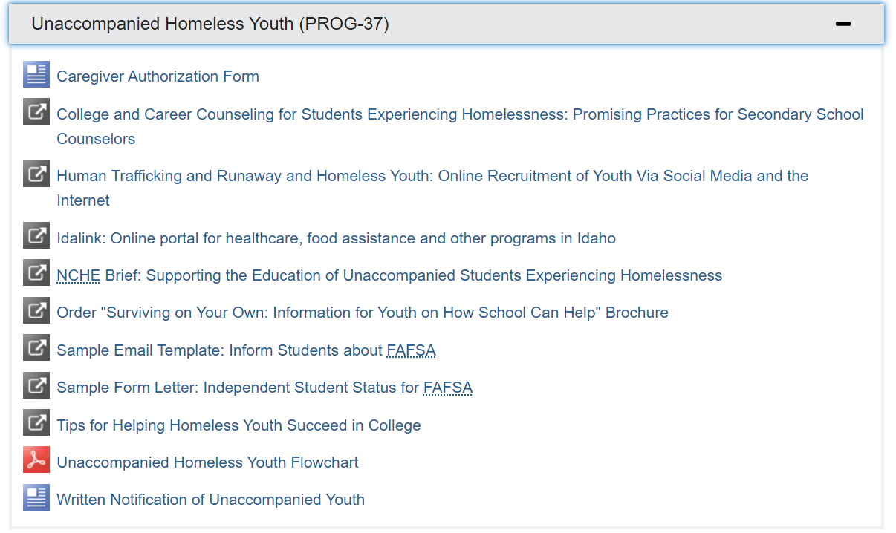
Idaho Department of Education's unaccompanied homeless youth webpage

Slide 13
What does federal law require school districts to do?
McKinney Vento Law requires a school district to:
Designate a liaison to carry out responsibilities outlined in law
Keep students in their schools of origin to the extent feasible, unless it is against the parent’s wishes
Provide transportation to the school of origin
Remove barriers to enrollment of homeless youth and children (school records, immunization records, etc.)
Homeless students immediately qualify for free/reduced lunch and breakfast

Slide 14
Steps to Identification and Eligibility
Outreach
  Nighttime residency forms (make sure families have access 2x/year), awareness activities, training, & staff referrals
Verify & Needs
  Collect additional information from forms/referrals to determine if they meet the requirements
  Determine & arrange supports needed (transportation & lunches)
Notify
  Written notification, rights, & services to parents or Unaccompanied Homeless Youth
Code
  Students coded in _(SMS)_____ to be included in the ISEE uploads
  MV + Living Situation + Other demographic info: UHY, Migrant, EL, SpEd

Slide 15
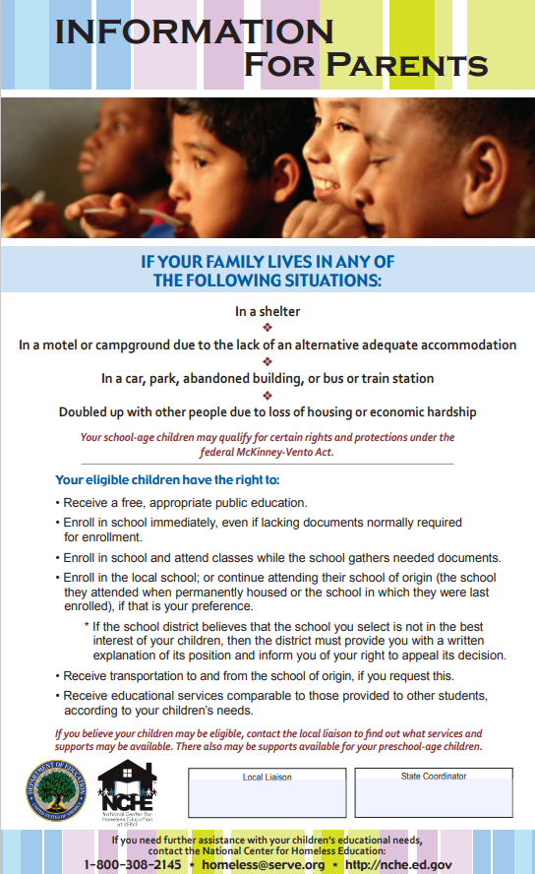

Please make sure that your school has McKinney-Vento Rights posters hung up in an area that is visible to students and parents when they are in the building (front office, parent information bulletin boards, etc.)
Parent and Student Posters
Posters need to be in both English and Spanish
McKinney-Vento Posters

Slide 16
Supports for Students

Slide 17
Supports Provided in Our District

Slide 18
Monitoring Students Wellbeing and Success
Attendance/Enrollment
Behavior, Emotional Well-being & Engagement
Coursework Completion & Credit Accrual
+
Physical Health & Well-being

Slide 19
Attendance
What will help promote attendance & achievement?
  Immediate enrollment/identification
  School of Origin (Best Interest)
  Transportation
  Accountability/Awareness
  Engagement w/ School

Slide 20
Behavioral/Emotional Wellbeing and Engagement
What will support positive behavior & emotional well being?
  Mentoring (check-in)
  Referrals for Mental Health services
  Academic/Intervention Support
  Extra-curricular activities
  College & Career Planning/Support
    FAFSA
    Career & Technical Ed.

Slide 21
Coursework Completion and Credit Accrual
What practices will remove barriers to support academic success?
  IEP & EL eligibility coordinated w/ prior school
    Prompt & Expeditious referrals & evaluations
  Transcript Review
    Full and/or Partial credit given
  Credit Recovery
  On-track to Graduate
  Foundational Skills/Intervention

Slide 22
Physical Health & Wellbeing
What community & school partnerships can meet a child’s physical needs?
  Food & Nutrition
    Free Breakfast & Lunch
    Food Banks & Weekend Backpacks
  Clothing & Winter gear
  Hygiene Supplies
  School Supplies
  Immunizations
  Medical & Dental Referrals
  Housing Referrals

Slide 23
Homelessness in Idaho
Putting it in Perspective for our State & District

Slide 24
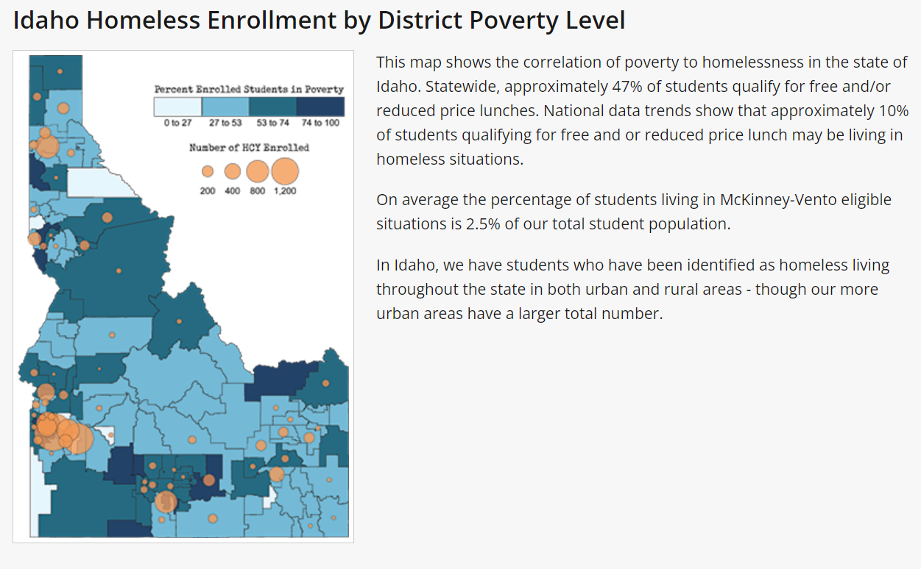
Idaho Data

Slide 25
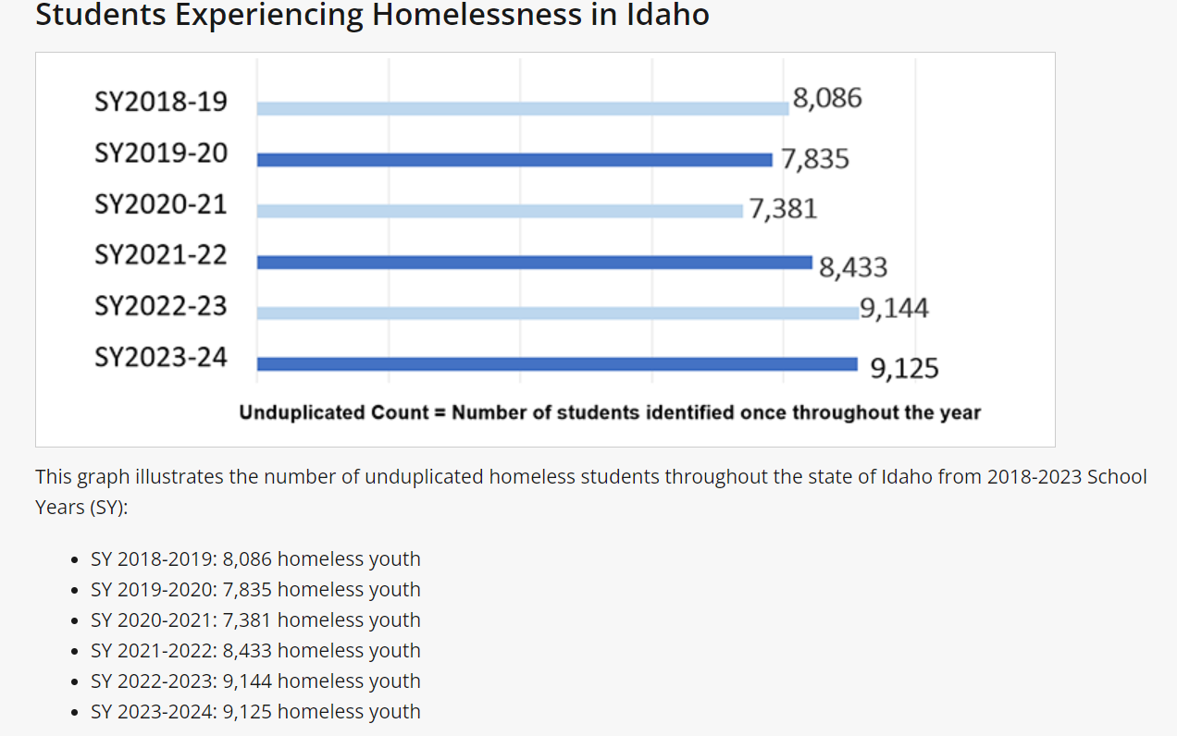
Students Experiencing Homelessness in Idaho

Slide 26
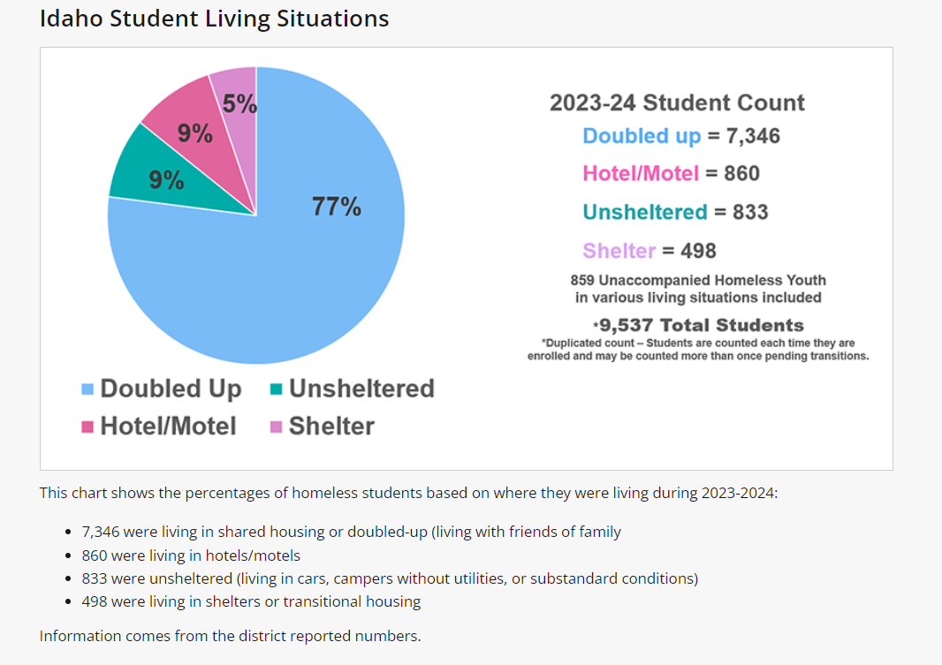
Idaho Student Living Situations

Slide 27
Our District Data

Slide 28
Know your numbers
How many youth identified were living in:
Shelters:
Doubled-up:
Hotels/Motels:
Unsheltered:
Unaccompanied youth:
Why is it important to know your numbers?
HUD definition vs McKinney-Vento Act
-Partnering with community agencies

Slide 29
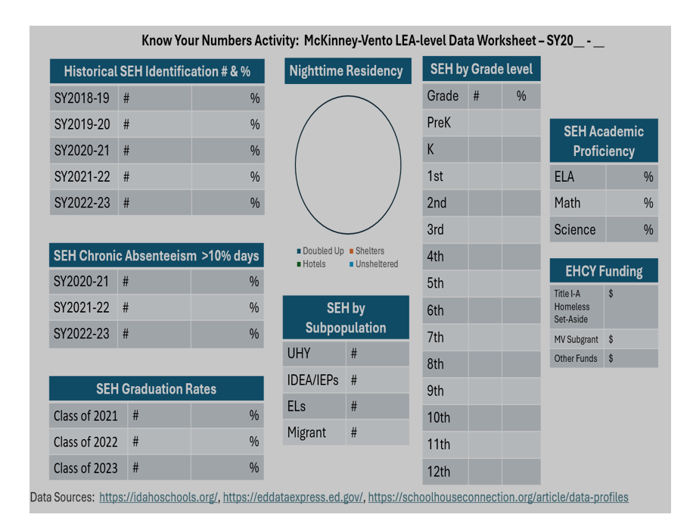
McKinney-Vento LEA-level Data Worksheet

Slide 30
Causes of Homelessness
Shortage of affordable rental housing
Increase in severe poverty
  Mean income of families experiencing homelessness is less than half the poverty line
  “a full-time minimum wage worker cannot afford fair market rent for housing in any jurisdiction within the United States”
Additional education or training to maintain living wage jobs
Childcare barriers
Mental and Physical health needs may go unmet and be exacerbated by homelessness
Unaccompanied Youth
  Abuse, Neglect, Extreme Family Conflict
Natural Disasters
Domestic Violence

Slide 31
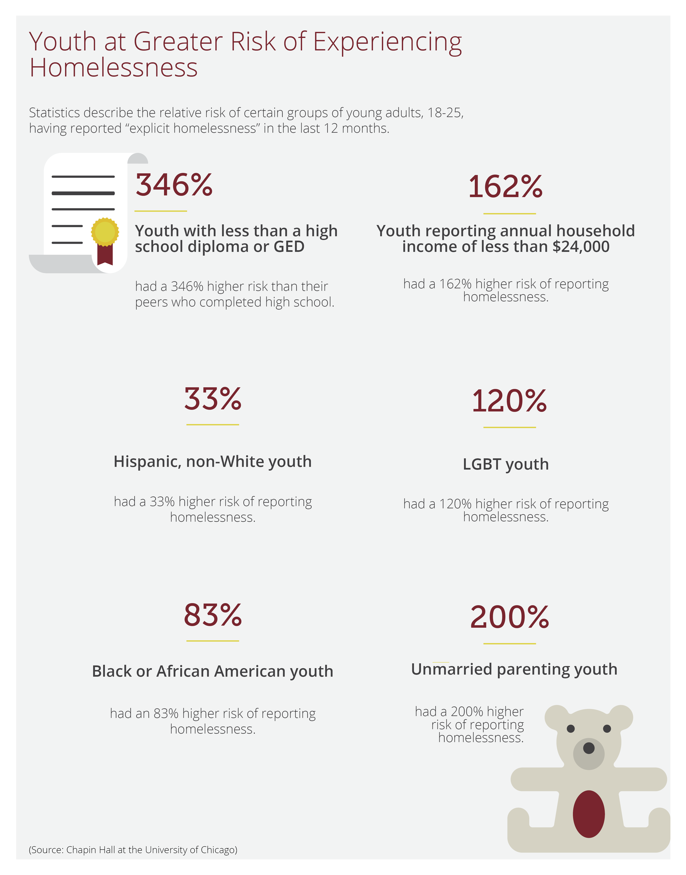
Consequences of Youth Homelessness:
Impacts education, health, and general well-being
  8-9x more likely to repeat a grade, 4x more likely to drop out of school, more likely to be placed in Special Education
  87% increased likelihood of dropping out of school

Slide 32
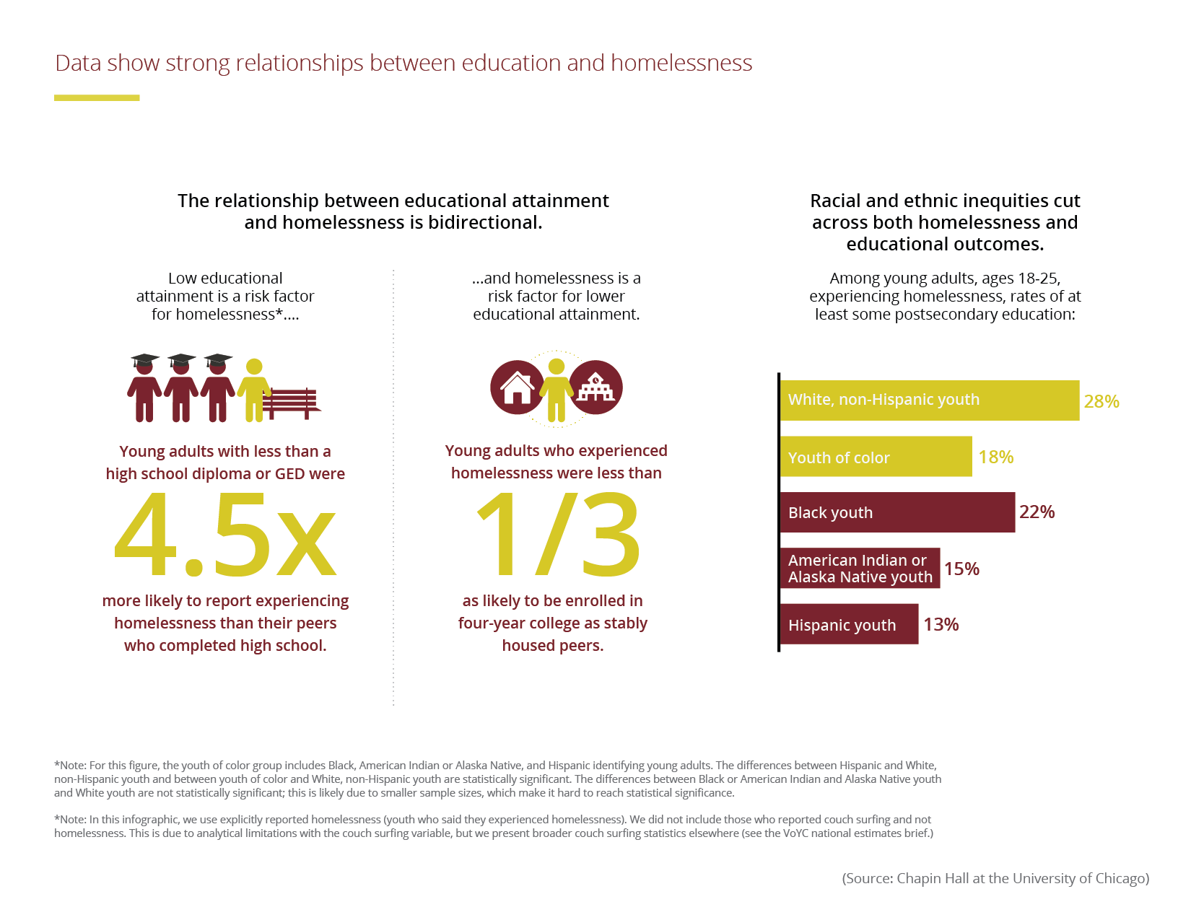
Data showing strong relationship between homelessness and education

Slide 33
Signs of Homelessness
Sometimes there are no signs
Gaps in skill development
Chronic hunger
Fatigue, tired, can’t focus
Poor organization skills
Unmet medical/dental needs
Erratic attendance/tardiness
Inability to pay fees
Lack of participation in afterschool activities
Poor hygiene

Slide 34
Homelessness Creates Barriers
Students experiencing homelessness may:
  Be unable to meet school enrollment requirements,
  Move around and change schools a lot,
  Be hungry, tired, and stressed,
  Not have school supplies or a quiet place to study,
  Not have access to reliable transportation,
  Not have a parent or guardian to help them (unaccompanied youth).

Slide 35
Homelessness Affects Learning
Students experiencing homelessness are more likely to -
  Have higher incidences of acute and chronic illnesses, depression and anxiety.
  Be chronically absent from school
  Get lower grades
  Poor classroom engagement & social skills
  Have special education needs
  Score poorly on assessment tests
  87% more likely to drop out of school

Slide 36

The Preventative Value of Education
• Children in quality preschool programs are more likely to graduate from high school and own homes
• High school graduation is associated with an array of positive live outcomes
• 95%+ of the jobs created since the Great Recession have gone to workers with at least some post-secondary education

Slide 37
Homeless Education Program

Slide 38
Goals of the McKinney-Vento Program
Ensure that children and youth experiencing homelessness have equal access to the same free, appropriate public education (including preschool) as provided to other children and youth.
Improve: Enrollment- Retention - Successful completion
Remove Barriers: Attendance, Credit Accrual, Extra-curriculars
Support transitions: Pre-k-School and School-College/Career

Slide 39
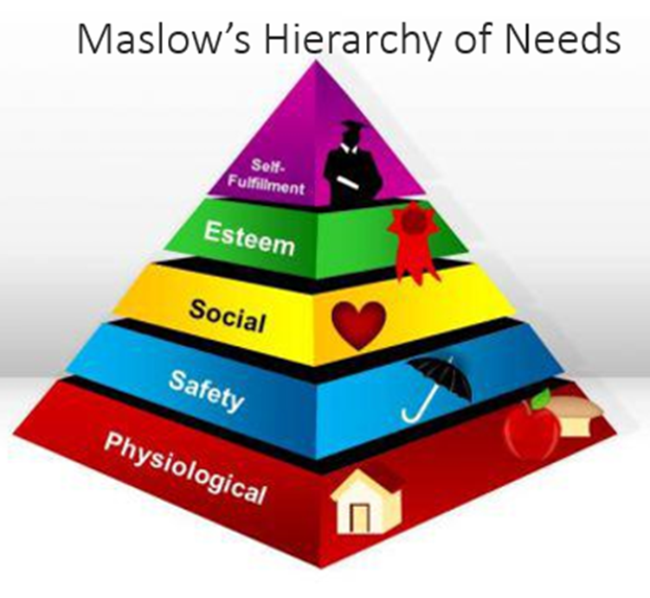



Goal= Stability & Security

Slide 40
Our District Homeless Education Team
District Level
•District Liaison
•Contact Information
School Level Contacts
•Options
•Admin Assistants
•Councilors
•Social Workers
•Etc.

Slide 41
Homeless Liaisons Responsibilities
1.Identify Students
2.Enrollment
3.Community partners
4.Referrals
5.Inform of rights
6.Public awareness
7.Mediate disputes
8.Inform of services
9.Professional Development
10.Support Unaccompanied Youth

Slide 42
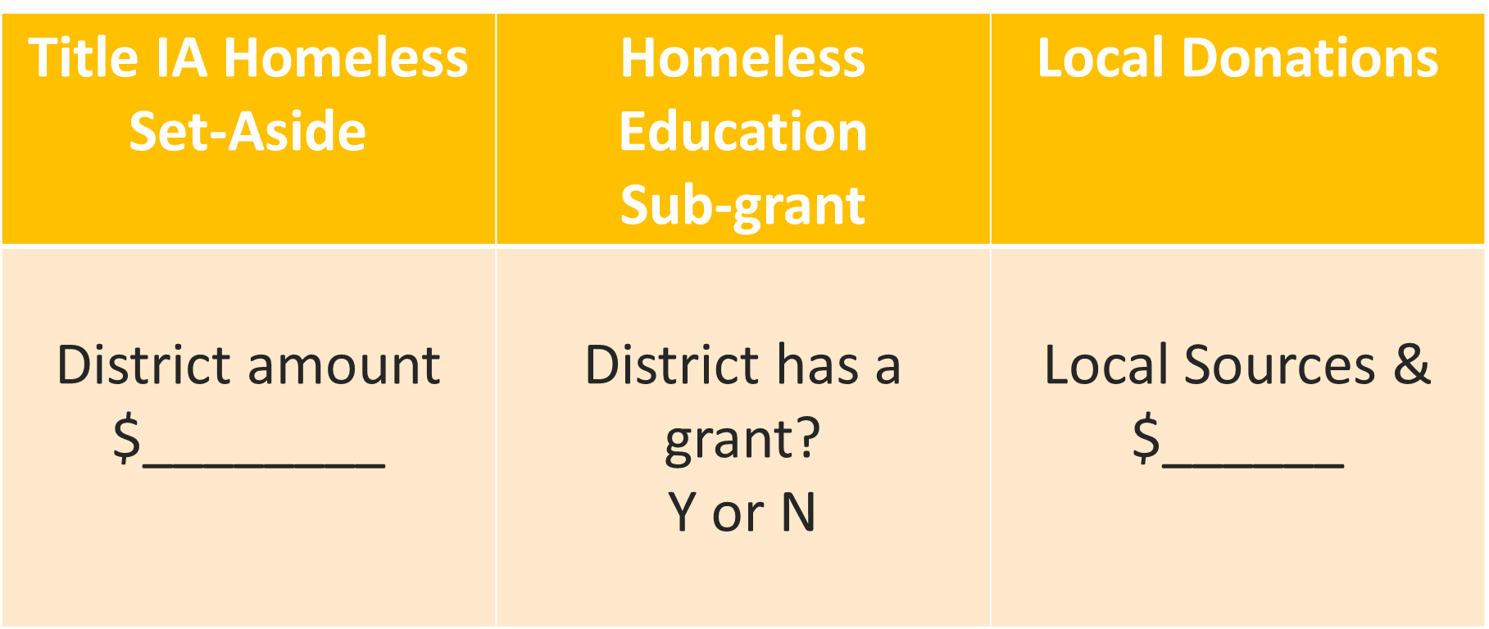
Available Funding Sources

Slide 43
Resources
School House Connection
SchoolHouse Connection
National Center for Homeless Education
https://nche.ed.gov/
National Coalition for the Homeless
https://nationalhomeless.org/
Idaho State Department of Education Website
https://www.sde.idaho.gov/federal-programs/homeless/
National Association for the Education of Homeless Children and Youth
https://naehcy.org/
Idaho Housing and Finance Association
Home - Idaho Housing and Finance Association

Slide 44
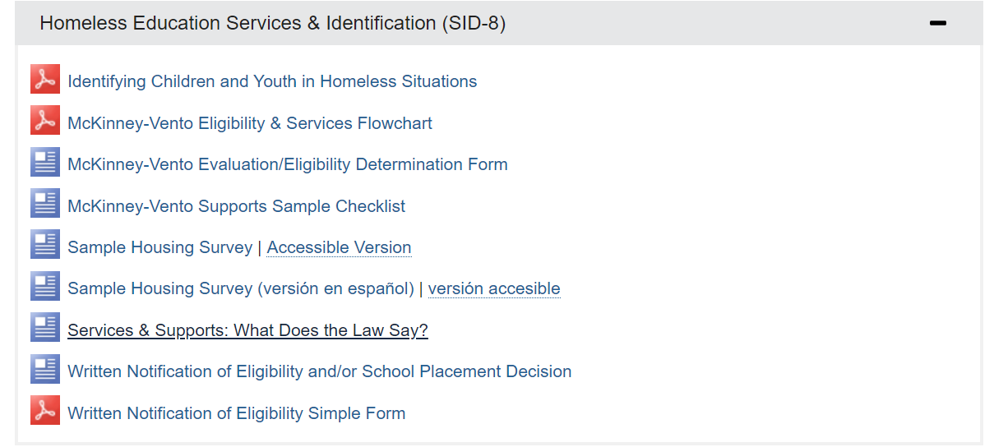
Idaho State Department of Education Resources
https://www.sde.idaho.gov/federal-programs/homeless

Slide 45
Questions?
Local Liaison Contact Information:
State Coordinator Contact Information:
Emily Kesler​
ekesler@sde.idaho.gov​
208-332-6904​

