Slide 1
Supporting Students Experiencing Homelessness
Annual Training
_____ School District

Slide 2
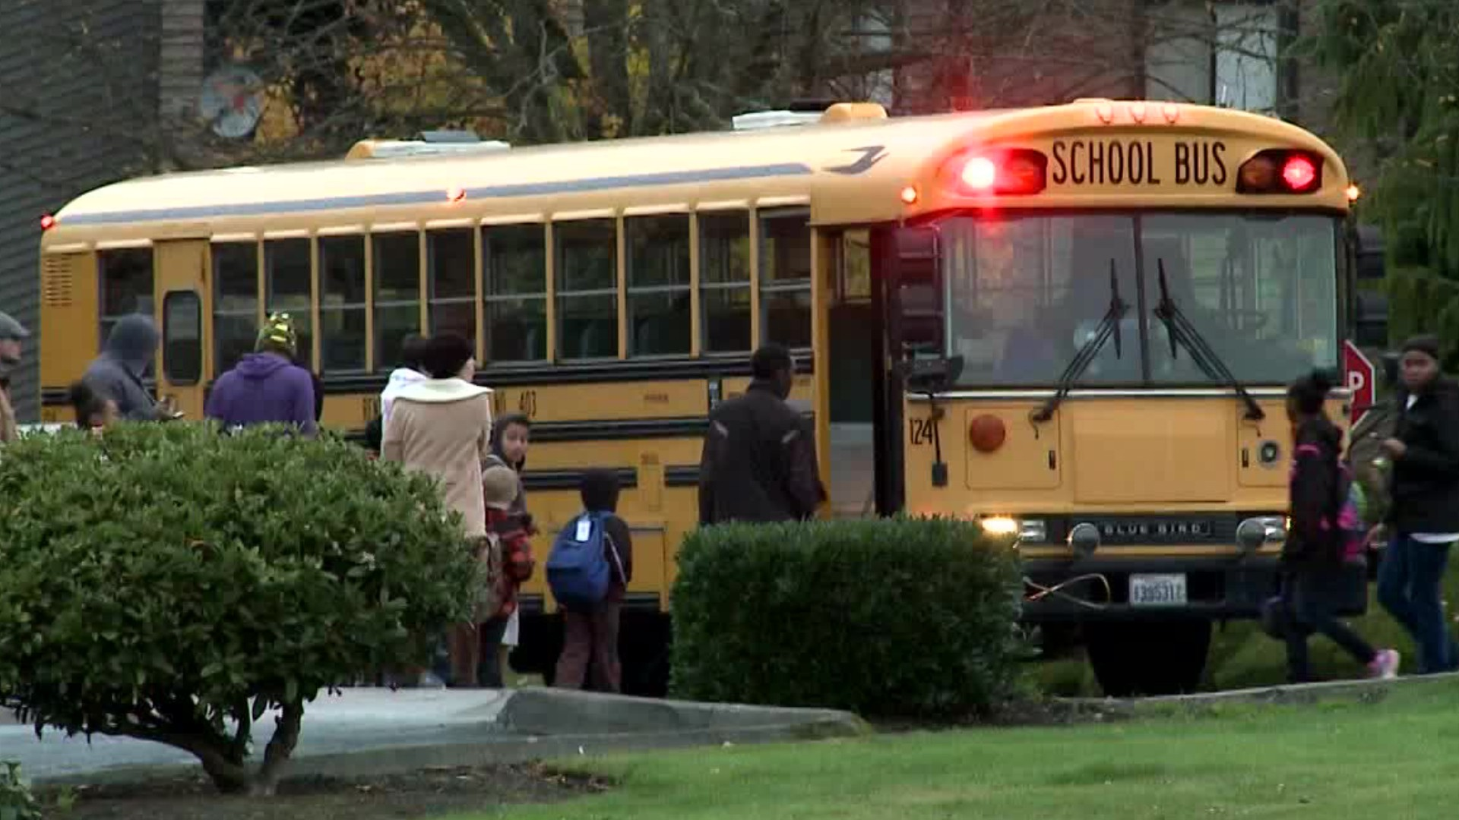
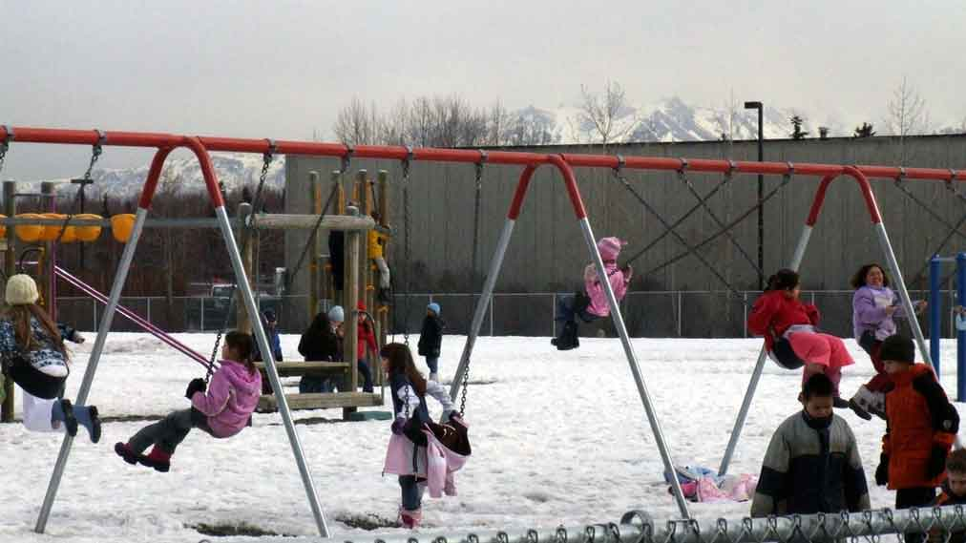
This is presentation is specifically designed for support staff.
Specifically:
-Bus Drivers
-Paraprofessionals
-Other supports staff
ThePhoto by PhotoAuthor is licensed under CCYYSA.

Slide 3

1. I know what the living situations qualify under McKinney Vento
2. I can identify the process our district has in place to meet the educational needs and provide supports for stability to students/families experiencing homelessness
3. I am aware of how homelessness can affect educational outcomes and what signs to look for that may indicate homelessness.
4. I know who to contact regarding the Homeless Education Program in our district
Learning Targets

Slide 4
Homelessness in Idaho
Putting it in Perspective

Slide 5
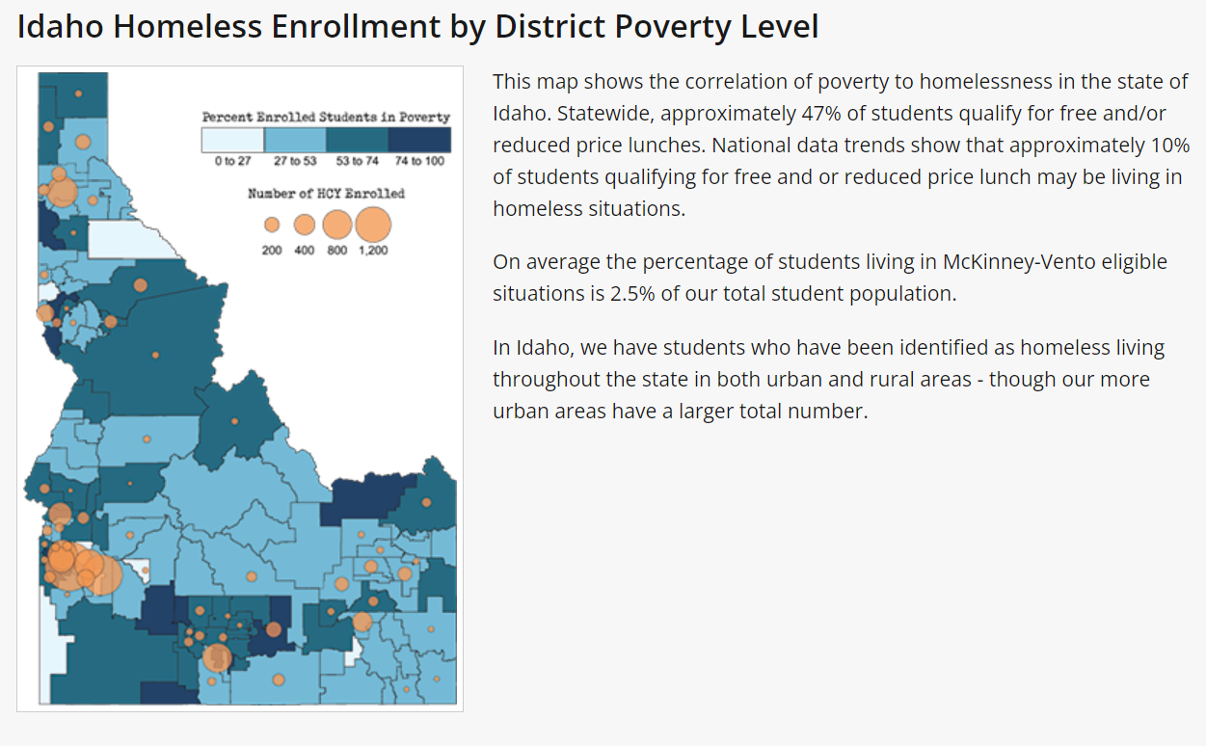
Idaho Data

Slide 6
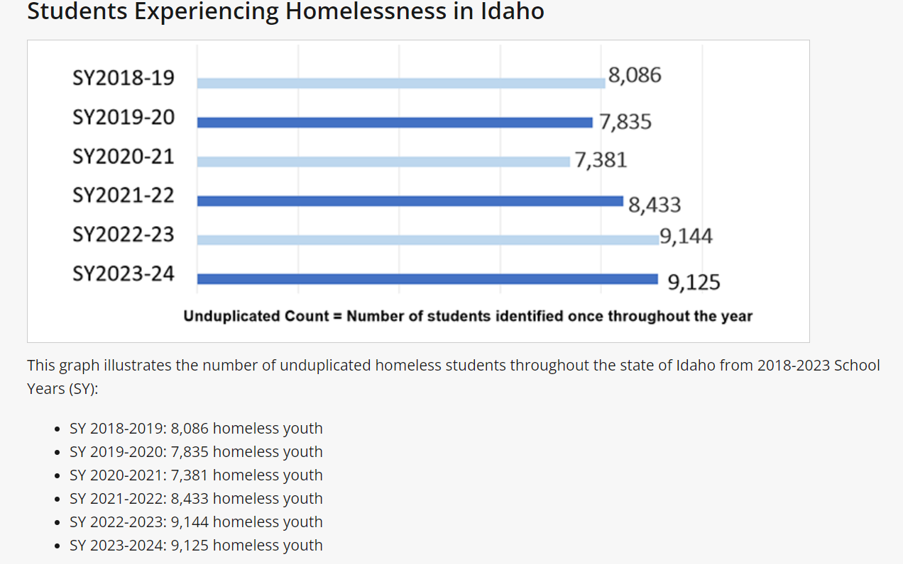
Students experiencing homelessness in Idaho

Slide 7
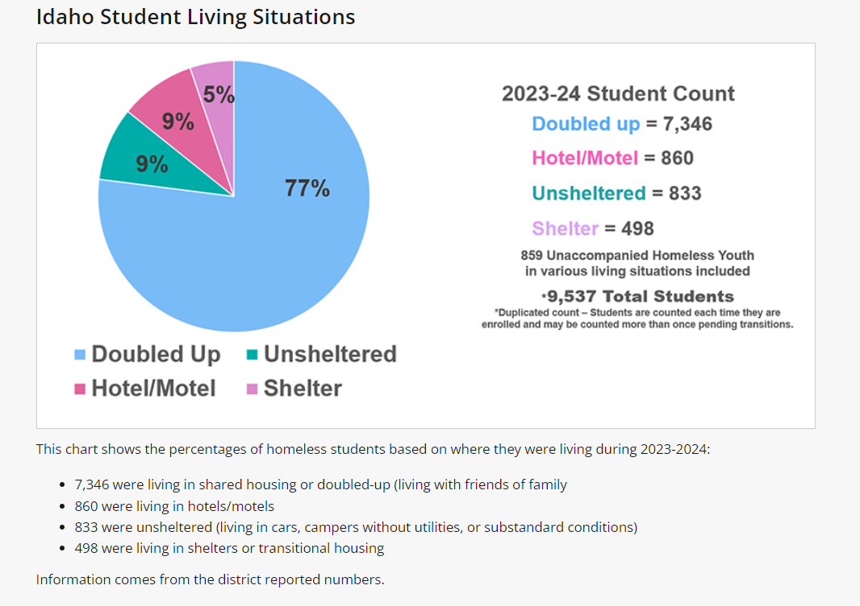
Idaho Student Living Situations

Slide 8
What does federal law require school districts to do?
McKinney Vento Law requires a school district to:
Keep students in their schools of origin to the extent feasible, unless it is against the parent’s wishes
Provide transportation to the school of origin
Remove barriers to enrollment of homeless youth and children (school records, immunization records, etc.)
Homeless students immediately qualify for free/reduced lunch and breakfast

Slide 9
Steps to Identification and Eligibility
Outreach
  Nighttime residency forms (make sure families have access 2x/year), awareness activities, training, & staff referrals
  Our district collects these during registration (update and personalize to your district)
Verify & Needs
  The district team collects additional information from forms/referrals to determine if they meet the requirements
  Determine & arrange supports needed (transportation & lunches)
Notify
  Written notification, rights, & services to parents or Unaccompanied Homeless Youth via the team
  Teachers and other staff are notified as needed, please be respectful of student privacy
Code
  Students are coded in _(SMS)_____ to be included in the ISEE uploads

Slide 10
Signs of Homelessness
Sometimes there are no signs. But signs can include the following:
Gaps in skill development
Chronic hunger
Fatigue, tired, can’t focus
Poor organization skills
Unmet medical/dental needs
Erratic attendance/tardiness
Inability to pay fees
Lack of participation in afterschool activities
Poor hygiene

Slide 11
Homelessness Creates Barriers
Students experiencing homelessness may
  Be unable to meet school enrollment requirements,
  Move around and change schools a lot,
  Be hungry, tired, and stressed,
  Not have school supplies or a quiet place to study,
  Not have access to reliable transportation,
  Not have a parent or guardian to help them (unaccompanied youth).

Slide 12
Homelessness Affects Learning
Students experiencing homelessness are more
likely to -
  Have higher incidences of acute and chronic illnesses, depression and anxiety.
  Be chronically absent from school
  Get lower grades
  Poor classroom engagement & social skills
  Have special education needs
  Score poorly on assessment tests
  87% more likely to drop out of school

Slide 13
What is McKinney Vento?

Slide 14
McKinney Vento Definitions
Children or youth who lack a nighttime residence that is:
    Fixed - Stationary, permanent, not subject to change
    Regular - Predictable, routine, consistent
    Adequate - Lawfully and reasonably sufficient
  Guiding question to ask yourself:
  Can the student go to the SAME PLACE (fixed) EVERY NIGHT (regular) to sleep in a SAFE and SUFFICIENT SPACE (adequate)?

Slide 15
Causes of Homelessness
Shortage of affordable rental housing
Increase in severe poverty
  Mean income of families experiencing homelessness is less than half the poverty line
  “a full-time minimum wage worker cannot afford fair market rent for housing in any jurisdiction within the United States”
Additional education or training to maintain living wage jobs
Childcare barriers
Mental and Physical health needs may go unmet and be exacerbated by homelessness
Unaccompanied Youth
  Abuse, Neglect, Extreme Family Conflict
Natural Disasters
Domestic Violence

Slide 16
Types of Living Situations that qualify for the McKinney Vento Act
  Sharing the housing of other persons due to loss of housing, economic hardship, or a similar reason
  Living in motels, hotels, trailer parks, or camping grounds due to the lack of alternative adequate accommodations
  Living in emergency or transitional shelters
  Living in a public or private place not designed for or ordinarily used as a regular sleeping accommodation for human beings
  Living in cars, parks, public spaces, abandoned buildings, substandard housing, bus or train stations, or similar settings
  [(42 U.S.C. § 11434a(2)]

Slide 17
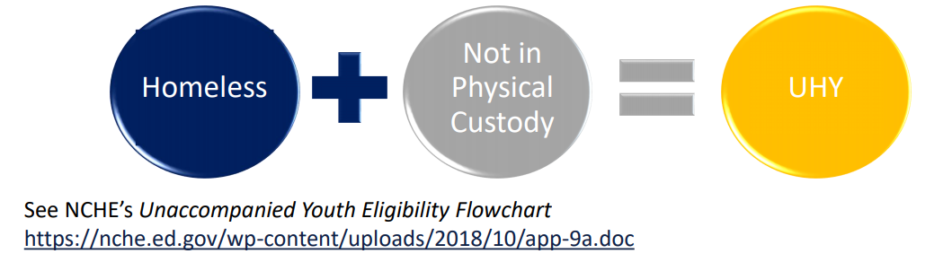
Unaccompanied Homeless Youth
1. Student’s living arrangement must meet the definition of homeless
AND
2. Student must be considered unaccompanied, defined as “not in the physical custody of a parent or guardian.”

Slide 18
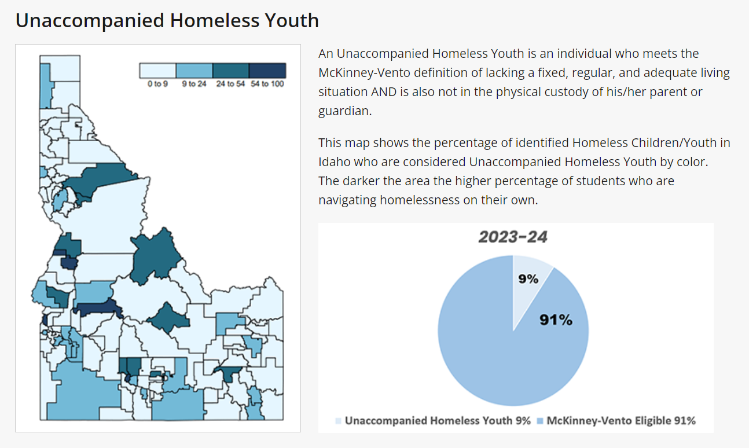
Unaccompanied Homeless and Youth

Slide 19
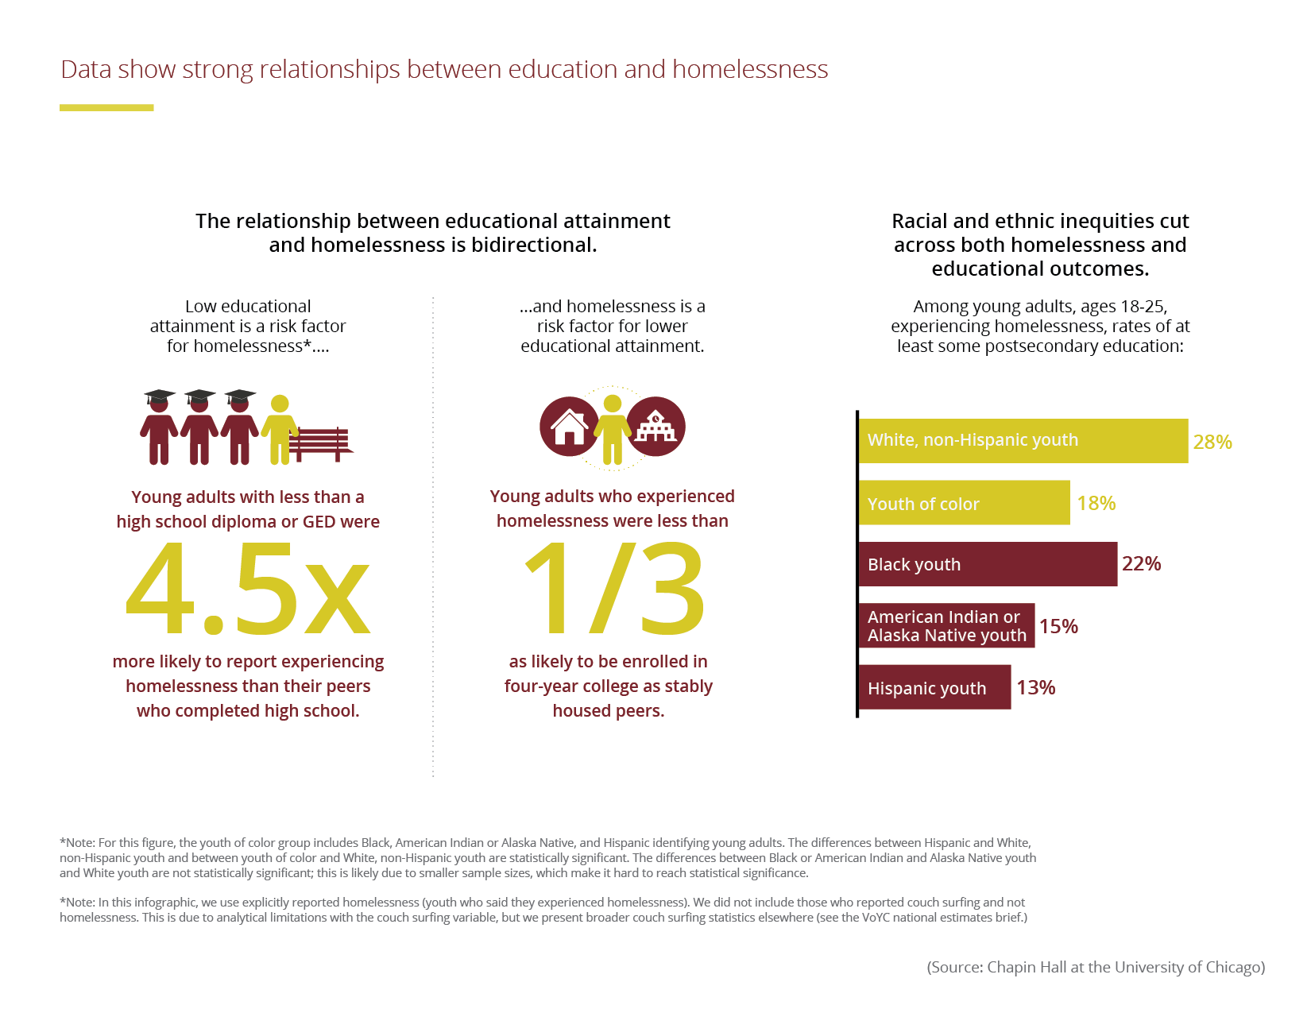
Data showing strong relationship between homelessness and academics

Slide 20
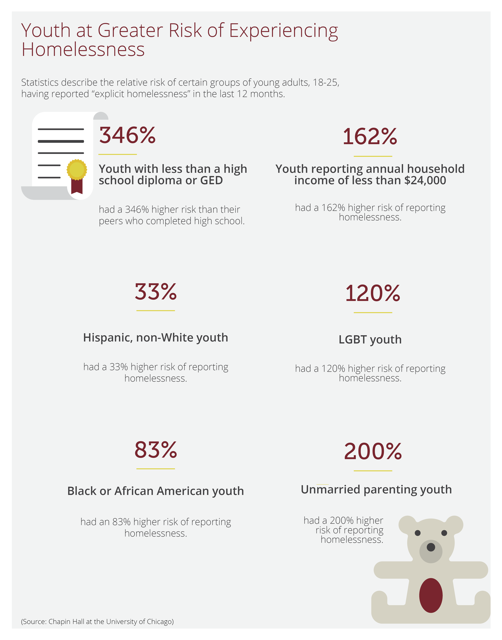
Consequences of Youth Homelessness:
Impacts education, health, and general well-being
  8-9x more likely to repeat a grade, 4x more likely to drop out of school, more likely to be placed in Special Education
  87% increased likelihood of dropping out of school

Slide 21
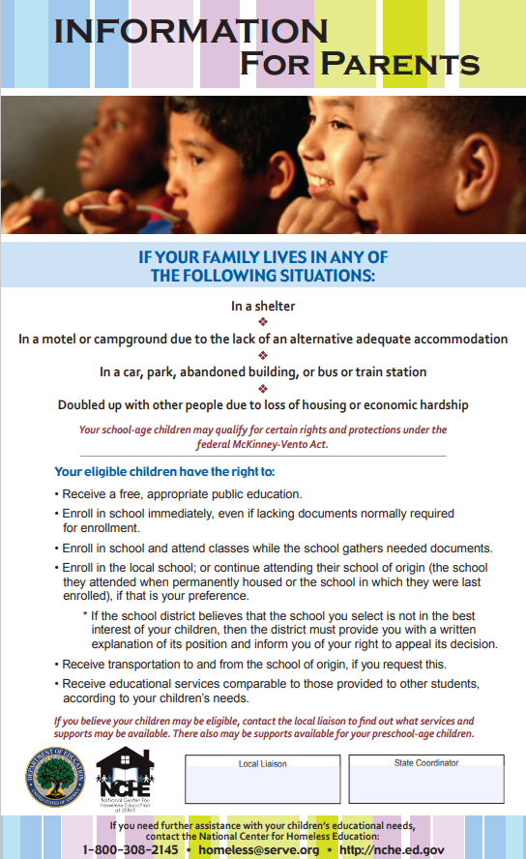
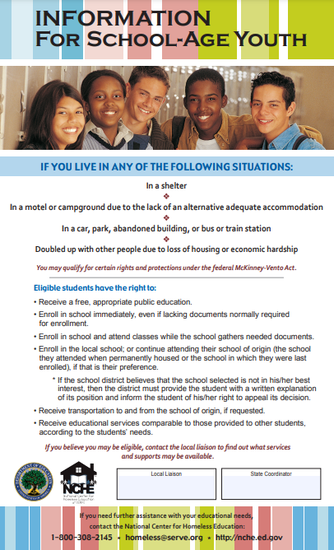
Please make sure that your school has McKinney Vento Rights posters hung up in an area that is visible to students and parents when they are in the building
Front office, parent information bulletin boards, etc.
-Parent and Student Posters
-Posters need to be in both English and Spanish
If one has been damaged, or you have ideas for additional spots to post please contact your liaison.

Slide 22
Supports for Students

Slide 23
Supports Provided in Our District
Please fill in with supports specific to your district or delete or feel free to delete the slide.
Examples may include
Students have access to clothing closet
Partnership with food bank
Weekly communication with liaison, etc.
Busing that is sensitive to student's housing situation
Monitoring for ABC+P
Attendance/Enrollment
Behavior, Emotional Well-being & Engagement
Coursework Completion & Credit Accrual
+
Physical Health & Well-being

Slide 24
Attendance
What will help promote attendance & achievement?
  Immediate enrollment/identification
  School of Origin (Best Interest)
  Transportation
  Accountability/Awareness
  Engagement w/ School

Slide 25
Behavioral/Emotional Wellbeing and Engagement
What will support positive behavior & emotional well being?
  Mentoring (check-in)
  Referrals for Mental Health services
  Academic/Intervention Support
  Extra-curricular activities
  College & Career Planning/Support
    FAFSA
    Career & Technical Ed.

Slide 26
Coursework Completion and Credit Accrual
What practices will remove barriers to support academic success?
  IEP & EL eligibility coordinated w/ prior school
    Prompt & Expeditious referrals & evaluations
  Transcript Review
    Full and/or Partial credit given
  Credit Recovery
  On-track to Graduate
  Foundational Skills/Intervention

Slide 27
Physical Health & Wellbeing
What community & school partnerships can meet a child’s physical needs?
  Food & Nutrition
    Free Breakfast & Lunch
    Food Banks & Weekend Backpacks
  Clothing & Winter gear
  Hygiene Supplies
  School Supplies
  Immunizations
  Medical & Dental Referrals
  Housing Referrals

Slide 28
Questions?
Liaison Contact Information:
District Federal Program Director

