Slide 1
Supporting Students Experiencing Homelessness in the _____ School District
Implementing the McKinney-Vento Act
Annual Training
Notes:
Information from the National Center for Homeless Educations (NCHE) - images and content used with permission
http://nche.ed.gov
NOTE TO DISTRICTS:
- Personalize slides to meet district culture, supports, processes, etc.
- Use a sign-in/verification sheet for staff to note they have been trained each school year.

Slide 2

Learning Targets
I better understand the issues around homelessness in the state of Idaho and our district.
I am aware of how homelessness can affect educational outcomes.
I can identify the processes our district has in place to meet the educational needs and provide supports for stability to students/families experiencing homelessness.
I know who to contact regarding the Homeless Education Program in our district

Slide 3
Homelessness in Idaho
Putting it into perspective for our State & District

Slide 4
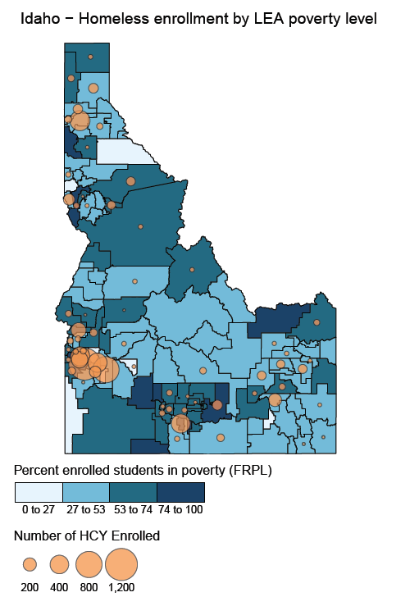
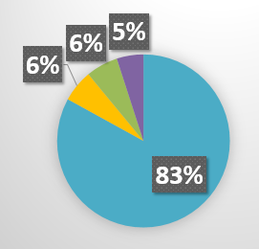
Idaho Data
2.5% of students identified in Idaho
Doubled up – 83%
Shelters – 6%
Hotels/Motels – 6%
Unsheltered – 5%
Notes:
Homeless Data evokes emotion! It is a statewide issue – NOT just in our larger population areas. Rural homelessness has it’s own unique issues.
- The darker the color the more students who receive Free and/or Reduced Lunch in a district/area
- The larger the orange circle the more students identified w/in districts
- We are seeing yearly increases.
- We follow the national trends of the bulk of our students are living in a doubled up saturation (These are stressful and oftentimes not safe)

Slide 5
Our District Data
Number Identified in SY18-19 | District Free Reduced % | Percentage Identified of F/R % | Percentage Identified of total enrollment
# | ____% | ___% | ___%
Are we above or below 10% of our F/R %?
Are we above or below the state average of 2.5%?
Notes:
A good rule of thumb for figuring the approximate number of students experiencing homelessness is to look at the district Free & Reduced percentage – About 10% of that number could be living in unstable housing situations.

Slide 6
Causes of Homelessness
Lack of affordable housing
Poverty
  Under-employment
Health problems/Medical bills
Domestic violence
Natural and other disasters
Abuse/neglect (unaccompanied youth)
Notes:
Lack of affordable housing
– Housing costs are increasing to the point where it is almost impossible for people to buy a home
- Rental market is so tight and so difficult to navigate w/ first & last months rent, security deposits, and application fees
Poverty/Under-employment
- Many of our families are working 2 and 3 jobs just to make it
Health problems/Medical bills
- Think about your own situation if you had a major medical bill. How close are you to losing it all???
Domestic violence
- Families are stressed
- Kids are experiencing trauma
Natural and other disasters
- Fires, flooding, etc. can displace families – which would qualify them for MV supports
Abuse/neglect
– especially w/ unaccompanied youth. They are leaving situations they can no longer handle.

Slide 7
Education is the Key to Breaking the Cycle of Poverty & Homelessness

Slide 8

Signs of Homelessness
Sometimes there are no signs
Gaps in skill development
Chronic hunger
Fatigue, tired, can’t focus
Poor organization skills
Unmet medical/dental needs
Erratic attendance/tardiness
Inability to pay fees
Lack of participation in afterschool activities
Poor hygiene
Notes:
Can you pick out the student? SOMETIMES THERE ARE NO SIGNS!!!

Slide 9
Homelessness Creates Barriers
Students experiencing homelessness may
  Be unable to meet school enrollment requirements,
  Move around and change schools a lot,
  Be hungry, tired, and stressed,
  Not have school supplies or a quiet place to study,
  Not have access to reliable transportation,
  Not have a parent or guardian to help them (unaccompanied youth).
Notes:
What are the results of these on kids?

Slide 10
Homelessness Affects Learning
Students experiencing homelessness are more
likely to -
  Have higher incidences of acute and chronic illnesses, depression and anxiety.
  Be chronically absent from school
  Get lower grades
  Poor classroom engagement & social skills
  Have special education needs
  Score poorly on assessment tests
  87% more likely to drop out of school

Slide 11
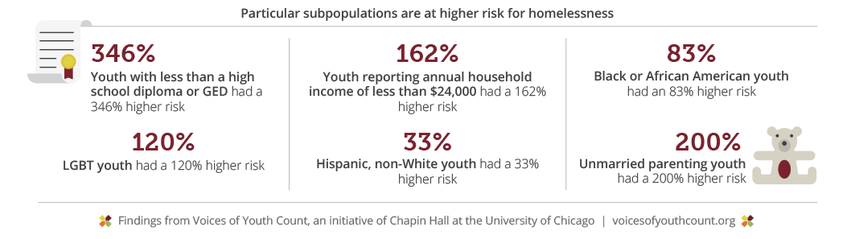

Those At Greatest Risk
Notes:
Source: Chapin Hall, http://voicesofyouthcount.org/wp-content/uploads/2017/11/ChapinHall_VoYC_1-Pager_Final_111517.pdf
Our goal should be to GET KIDS TO GRADUATION – NO MATTER WHAT IT TAKES!!!!

Slide 12
The Preventive Value of Education
Children in quality preschool programs are more likely to graduate from high school and own homes
High school graduation is associated with an array of positive live outcomes
95%+ of the jobs created since the Great Recession have gone to workers with at least some post-secondary education
unemployment criminal justice involvement | income health outcomes life span
Notes:
Children in quality preschool programs are more likely to graduate from high school and own homes
Source: Early Childhood Education, NEA, http://www.nea.org/home/18163.htm
High school graduation is associated with an array of positive live outcomes ( unemployment,  criminal justice involvement,  income,  health outcomes,  life span)
Source: The Graduation Effect, The Alliance for Excellent Education, http://impact.all4ed.org/
95%+ of the jobs created since the Great Recession have gone to workers with at least some post-secondary education
Source: America’s Divided Recovery, Georgetown University
https://cew.georgetown.edu/cew-reports/americas-divided-recovery/

Slide 13
Homeless Education Program
Notes:
Personalize for your district – some districts have eliminated the word “Homeless”

Slide 14
Goals of the McKinney-Vento Act
Ensure that children and youth experiencing homelessness have equal access to the same free, appropriate public education (including preschool) as provided to other children and youth.
Improve: Enrollment- Retention - Successful completion
Remove Barriers: Attendance, Credit Accrual, Extra-curriculars
Support transitions: Prek-School and School-College/Career
Notes:
The McKinney-Vento Act: Parent-Student Rights
Idaho public schools shall provide an educational environment that treats all students with dignity and respect. Every student experiencing homelessness or transition shall have access to the same free and appropriate educational opportunities as students who are not homeless. This commitment to the educational rights of homeless children, youth, and unaccompanied youth, applied to all services, programs, and activities provided or made available.
A student may be considered eligible for services under the McKinney-Vento Homeless Assistance Act if he or she is presently living:
In temporary shared housing, a shelter, or transitional living program
In a hotel/motel, campground, or similar situation due to lack of alternatives
At a bus station, park, car, or abandoned building
According to the McKinney-Vento Act, eligible students have rights to:
*Immediate enrollment: Documentation and immunization records cannot serve as a barrier to the enrollment in school.
*School Selection: Eligible students have a right to select from the following schools:
The school he/she attended when permanently housed (School of Origin)
The school in which he/she was last enrolled (School of Origin)
The school in the attendance area in which the student currently resides (School of Residency)
*Remain enrolled in his/her selected school for the duration of homelessness, or until the academic year upon which they are permanently housed.
*Participate in programs for which they are eligible, including Title I tutoring programs, Free Lunch in schools with the, National School Lunch Program, Head Start & Even Start Preschool Programs.
*Transportation Services: A McKinney-Vento eligible student attending his/her School of Origin has a right to transportation to and from the School of Origin.
*Dispute Resolution: If you disagree with school officials about enrollment, transportation, or fair treatment of a homeless child or youth, you may file a complaint with the school district. The school district must respond and attempt to resolve it quickly. During the dispute, the student must be immediately enrolled in the school and provided transportation until the matter is resolved. The McKinney Vento Liaison will assist you in making decision, providing notice of any appeal process, and filling out dispute forms.

Slide 15
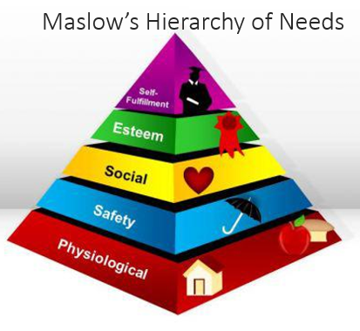
Goal = Stability & Security
+
Supporting the Whole Child
Notes:
It is HARD TO TEACH STUDENTS WHO ARE TIRED, HUNGRY, & STRESSED!!!

Slide 16
Our District Homeless Education Team
District Level
District Liaison
  Contact Information
School Level Contacts
Options
  Admin Assistants
  Councilors
  Social Workers
  Etc.
Notes:
Personalize this slide to match your district support structure!

Slide 17
Homeless Liaisons Responsibilities
Identify Students
Enrollment
Community partners
Referrals
Inform of rights
Public awareness
Mediate disputes
Inform of services
Professional Development
Support Unaccompanied Youth
Notes:
The McKinney-Vento Act includes a “job description” for the local liaison in the form of a list of duties. According to the Act [42 U.S.C. § 11432(g)(6)(A)], local liaisons must ensure that:
(i) children and youth experiencing homelessness are identified by school personnel through outreach and coordination activities with other entities and agencies;
(ii) children and youth experiencing homelessness are enrolled in, and have a full and equal opportunity to succeed in, schools within the district;
(iii) children, youth, and families experiencing homelessness have access to and receive educational services for which they are eligible, including Early Head Start and Head Start programs, early intervention services under Part C of the Individual with Disabilities Education Act, and other preschool programs administered by the school district;
(iv) children, youth, and families experiencing homelessness receive referrals to health care, dental, mental health, substance abuse, housing, and other appropriate services;
(v) the parents or guardians of students experiencing homelessness are informed of the educational and related opportunities available to their children, and are provided with meaningful opportunities to participate in the education of their children;
(vi) public notice of the educational rights of students experiencing homelessness is disseminated in locations frequented by families and youth experiencing homelessness, including schools, shelters, public libraries, and soup kitchens, in a manner and form understandable to parents, guardians, and unaccompanied youth;
(vii) enrollment disputes are mediated in accordance with the provisions of the Act;
(viii) parents, guardians, and unaccompanied youth experiencing homelessness are fully informed of all transportation services available to McKinney-Vento students, including transportation to the school of origin, and are assisted in accessing transportation;
(ix) school personnel providing services to students experiencing homelessness receive professional development and other support; and
(x) unaccompanied youth
(I) are enrolled in school;
(II) have opportunities to meet the same challenging State academic standards as other children and youth; and
(III) are informed of their status as independent students under the Higher Education Act of 1965 (20 U.S.C. § 1087vv), and receive assistance verifying this status for purposes of the Free Application

Slide 18
Available Funding Sources
Title IA Homeless Set-Aside | Homeless Education Sub-grant | Local Donations
District amount $________ | District has a grant? Y or N | Local Sources & $______
Notes:
Personalize this slide for your district

Slide 19
Identification Process

Slide 20
McKinney-Vento Definition
Children or youth who lack a nighttime residence
that is:
    Fixed - Stationary, permanent, not subject to change
    Regular - Predictable, routine, consistent
    Adequate - Lawfully and reasonably sufficient
Notes:
Nighttime Residency Form (2 times/year)
Referral Process (staff awareness)
A fixed residence is one that is stationary, permanent, and not subject to change
1. Is this a temporary living arrangement?
2. Did you and your friends/relatives decide to move in together and share a home and expenses for the long term?
3. Where would you go if something happened between you as adults?
4. How long do you expect to be at this address?
A regular residence is one that is used on a regular (i.e. nightly) basis
1. Do you stay in the same place every night?
2. Do you move around a lot?
An adequate residence is one that is sufficient for meeting both the physical and psychological needs typically met in home environments.
1. Are you safe where you are staying?
2. Do you have adequate space for your belongings?
3. Do you share a room/bed with your children?
4. Are your children safe if you are not home?
5. Do you and your children have access to a phone?
6. Is there adequate food in the home?
Other considerations: Temporary housing due to loss of housing, economic hardship or similar reason.
1. Where did you live previously?
2. What happened to cause you to move?
Did the student/family lose their previous housing due to:
- An eviction or an inability to pay rent or other bills?
- Destruction of or damage to the previous home?
- Conflict, abuse or neglect?
- Unhealthy conditions such as an inadequate physical environment or infestations?
- Drug or alcohol abuse in the home or domestic violence?
- Absence of a parent or guardian due to abandonment, incarceration or another reason?

Slide 21
Living Situations
  Sharing the housing of other persons due to loss of housing, economic hardship, or a similar reason
  Living in motels, hotels, trailer parks, or camping grounds due to the lack of alternative adequate accommodations
  Living in emergency or transitional shelters
  Living in a public or private place not designed for or ordinarily used as a regular sleeping accommodation for human beings
  Living in cars, parks, public spaces, abandoned buildings, substandard housing, bus or train stations, or similar settings
  [42 U.S.C. § 11434a(2)]
Notes:
Doubled Up –An individual may be considered to be homeless if that person is “doubled up,” a term that refers to a situation where individuals are unable to maintain their housing situation and are forced to stay with a series of friends and/or extended family members.
Clarifying questions for Doubled Up:
- Does the family or youth have any legal right to be in the home?
- Can the family or youth be asked to leave at any time with no legal recourse?
These questions may help to determine the stability of the living arrangement for purposes of determining homelessness.
_______________________________________
Clarifying questions: Did the family or youth lose previous housing due to
An eviction or foreclosure?
Destruction of or damage to the previous home?
Unhealthy or unsafe conditions?
Domestic violence?
Abuse or neglect?
The absence of a parent or guardian due to abandonment, parental incarceration, or a similar reason?
____________________________________
Implies that limited financial resources have forced the family or youth to leave the personal residence and share housing due to an inability to pay the rent/mortgage and other bills
Clarifying question:
Did economic hardship due to an accident or illness, loss of employment, loss of public benefits, or a similar reason force the
family or youth to share the housing of
others temporarily?
It is important to note that a long-term, cooperative living arrangement among families or friends that is fixed, regular, and adequate should not be considered a homeless situation, even if the parties are living together to save money.

Slide 22
Special Situations
Migratory children living in these circumstances
Unaccompanied Youth – any youth who is not in the physical custody of a parent or guardian
[42 U.S.C. § 11434a(6)]
Notes:
Unaccompanied Youth
- Develop clear policies for enrolling unaccompanied youth immediately, whether youth enroll themselves, liaisons do enrollment, caretakers enroll youth in their care, or another procedure is in place.
- Offer youth an adult and peer mentor.
- Establish systems to monitor youth’s attendance and performance, and let youth know you’ll be checking up on them.
- Help youth participate fully in school (clubs, sports, homework help, etc.)
- Build trust! Be patient, and ensure discretion and confidentiality when working with youth.

Slide 23
Unaccompanied Homeless Youth
Definition: a child or youth who meets the MV definition and is NOT in the physical custody of a parent or guardian.
  Many youth become separated from parents due to lack of space in living situations or shelter policies.
  Many flee abuse: 20-50% sexual; 40-60% physical.
  Many flee family dysfunction: Over 2/3 Hotline callers report at least one parent abuses drugs or alcohol.
  10% of currently homeless female teens are pregnant.
  Many are not enrolled in school.

Slide 24
Steps to Identification/Eligibility
Outreach
  Nighttime residency forms, awareness activities, training, & staff referrals
Verify & Needs
  Collect additional information from forms/referrals to determine if they meet the requirements
  Determine & arrange supports needed (transportation & lunches)
Notify
  Written notification, rights, & services to parents or Unaccompanied Homeless Youth
Code
  Students coded in _(SMS)_____ to be included in the ISEE uploads
  MV + Living Situation + Other demographic info: UHY, Migrant, EL, IEP
Notes:
Personalize your Student Management System (SMS)
Those in the district who are responsible for these:
Outreach Activities__________________________________
Verification/Determining Needs_____________________
Notification__________________________________________
Coding & Data Quality______________________________

Slide 25
Determinations of Eligibility
Local liaison has the authority and responsibility to ensure that eligible students are identified!
  Collaborative effort
    school personnel
    outreach/coordination activities
  Case-by-case basis
    Pay close attention to the legislative wording
[42 U.S.C. § 11432(g)(6)(A)(i)]
Notes:
Look past the drama of the situation.
Flowcharts can be helpful - MV & UHY

Slide 26
Helpful Considerations
  how the shared housing came about
  the intention of the residents
  the family’s or youth’s housing options if not sharing housing
  the fixed, regular, and adequate guiding phrase

Slide 27
Supports for Students

Slide 28
Supports & Services
54% of formerly homeless students identified both tangible and intangible supports as equally important to their ability to stay in school and do well.
Tangible | Intangible
-School Supplies -Transportation -Breakfast & Lunch -Academic Support | -Sense of Stability -Feeling Safe -Emotional Support
Notes:
Grad Nation.org – Hidden in Plain Sight

Slide 29
Supports provided in our District
District Services
Free Lunch
Transportation (as needed)
Etc.
Referral Services
Notes:
Personalize for your district

Slide 30
Monitoring Students -
Well Being & Academic Success
Attendance/Enrollment
Behavior, Emotional Well-being & Engagement
Coursework Completion & Credit Accrual
+
Physical Health & Well-being
Notes:
What is the process in our district for monitoring student well-being & academic success?

Slide 31
Attendance
What will help promote attendance & achievement?
  Immediate enrollment/identification
  School of Origin (Best Interest)
  Transportation
  Accountability/Awareness
  Engagement w/ School
Notes:
Children and youth experiencing homelessness have the right to immediate school enrollment
even if lacking paperwork normally required for enrollment; or
even if having missed application or enrollment deadlines during any period of homelessness [42 U.S.C. § 11432(g)(3)(C)(i)].
Enrollment is defined as “attending classes and participating fully in school activities” [42 U.S.C. § 11434a(1)].
Children and youth experiencing homelessness have the right to attend
The school of origin [42 U.S.C. § 11432(g)(3)(I)(i)]
The school that a child or youth attended when permanently housed, or
The school in which the child or youth was last enrolled
Includes public preschools
Includes receiving schools
The local attendance area school [42 U.S.C. § 11432(g)(3)(A)(ii)]
Any public school that non-homeless students who live in the attendance area in which the child or youth is actually living are eligible to attend
Homeless children and youth have the right to attend the school of origin for the duration of homelessness
- In any case in which a family becomes homeless between academic years or during an academic year
- For the remainder of the academic year, if the child or youth becomes permanently housed during an academic year
[42 U.S.C. § 11432(g)(3)(A)(i)(II)]
Do McKinney-Vento Act requirements apply to homeless children attending preschool?
To the extent that an LEA offers a public education to preschool children, including LEA-administered Head Start programs, an LEA must meet the McKinney-Vento Act requirements for homeless children in preschool, including ensuring that a homeless child remains in his or her public preschool of origin, unless a determination is made that it is not in the child’s best interest.
When the child or youth completes the final grade level served by the school of origin, the term school of origin shall include the designated receiving school at the next grade level for all feeder schools [42 U.S.C. §11432(g)(3)(I)(ii)].
In determining best interest, the school district shall
Presume that keeping the child or youth in the school of origin is in the child’s or youth’s best interest, except when doing so is contrary to the request of the parent, guardian, or unaccompanied youth
Consider student-centered factors related to the child’s or youth’s best interest, including factors related to the impact of mobility on achievement, education, health, and safety, giving priority to the request of the parent, guardian, or unaccompanied youth
Must LEAs continue to provide transportation to and from the school of origin for formerly homeless students who have become permanently housed?
Yes. LEAs must continue to provide transportation to and from the school of origin to formerly homeless students who have become permanently housed for the remainder of the academic year during which the child or youth becomes permanently housed.
Does the McKinney-Vento Act require an LEA to provide transportation services to homeless children attending preschool?
Yes. The McKinney-Vento Act requires LEAs to provide transportation services to the school of origin, which includes public preschools. Accordingly, transportation to the school of origin must be provided even if a homeless preschooler who is enrolled in a public preschool in one LEA moves to another LEA that does not provide widely available or universal preschool.
If crossing LEA lines, they must determine how to divide the responsibility and share the cost, or they must share the cost equally.
Strategies:
- Develop close ties among local liaisons, school staff, pupil transportation staff, and shelter workers.
- Use school buses (including special education, magnet school and other buses).
- Develop formal or informal agreements with school districts where homeless children cross district lines.
- Use public transit where feasible.
- Use approved carpools, van or taxi services.
- Reimburse parents and youth for gas.
Transportation must be provided to and from the school of origin at the request of the parent or guardian, or, in the case of an unaccompanied youth, at the request of the local liaison.
[42 U.S.C. §11432(g)(1)(J)(iii)]
Arrange services with your transportation department
Inter-district Memorandium of Understanding (MOU)

Slide 32
Behavioral/Emotional Well-Being & Engagement
What will support positive behavior & emotional well being?
  Mentoring (check-in)
  Referrals for Mental Health services
  Academic/Intervention Support
  Extra-curricular activities
  College & Career Planning/Support
    FAFSA
    Career & Technical Ed.

Slide 33
Coursework Completion & Credit Accrual
What practices will remove barriers to support academic success?
  IEP & EL eligibility coordinated w/ prior school
    Prompt & Expeditious referrals & evaluations
  Transcript Review
    Full and/or Partial credit given
  Credit Recovery
  On-track to Graduate
  Foundational Skills/Intervention

Slide 34
Physical Health & Well-Being
What community & school partnerships can meet a child’s physical needs?
  Food & Nutrition
    Free Breakfast & Lunch
    Food Banks & Weekend Backpacks
  Clothing & Winter gear
  Hygiene Supplies
  School Supplies
  Immunizations
  Medical & Dental Referrals
  Housing Referrals

Slide 35
Learning Targets - Review
I better understand the issues around homelessness in the state of Idaho and our district.
I am aware of how homelessness can affect educational outcomes.
I can identify the processes our district has in place to meet the educational needs and provide supports for stability to students/families experiencing homelessness.
I know who to contact regarding the Homeless Education Program in our district

Slide 36
Questions?
___________| District Liaison
____ School District
Phone:
Email:
Website:
Suzanne M Peck| State Coordinator
Title IX-A Homeless Education
Idaho State Department of Education
650 W State Street, Boise, ID 83702
208 332 6904
speck@sde.Idaho.gov
www.sde.Idaho.gov/federal-programs
Notes:
Personalize for district

