Slide 1
Navigating MSIS &
Using Reports for Data Accuracy
Mini-Training February 2022

Slide 2
MSIS Navigation

Slide 3
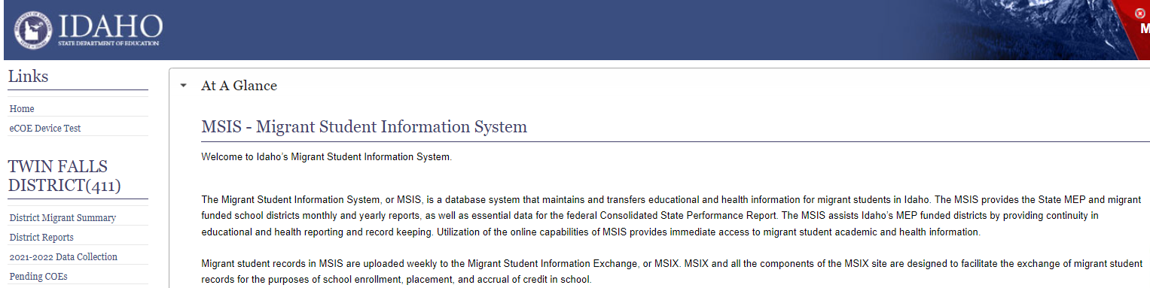
MSIS Navigation Panel
The Navigation Panel:
District Migrant Summary – list of migratory students in your district
District Reports – all of the very useful reports available to you
Data Collection – location for reporting re-interviews and MPO completion
Pending COEs – location for COEs that are imported, but not yet submitted or that are rejected and waiting for you to export, correct and re-submit.

Slide 4
Using the District Migrant Summary
Click on the District Migrant Summary on the navigation panel on the left
Find a student by entering the student’s Name, EDUID, or COE number in the search bar.
The student will appear and can be selected using the blue hyperlinks
  by name
  by COE number

Slide 5

Looking at a Student in MSIS
Tabs
Family/Child Data
Movement History
Enrollment
Course History
Assessments
Immunizations
Current Year Data

Slide 6
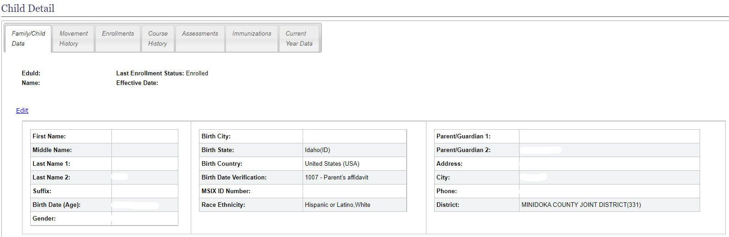
Family/Child Data
There is a lot of information on this tab:
Information for contacting the family
Information on the student, including EDUID and MSIX ID

Slide 7
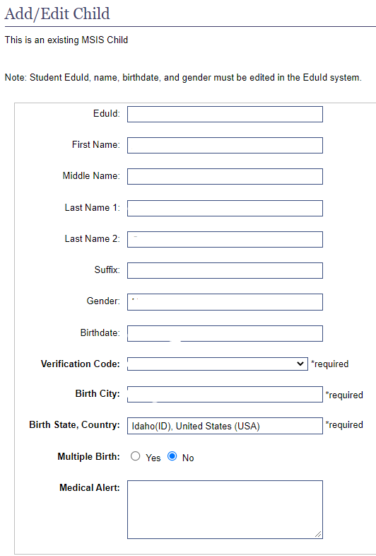
Editing Child Data
Only limited changes can be made here.
Note: Student EDUID, name, birthdates, and gender must be edited in the EDUID system by OTIS ticket and cannot be changed here.
Enter medical alerts on the immunization tab.

Slide 8
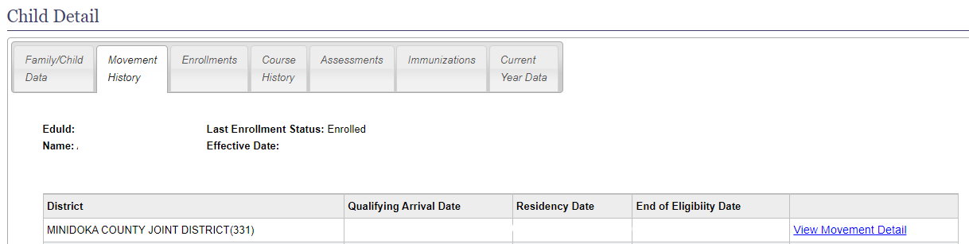
Movement History (COEs)
The Movement History allows you to see each Movement Detail, which is another way of saying Certificate of Eligibility (COE).
Click on View Movement Detail hyperlink to view this movement.
This is where to correct an address, print a COE in English or Spanish, or view the electronic COE.

Slide 9
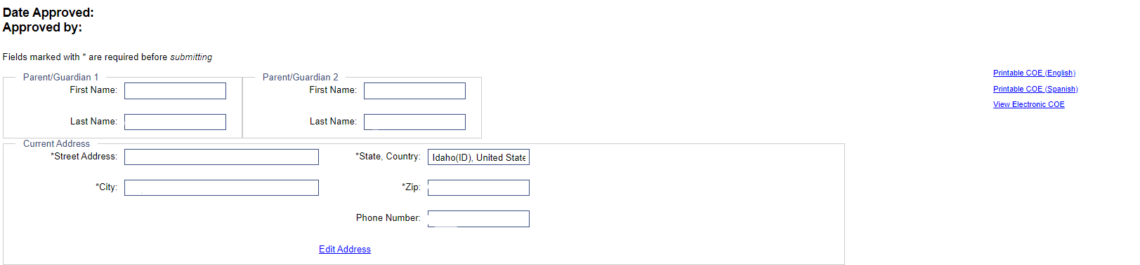
Movement Detail
Within the Movement Detail are
Edit Address
Printable COEs in English or Spanish
View Electronic COE

Slide 10
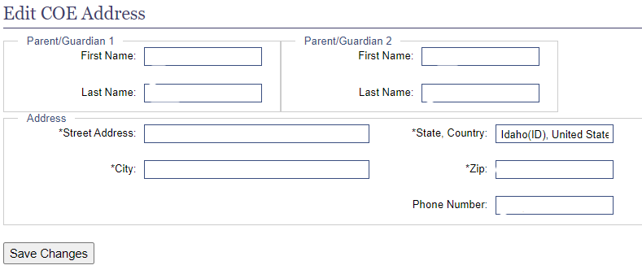
Edit COE Address
Parent Guardian Names cannot be changed
Address and phone number can be changed
Don’t forget to SAVE!

Slide 11
Enrollment
School enrollment information for Idaho schools (including prior to, during, and after eligibility in the MEP)
Includes Enrollment dates, grade level and EL status

Slide 12
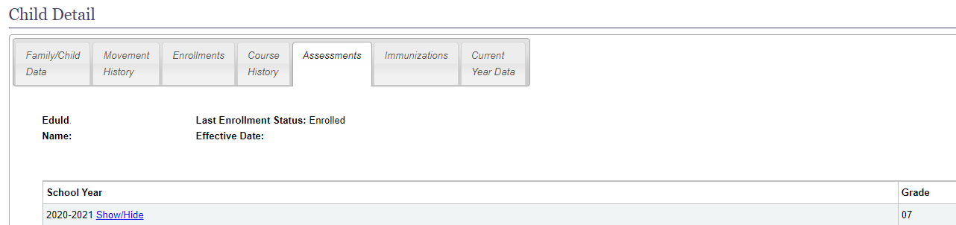
State Assessments
All state assessment scores are available.
Use Show/Hide to open and close each year’s assessment scores

Slide 13
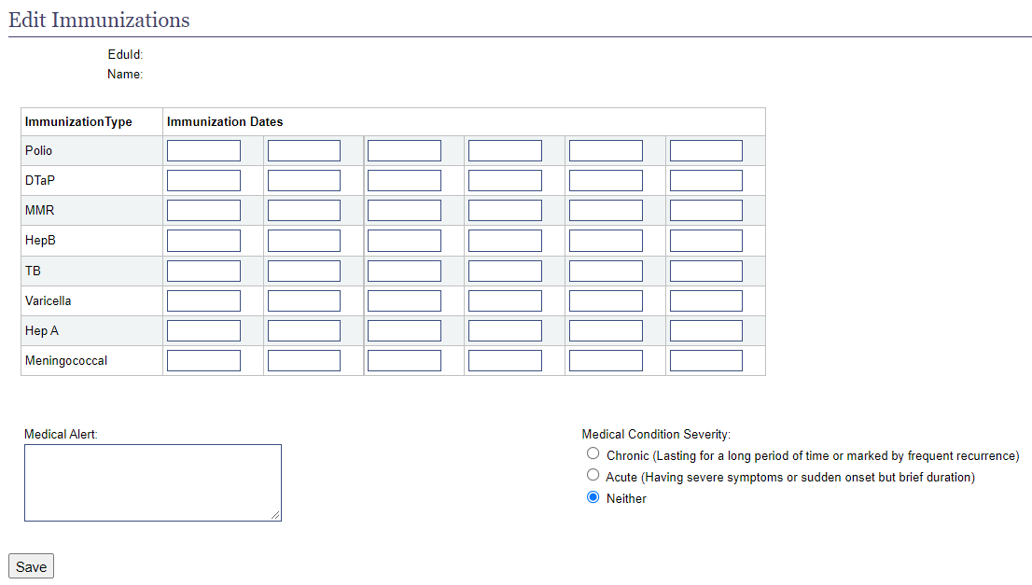
Immunizations
Click on edit and enter dates or a Medical Alert
Record immunizations dates. This should be updated at the student receives additional vaccines.
If the student has a Medical Alert (e.g. peanut allergy), also enter the Condition Severity.

Slide 14
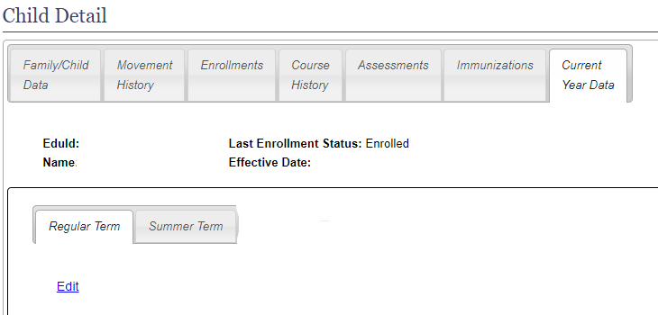
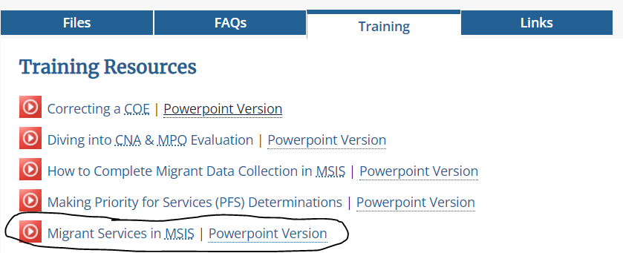
Current Year Data
For more detailed information on how to correctly record services, visit our website at https://www.sde.idaho.gov/federal-programs/migrant/index.html
Use the Current Year Data tab to enter Residency Verification Dates, Summer School begin and end dates, and all services during the regular year and summer.

Slide 15
Using Reports to Accurately Report Data

Slide 16
MSIS Reports
This mini-training is only looking at reports that affect data accuracy. There are many other reports and there will be a mini-training in the future that goes over the usefulness of each report.
District Migrant Summary (Enrollment Status)
Summer School/Student Services
Bad Residency Verification Dates
District Enrollment Movement Discrepancy
Migrant Counts for Funding District Detail

Slide 17
District Migrant Summary (Enrollment Status)
This report has the potential to increase our numbers and is an easy form of ID&R.
Once you have run the report, click on Data and then Filter
Select the down arrow next to Enrollment Status and unselect everything except “Left District.”
Every student on the report is still eligible and does NOT have a newer COE in another district.
Look up each student in MSIS and look at the Enrollment tab:
  If showing in another district, create an MSIX Move Notice to inform them
  If showing in your own district, attempt to requalify and remove “Left District” and date
Notes:
We are missing a lot of students because they are marked as Left District and are STILL IN IDAHO! Never mark students as Left District if they still live in your district, even if they go to a school in another district, an independent charter, or have dropped out. If the residence address is within your district borders, they haven’t left!
When I look at a student and see enrollments in 6 districts in 4 years and only 1 district has done a COE we have a problem.
The District/School column shows you the district # and school # where the student is currently attending.

Slide 18
Summer Services/Student Services
Summer Services and Student Services give you information on who received services. (See the last mini-training for more on how to correctly report services.)
Check these reports for completeness as all services we report come from here.

Slide 19
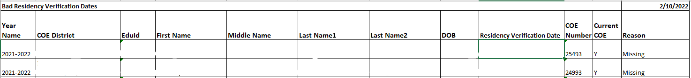
Bad Residency Verification Dates
Residency Verification Dates are critical! It is so easy to enter a date that won’t work.
This report will show you if you entered any dates that are invalid for counting that student. It also tells you why it is invalid.
If the date is the only one you can use, leave it as is. If there are other dates, select one that works.

Slide 20
District Enrollment Movement Discrepancy
This report shows where a student is enrolled versus who holds the current COE.
If the student is attending another district, verify that he/she is not still living in your district and if not, create an MSIX Move Notice to the new district.
If the student is attending your district, but another district has the COE, contact the family to see if they have moved into your district, and attempt to requalify the children.
When to run this report: After each ISEE upload in October, November, March, May, July (summer).

Slide 21
Migrant Counts for Funding District Detail
This report will give you the students will be funded on. It is a good way to check your numbers for “reasonableness,” an important part of data quality.
Be sure to check Enrolled, Not Enrolled, PFS, and summer services.

Slide 22

Questions?
Sarah Seamount | Migrant Education Coordinator
Idaho State Department of Education
650 W State Street, Boise, ID 83702
208.332.6958
sseamount@sde.idaho.gov
www.sde.idaho.gov/federal-programs/migrant
Julissa Lara | Migrant Education Program Specialist
Idaho State Department of Education
650 W State Street, Boise, ID 83702
208.332.6907
jlara@sde.idaho.gov
www.sde.idaho.gov/federal-programs/migrant
Tania Scurtu| Migrant Education Admin. Asst.
Idaho State Department of Education
650 W State Street, Boise, ID 83702
208.332.6928
tscurtu@sde.idaho.gov
www.sde.idaho.gov/federal-programs/migrant

