Slide 1
IASBO Workshop
Finance
Aaron McCoy
Public School Finance

Slide 2

Public School Finance
Data Acquisition Calendar
Instructional Calendars
IFARMS
Tuition Rates
School Building Maintenance
Continuous Improvement Reimbursement
Other State Funding on Line 6 of the Foundation Program Calculation Worksheet
Indirect Costs

Slide 3
Data Acquisition Calendar
2022-2023 Data Acquisition Calendar is available online at: http://www.sde.idaho.gov/finance/
List of reports due to the Idaho State Department of Education
  Broken out by month
  Due Dates and who to contact with questions
  Why the report is required
Typically posted in July (updated continuously)
Review the Data Acquisition Calendar often for items due (prior to school year, monthly)

Slide 4
Instructional Calendars
Idaho Code 33-512

Slide 5
Instructional Calendars
What are instructional calendars?
Listing of instructional hours by grade grouping and building numbers
Required by Idaho Code 33-512, requires minimum hours of instruction per grade level
Kindergarten 450 instructional hours
Grades 1 - 3 810 instructional hours
Grades 4 - 8 900 instructional hours
Grades 9 - 11 990 instructional hours
Grade 12 979 instructional hours
Alternative 900 instructional hours
Calendar forms are based on grade groupings when determining minimum instructional hours.
Please try to condense school calendars as much as possible

Slide 6
Calendars - Example of a Calendar
  Based on feedback from school staff, form was revised in 2022-2023 School year.

Slide 7
Calendars - Calculation of Instructional Hours

Slide 8
Calendars - Calculation of Instructional Hours
For Calendar purposes, ANY deviation from your regular day of instruction is considered a shortened session and should be marked on your calendar
All shortened days or staff development days should be listed in the grid at the bottom of the calendar form

Slide 9
Calendars - Calculation of Instructional Hours

Slide 10

Calendars – Reduction in Hours
Grade 12 Students:
Instructional Hours may be reduced for Grade 12 Students
Up to 11 hours for grade 12 students ONLY
  Many schools end the school year earlier for grade 12 students
  If your school elects to reduce the amount of instructional time for grade 12 students, a separate calendar must be completed for grade 12

Slide 11
Calendars - Reduction in Hours
STAFF DEVELOPMENT:
Up to 22 hours for actual qualified staff development activities (11 hours for kindergarten)
  Staff development is time set aside for the training of teachers to allow for the development of teaching skills
  Staff development hours are not limited to the length of the “normal” school day and may occur prior to the first day and after the last day of school for students
  You can have as many staff development hours as you want, but only 22 hours count as instructional time (11 hours for kindergarten)
  Not considered to be staff development activities: Teacher prep days, work days, parent teacher conferences, and mentor time

Slide 12

Calendars - Reduction in Hours
Emergency Closures
Up to a total of 11 hours for emergency school closures.
  Must be due to adverse weather conditions and facility failures
For instructional hour purposes only, a closure due to widespread sickness is not a qualified emergency closure
Submit the Certificate of Closure as your closures occur with a copy of your board minutes approving the emergency closure
  Emergency Closure form can be found under Calendars, School Calendar Forms on the School Finance website
  Please submit form to Dean Reich, dreich@sde.Idaho.gov

Slide 13
Calendars - Emergency Closures

Slide 14
Instructional Calendars
Required by Idaho Code 33-512, requires minimum hours of instruction per grade level
Calendar forms and a Manual are available on the SDE website at: www.sde.idaho.gov/finance/ under Calendars
  2023-2024 calendar forms will be available in the spring
  Schools will be notified via email when posted
Include a copy of the patron school calendar with your forms
Due to School Finance by May 31st for the 2023-2024 school year
  Notify School Finance of changes as they occur (any closure or deviation from original calendars)
Call or email Morgan Phillips at (208) 332-6840 with changes or questions, mphillips@sde.idaho.gov
  Please also submit emergency closures to Dean Reich, dreich@sde.idaho.gov

Slide 15
Calendars - Summary
Before submitting, check the following:
Instructional hour requirement has been fully satisfied
Build in a buffer to allow for any closures during the school year
Contact information completed
Condense school calendars as much as possible
Include patron calendar when submitting

Slide 16
IFARMS
Idaho Code 33-701(7)

Slide 17
IFARMS - General Information
Idaho Financial Accounting Reporting Management System (IFARMS)
  Allows for the reporting of uniform, consistent data among schools
Accounting system should be able to incorporate the IFARMS chart of accounts
  Every revenue has a fund number and account code tied to it
  Every expenditure has a fund number, function code, and subobject code tied to it
IFARMS Manual is available on the School Finance website under Financial Information & Manuals
Please setup funds according to the IFARMS Chart of Accounts

Slide 18
IFARMS - Chart of Accounts

Slide 19
Recent changes to the Chart of Accounts
Fund 238 designated for the reporting of Student Activity program
Function Code 740 – Student Activity Program
ESSER Funds 250, 252, 254, 259
  For specifics, please contact Brian Butkus, 208-332-6900
Upcoming Additions:
  Function Code for Books and Periodicals
Notes:
GASB 84, Effective Dec 15, 2019

Slide 20
IFARMS - Annual Financial Report
IFARMS Annual Financial Report
Summary of revenue/expenditures/balance sheet activity
FY 2023 Report due by October 31st
Report must be submitted via an ISEE upload
Early submission is greatly appreciated!
  Do not submit your annual report until all adjusting/closing entries have been completed
When Submitting Your Annual Report:
Reconcile your annual and audit report data prior to submitting
  Compare beginning and ending fund balances by fund
  Compare revenues and expenditures by fund
  Compare balance sheet information by fund
  Must use valid Balance Sheet Codes, Revenue Codes, and Fund Number/Function Program/Object Codes
  Reasonableness check

Slide 21
IFARMS - Audit Reports
Audit Report (IC 33-701(6))
FY 2023 Reports are due by November 10th
  November 15th payment will be delayed if audit report is not received by due date
Please submit as a PDF
Please do include the Combining Statement of Revenues/Expenditures (listing of non-major funds)
We will forward a copy to Legislative Services-Audits and to the Charter Commission (if applicable)
Early submission is greatly appreciated!

Slide 22
IFARMS - Audit Reports
In FY 2023, the State Department of Education received an audit finding from the Idaho Legislative Services Office due to lack of monitoring on Public School data. This finding was related to attendance, staffing and financial data submitted through ISEE.
NEW!
Audit reports for FY 2023
Letter of assurance will be sent to all auditors of Idaho Public Schools. This letter will outline the expectations for the public school auditors.
Draft language is currently being developed
April – will send out a notification requesting who will perform your audit and their information
Letter of assurance will be between the Auditor and the State Department of Education

Slide 23
IFARMS - Comparison of Annual and Audit Reports
Once we have both your annual and audit reports, we:
Compare the IFARMS annual report balance sheet, revenue, expenditure, and fund balance data to the audit report fund by fund
  May recode some funds
    For example, we would reclassify State LEP Fund 242 to the General Fund 100
If there are differences, we will contact you for an explanation
Upon completion of our review, we will re-upload into ISEE
  you will need to “approve” changes made to your data during the School Finance reconciliation process and certify the report in ISEE.

Slide 24
IFARMS - How the Data is Used
Financial Data From the Districts and Charters:
Generates the Financial Summaries Report
Used to generate the Fiscal Report that will be part of each school’s report card
Used to complete Federal Surveys
  Ranks Idaho’s educational spending as compared to other states
  Allocates Title I dollars to the State of Idaho

Slide 25
IFARMS - How the Data is Used, cont.
Financial Data From the Districts and Charters, continued:
Basis for determining in-state and out-of-state tuition rates
  Used in the calculation of several of the tuition equivalencies
Used by SOPI’s Special Education and Child Nutrition staff
Basis for calculating Indirect Cost Rates
Basis for determining Maintenance of Effort
Legislative inquiries (IC 33-1028)
A lot of public inquiries

Slide 26
IFARMS – Financial Summaries
Available once all audit reports and annual reports have been reconciled
Will be posted on the SDE – School Finance webpage
Comprehensive analysis between all Idaho public schools
Also provides a one-page document summarizing revenues and expenditures by major fund category, for each individual district or charter school
Prior year files available for additional analysis

Slide 27
IFARMS - Example of a Summary Page

Slide 28
IFARMS - Summary
It is very important you use the correct fund numbers, revenue codes, and function/program codes when recording your financial activity
Call if you are unsure how to code a transaction
ESSA requires school-level reporting of expenditures
Make sure you have a mechanism to report expenditures by building level

Slide 29
Financial Transparency
Idaho Code 33-357

Slide 30
Financial Transparency
FY 2021 - House Bill 73 was passed
  Modified Idaho Code 33-357
  Changed how schools display their financial data
  Before
    Posted Expenditures monthly on their own website
  After
    LEA’s will submit a quarterly transactional report to the Office of the State Board of Education (OSBE).
    The report will contain expenditures, revenues, and the accompanying general ledger information
    SCO will make the data received from OSBE available to the public on the Transparent Idaho website.
    LEAs will be provided a link to the SCO hosted expenditures to add to their websites rather than having to format and post the data as you currently are.

Slide 31
Financial Transparency
  Questions? Contact:
  Idaho State Board of Education
  ISEE Data Collection Regional Coordinator
  Todd King –Education Data Systems Reporting Manager
  Amy Sigler –Region 1-3 ISEE Technology Coordinator
  Roger Evans –Region 4-6 ISEE Technology
  regionalcoordinators@sde.idaho.gov
  State Controllers Office
  John Iasonides –Deputy Controller of Administration Division
  Heath Ribordy –Project Coordinator SR Tina Fuller –Business Analyst
  Tina Fuller –Business Analyst
  registry@sco.idaho.gov

Slide 32
Tuition Rates
Idaho Code 33-1405

Slide 33
Tuition Rates - General Information
We will be calculating 2023-2024 tuition rates this spring using your 2021-2022 financial data
Idaho Code 33-1405 requires out-of-state student tuition be charged to those students whose “home” district is outside of Idaho
  Can request a waiver from the State Board of Education for any portion of the tuition rate
  Waiver must be submitted before April 1

Slide 34
Tuition Rates - Example of Tuition Rates

Slide 35
Tuition Rates - Questions to Ask
Is the student from “without” the state of Idaho?
  IC 33-1405 requires that the gross Monthly Per Capita rate be charged to all students attending an Idaho public school…unless a waiver has been granted from the SBOE
    Waiver requests must be submitted before April 1 of the year prior to the waiver’s effective date
Questions to ask for incoming students:
  Is the student home-schooled or attending a non-public school?
  Is the student enrolled at another Idaho public school?
  If the student is a resident of your district, no tuition should be charged
  Be cautious if a student says they are being home-schooled. Students should also be asked if they are enrolled in or attending an online charter school.

Slide 36
Tuition Rates - Which Rate to Use When
Which Rate to Use When
Monthly Per Capita Rate (overall cost of attendance)
  Must use if student is from outside Idaho (unless you have received a waiver from the SBOE)
  Use if an Idaho student from another district is attending your schools and no attendance is being reported
Monthly Per Capita State Support Rate (State funding)
    May use if student is from within your district but is enrolled at another school and no attendance is being reported by your district (examples: dually enrolled/home schooled/private schooled)
Net Monthly Tuition Rate (Local funding)
  May use if student is from another Idaho district and you are reporting attendance
*If electing to charge tuition, please make sure you have an internal policy on the enforcement and collection of tuition. Consult with your legal council.

Slide 37
School Building Maintenance
Idaho Code 33-1019

Slide 38
School Building Maintenance - General Information
Idaho Code 33-1019
Must comply if you own your school building(s) or are purchasing a building(s) via a lease-purchase agreement
  N/A if you are leasing all of your buildings
If you are buying your building(s)…
  Must allocate or spend at least 2% of the replacement value of your student-occupied buildings for qualifying maintenance and repairs
Replacement value = total square footage of student-occupied school buildings x $81.45 replacement value (for FY 2023)
Funding provided for SBM provided through the Lottery distribution and additional state match.
  Funding must remained purposed for the repairs and maintenance of student occupied buildings.
  If the full 2% allocation is not spent, the unspent dollars must be reserved for future years

Slide 39
School Building Maintenance - Excess Expenditures
Excess Expenditures
  “Excess” expenditures may be carried forward in certain circumstances
  Expenditures exceeding 4% of the replacement value of school buildings (4% “floor”) may be carried forward for up to 15 years and may be used to reduce future year allocations
  Expenditures greater than the required allocation but less than the 4% floor may be used to reduce prior year unexpended allocations that have been carried forward

Slide 40
School Building Maintenance - School
Building Maintenance Report
School Building Maintenance Report
  Officially Due the 3rd Friday in December
    Financial data is pulled from your annual report, which may delay SDE from sending you your report; due dates will vary
  SBM report includes:
    Square footage of student-occupied school building floor space (SDE will complete)
      Square footage information is collected each summer for the upcoming school year
      Exclude the square footage of owned student-occupied buildings less than one year old on the first day of school
    The funds and fund sources allocated for school building maintenance and any unexpended allocations carried forward from prior fiscal years
    Projects on which moneys were expended
    The planned uses for school building maintenance allocation

Slide 41
School Building Maintenance - Coding of Expenditures
Coding of Expenditures
  Qualifying expenditures should be coded to Function Codes 664 and 810
    Function Code 664 – Maintenance – Student Occupied Buildings
    Function Code 810 – Capital Assets – Student Occupied Buildings (Qualifying Expenditures)
  Non-qualifying repairs and maintenance expenditures and non-qualifying capital asset activities should be coded using Function Codes 663 and 811
    Function Code 663 – Maintenance – Non-Student Occupied
    Function Code 811 – Capital Assets – Non-Student Occupied (& Student Occupied Non-Qualifying Expenditures)

Slide 42
School Building Maintenance - Examples of Non-Qualifying Expenditures
Maintenance and/or Repairs for Serious or Imminent Safety Hazards on the Property
  Maintenance and/or repairs outside the building must be formally declared serious or imminent safety hazards (Idaho Code 39-8004) by the Division of Building Safety to be qualifying expenditures
  Think you have a serious or imminent safety hazard? Call the Division of Building Safety at (208) 334-3950

Slide 43
School Building Maintenance - Summary
In Summary…
  You must allocate (not deposit) an amount equal to 2% of the replacement value of school buildings for qualifying school maintenance and repairs
  If qualifying school maintenance and repair expenditures don’t equal the required allocation, the difference must remain allocated for the purposes of IC 33-1019(3)
  Consider using Fund 240 or Fund 430 to carry-forward unspent maintenance dollars

Slide 44
Continuous Improvement Reimbursement
Idaho Code 33-320, IDAPA 08.02.01.801

Slide 45
Continuous Improvement Reimbursement
- General Information
Each school district and charter school is allowed to request reimbursement for up to $6,600 in allowable training costs in FY 2023
  Training must be for superintendents/charter school administrators and boards of trustees/directors in the areas of continuous improvement, strategic planning, finance, administrator evaluation, ethics and/or governance
  Must use a qualified training provider as identified by the State Board of Education
  Travel may be requested but is limited to eligible attendees and reimbursement is based on schools internal policy.
Guidance and the FY 2023 Reimbursement Request form was emailed to schools on July 1 and October 18
Requests must be submitted in the same fiscal year
Per Idaho Code 33-320 and IDAPA 08.02.01.801

Slide 46
Other State Funding – Line 6
Idaho Code 33-2004, 33-1002B, 33-2005

Slide 47
Other State Funding

Slide 48
Other State Funding - Types of Funding
Line 6 funding may include:
  District to Agency Contracts
  Special Education/Exceptional Child Tuition Equivalency
  Court-Ordered Tuition Equivalency
  Juvenile Detention Center Tuition Equivalency
  Summer Juvenile Detention Center Tuition Equivalency
  Serious Emotional Disturbance (SED) Allowance

Slide 49
Other State Funding - District to Agency Contracts
District to Agency Contracts
  Idaho Code 33-2004
  Received when a district contracts with a public or private agency to educate exceptional students
  Payment:
    Best 28 Weeks ADA
    x Prior Year Per Pupil State Support
    = District to Agency Contract Payment
  In FY 2022, $102,762 was paid to two districts

Slide 50
Other State Funding - District to Agency Contracts, cont.
District to Agency Contracts
  So you have qualifying kids, now what?
    Contact SOPI’s Special Education staff (Lisa Pofelski Rosa, (208) 332-6916)
  Specific forms must be completed (available online)
  School Finance pulls the attendance data needed from your ISEE data submissions

Slide 51
Other State Funding - Special Ed/Exceptional Child Tuition Equivalency
Special Ed/Exceptional Child Tuition Equivalency
  Idaho Code 33-1002B(3)
  Received when a district is educating a student who:
  1) is on their fall Special Education child count
  2) resides in a licensed facility due to the nature and severity of the disability; and
  3) whose parents live in another Idaho district
  Paid with the February 15th payment
  7 districts were paid $814,694 in FY 2022

Slide 52
Other State Funding - Special Ed/Exceptional Child Tuition Equivalency, cont.
Special Ed/Exceptional Child Tuition Equivalency
So you have qualifying kids, now what?
  Work with SOPI’s Special Education staff (Lisa Pofelski Rosa, (208) 332-6916)
Special Ed has an application available online that must be completed (students are listed individually)
Special Ed reviews the application and verifies that students listed are on the fall child count
  Summarized list showing the number of qualifying students by district is then sent to School Finance

Slide 53
Other State Funding - Court-Ordered
Tuition Equivalency - General Info
Court-Ordered Tuition Equivalency
  Idaho Code 33-1002B(1)
  Received when a district/charter educates students placed into a licensed home or facility by an Idaho court order
  $1,648,224 paid to 70 districts/charter in FY 2022

Slide 54
Other State Funding - Court-Ordered
Tuition Equivalency - Payment
Court-Ordered Tuition Equivalency
  To receive payment, a district/charter must submit the court-ordered tuition equivalency form
  The form will be emailed to districts and charters in the spring
    The form must include the number of days present for each student while in foster care, their grade level, and the name of the home or facility
  The form should be returned AFTER the last day of school or after the eligible child(ren) is no longer living in the licensed home or facility
  Forms returned prior to the last day of school showing perfect attendance through the end of the school year will be returned

Slide 55
Other State Funding - Court-Ordered
Tuition Equivalency - Calculation
Court-Ordered Tuition Equivalency
  Once School Finance has received the completed form, we…
    Calculate the total days of attendance for elementary students
    Calculate the total days of attendance for secondary students
    Multiply the total number of attendance days by the applicable elementary or secondary prior year’s daily tuition rate
    Daily rate = 42% of the gross monthly tuition rate divided by 20 days (16 days for 4-day week schools)

Slide 56
Other State Funding - Court-Ordered
Tuition Equivalency - Payment, cont.
Court-Ordered Tuition Equivalency
  Talk to your school counselors
  Summary reports from Health & Welfare showing foster children in Idaho are posted to SOPI’s secure website several times a year (January, April, June)
    Contact your regional Health and Welfare office with questions regarding the data shown on the report
  Paid with the July 15th payment
  Funding is in addition to the regular support-unit funding for these students

Slide 57
Other State Funding - Juvenile Detention Center Tuition Equivalency
Juvenile Detention Center Tuition Equivalency
  Idaho Code 33-1002B(2)
  Received when a district educates students placed into a juvenile detention facility by an Idaho court order
  Attendance information is pulled from your ISEE submissions (no data, no payment)
  Calculation is very similar to the Court-Ordered Tuition Equivalency calculation
  $330,251 paid for the 2021-2022 school year; $20,822 paid for the 2021 summer session

Slide 58
Other State Funding - Serious Emotional Disturbances (SED) Allowance – General Info
Serious Emotional Disturbances Allowances (SED)
  Idaho Code 33-2005
  Received when a district/charter is educating a higher than average percentage of SED students
  To receive an SED payment, a district or charter needs only to submit an accurate fall child count to the Special Education staff (Lisa Pofelski-Rosa, (208) 332-6916)
  58 districts/charters received $2,978,943 in FY 2022

Slide 59
Other State Funding - Serious Emotional Disturbances (SED) Allowance - Calculation
Serious Emotional Disturbances Allowances (SED)
  Total SED students statewide (from the fall child count)/Total statewide enrollment = Statewide SED percentage
  That percentage is then multiplied by the district/charter’s enrollment to determine the expected number of SED students for that district/charter
  If the actual number of SED students at the district/charter is higher than the “expected” number of SED students, the “excess” is multiplied by the prior year’s excess cost rate

Slide 60
Other State Funding - Serious Emotional Disturbances (SED) Allowance – Calculation, cont.

Slide 61
Other State Funding - 2022-2023 Budget Worksheet

Slide 62
Indirect Cost Rates

Slide 63
Indirect Cost Rates - General Information
An indirect cost rate allows a school to recover some costs incurred to run Federal programs that are difficult to charge directly to the grant
Indirect costs are generally those costs not readily identifiable with the activities of the grant but are incurred for the joint benefit of those activities and other activities of the organization (payroll, utilities, etc.)
Indirect cost rate is applied to the direct cost amount expended, not the grant award
If you elect to charge indirect, you must request a rate from the State Department of Education

Slide 64
Indirect Cost Rates - General Information, cont.
Unallowed/Excluded costs include:
  General governance, bad debts, fines
  Capital outlay, debt service, judgments against the school, food service expenditures
Restricted Rates
  Used for grants with supplement-not-supplant provisions
  Calculation includes general management costs for:
    Accounting, Payroll, HR
  Excludes governing costs, CEO, CFO, etc.
Unrestricted
  Includes expenditures for operations and maintenance of plant and district administration

Slide 65
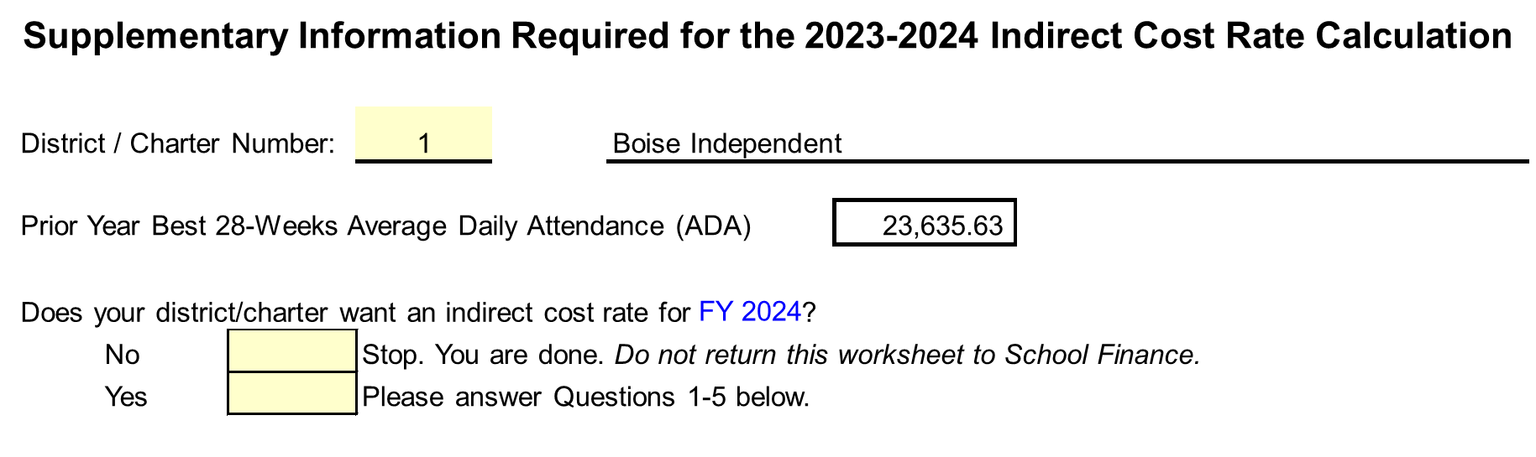
Indirect Cost Rates - Calculation
Example of FY 2024 Calculation Worksheet

Slide 66
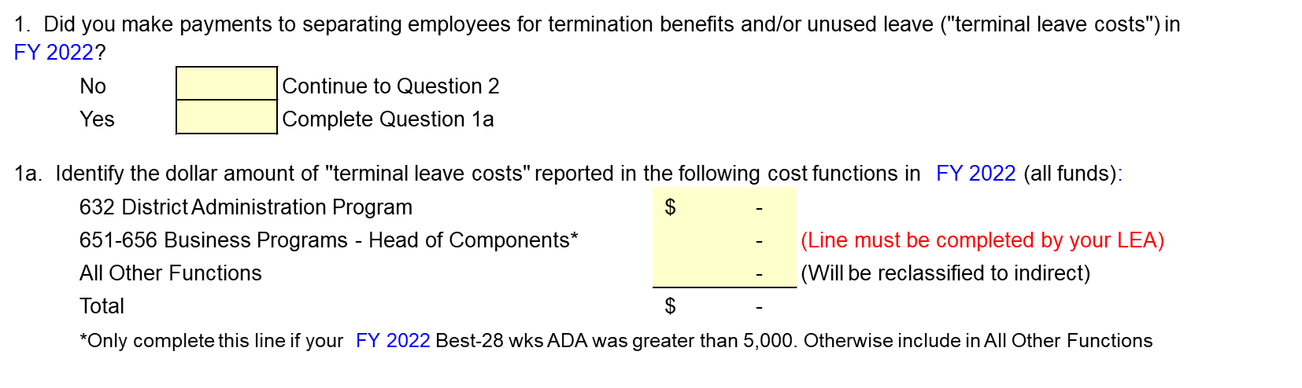
Indirect Cost Rates - Termination Benefits
Terminal Leave Costs
  Payments to separating employees for unused leave are chargeable only as indirect costs
    Not allowed as direct costs
  Will be captured as an indirect cost

Slide 67
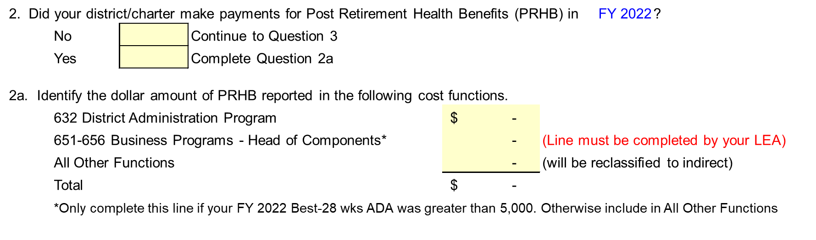
Indirect Cost Rates - Post Retirement
Health Benefits (PRHB)
PRHB = Post Retirement Health Benefits
  Example: district provided benefits to its retirees (medical, dental, etc.)

Slide 68
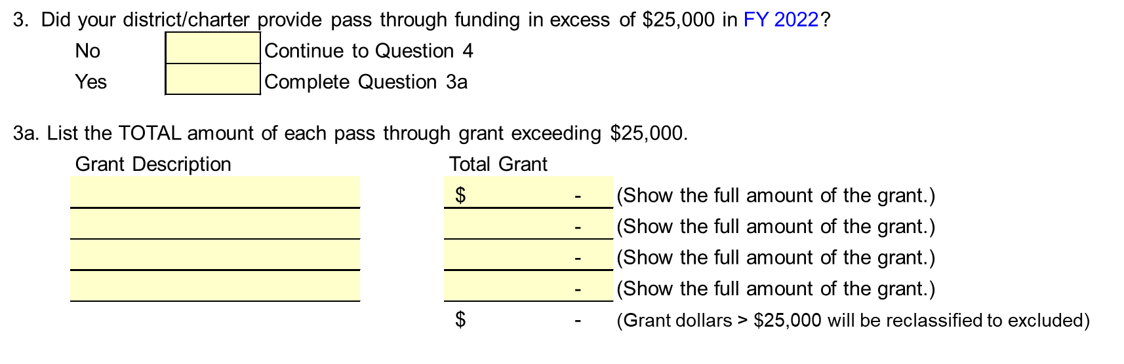
Indirect Cost Rates - Subawards, cont.
  Subawards, continued

Slide 69
Indirect Cost Rates - Subawards
Subawards
  What is a subaward?
    An award provided by a pass-through entity to a subrecipient
    Examples include subgrants and subcontracts
      Does not include payments for goods and services
      Contracting with another entity to provide services instead of you providing those services
        You receive federal funding to provide a summer reading program and you then contract with another entity to provide that program
  Only the first $25,000 of each subcontract should be included in the indirect cost calculation
  Per 2 CFR 200.92
    Subaward means an award provided by a pass-through entity to a subrecipient for the subrecipient to carry out part of a Federal award received by the pass-through entity. It does not include payments to a contractor or payments to an individual that is a beneficiary of a Federal program. A subaward may be provided through any form of legal agreement, including an agreement that the pass-through entity considers a contract.

Slide 70
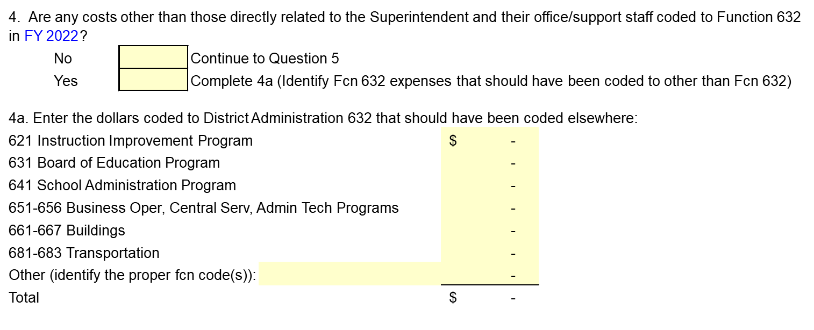
Indirect Cost Rates - Function 632 –
District Admin Program
  Function Code 632 - Superintendent Related Costs
  Complete only if you have been coding Business Operations 651, Central Services 655 and/or Admin Tech 656 expenditures to District Admin 632

Slide 71
Indirect Cost Rates - Head of Component
  Who is a Head of Component?
    Generally organizational units one management level below the executive office
    Examples would include a CFO or Director of Business Operations type position that has a business manager or accountant overseeing the day-to-day accounting functions
  Only applicable to those with a Best-28 Week ADA > 5,000

Slide 72
Indirect Cost Rates - Summary
The Indirect Cost Plan is available on the School Finance website
2023-2024 Indirect Cost email was sent February 21st

Slide 73
Public School Finance - Staff
Contacts:
Julie Oberle, CFO (208) 332-6840 jaoberle@sde.idaho.gov
Aaron McCoy (IFARMS) (208) 332-6846 amcCoy@sde.idaho.gov
Branwyn Phillips (Staffing) (208) 332-6875 bcphillips@sde.idaho.gov
Dean Reich (Attendance) (208) 332-6983 dreich@sde.idaho.gov
Carol Piranfar (Budgets) (208) 332-6844 clpiranfar@sde.idaho.gov
Tania Goretoy (208) 332-6841 tgoretoy@sde.idaho.gov
Morgan Phillips (208) 332-6840 mphillips@sde.idaho.gov
FAX (208) 334-2228
Web Site:
Idaho State Department of Education, School Finance http://www.sde.idaho.gov/finance/
Idaho State Department of Education: www.sde.idaho.gov/

Slide 74
Questions
Aaron McCoy | Financial Specialist, Sr.
Idaho State Department of Education
650 W State Street, Boise, ID 83702
208.332.6800
amccoy@sde.idaho.gov
www.sde.idaho.gov

