Slide 1
Public School Finance 101
Idaho Association of School Business Officials

Slide 2
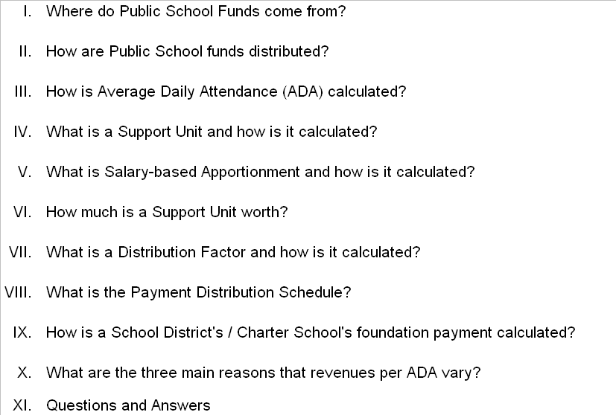
Public School Finance

Slide 3
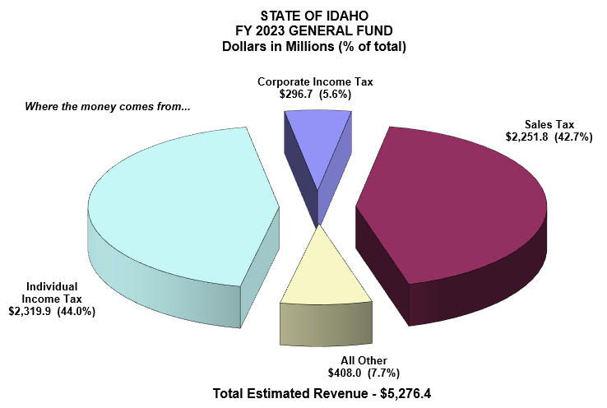
State of Idaho - FY 2023 General Fund

Slide 4
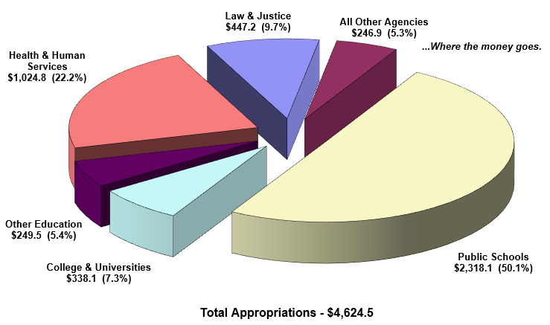
State of Idaho - FY 2023 Appropriations
(Other Education includes funding for Career Technical Education, Community Colleges, Ag. Research & Extension Service, Special Programs, Health Education Programs, SDE, Voc. Rehabilitation, SBOE, and Idaho Public Television)

Slide 5
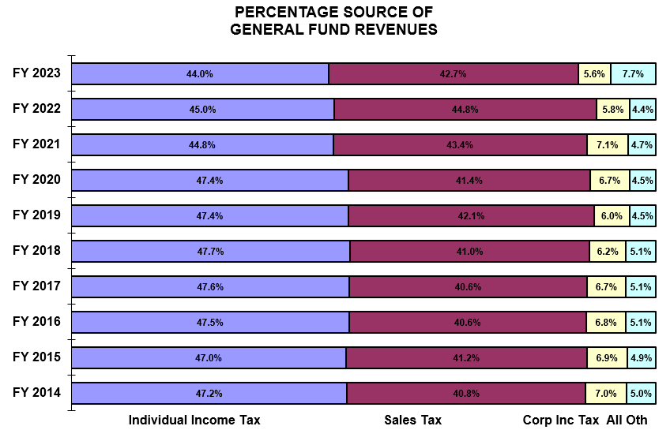
State of Idaho – Historical Revenues

Slide 6
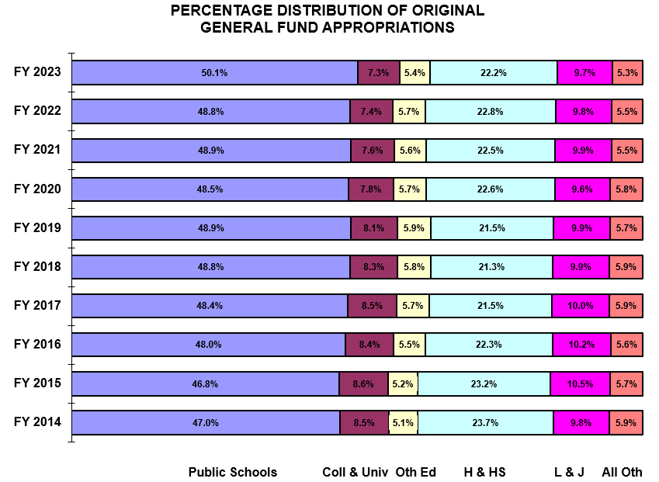
State of Idaho – Historical Appropriations

Slide 7
Pupil Accounting and Required Instructional Time – Average Daily Attendance

Slide 8
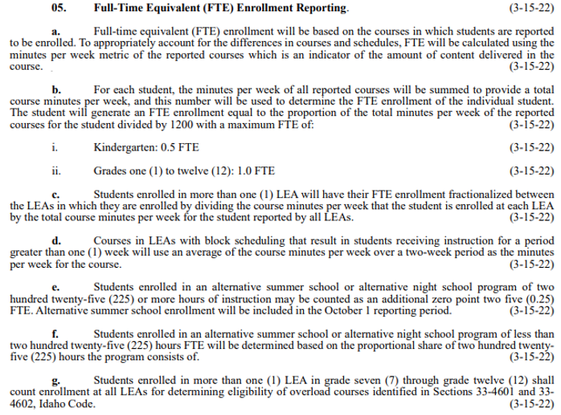
Pupil Accounting and Required Instructional Time – Full-time Equivalent Enrollment

Slide 9
Idaho Code 33-1002(4)

Slide 10
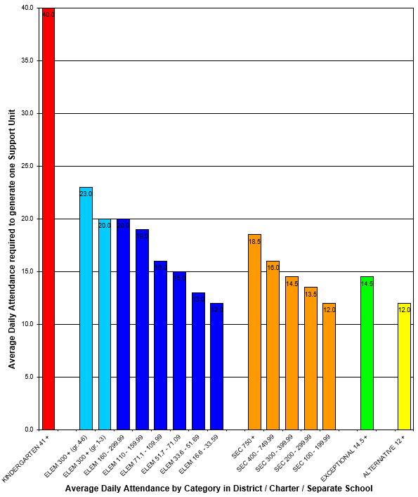
Support Units
Each bar equals 1 Support Unit of funding

Slide 11
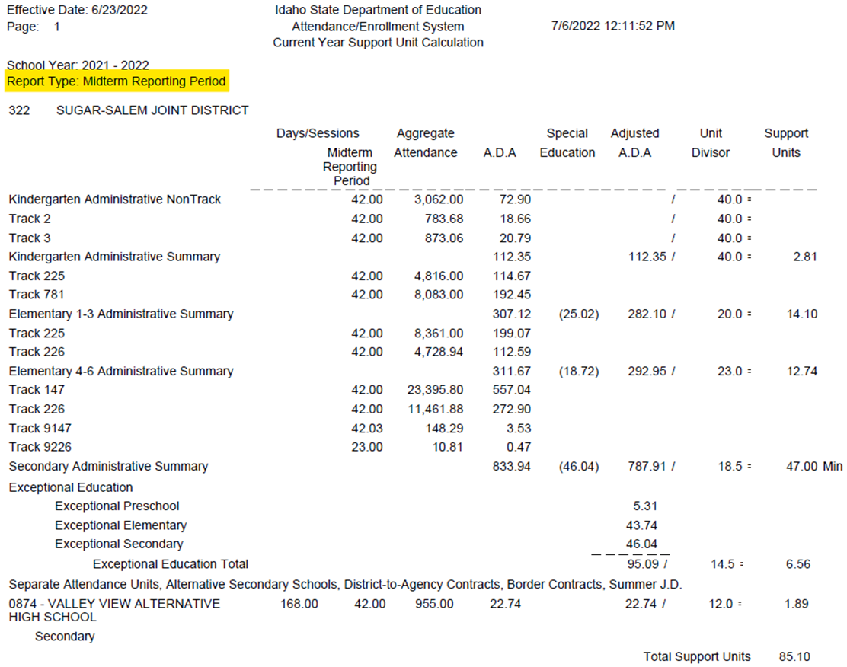
Midterm Reporting Period

Slide 12
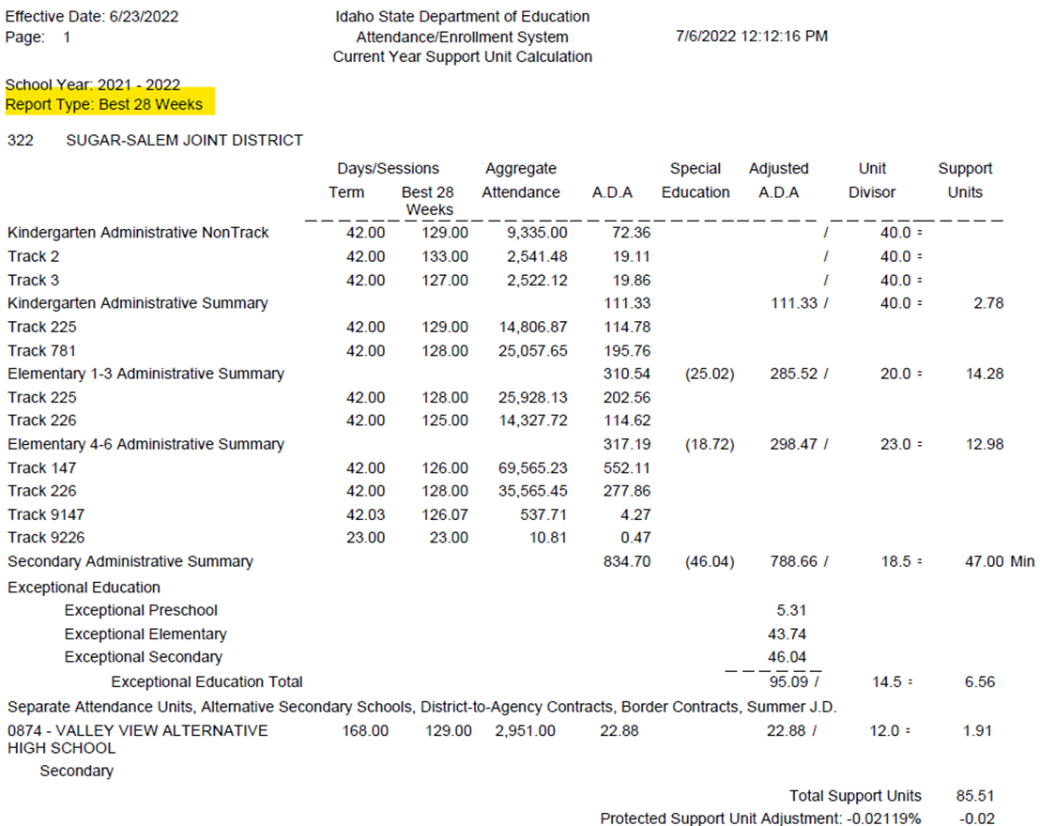
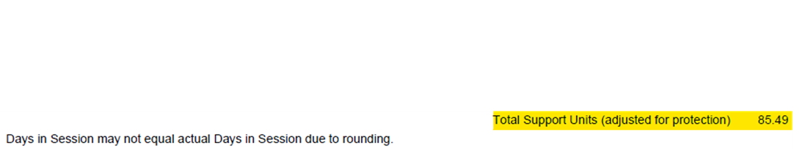
Best 28 Weeks Reporting Period

Slide 13
Idaho Code 33-1004A – Experience & Education Multiplier

Slide 14
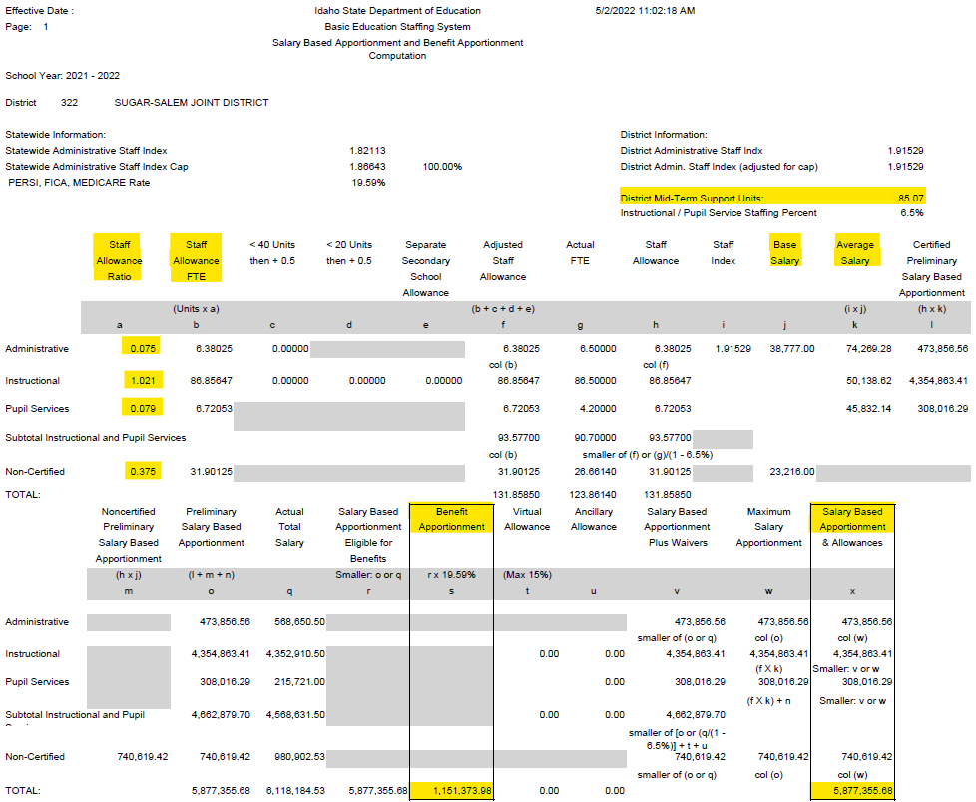
Salary-based & Benefit Apportionment Calculation

Slide 15
Estimated Statewide Support Unit Value

Slide 16
Public School Foundation Program Appropriation

Slide 17
FY 2023 Distribution Schedule - Idaho Code 33-1009

Slide 18
Foundation Program Calculation – July 15, 2022

Slide 19
Public School Finance Contacts
Julie Oberle (208) 332-6840 JAOberle@sde.idaho.gov
Branwyn Phillips (Staffing) (208) 332-6875 BCPhillips@sde.idaho.gov
Dean Reich (Attendance) (208) 332-6983 DReich@sde.idaho.gov
Aaron McCoy (IFARMS) (208) 332-6846 AMcCoy@sde.idaho.gov
Carol Piranfar (Budgets) (208) 332-6844 CLPiranfar@sde.idaho.gov
Morgan Phillips (208) 332-6840 MPhillips@sde.idaho.gov
Tania Goretoy (208) 332-6841 TGoretoy@sde.idaho.gov
FAX (208) 334-2228
Web Site:
Idaho State Department of Education, School Finance
www.sde.idaho.gov/finance/index.html
Idaho State Department of Education
www.sde.idaho.gov/

Slide 20
Questions?
Julie Oberle | Public School Finance
Idaho State Department of Education
650 W State Street, Boise, ID 83702
208.332.6800
JAOberle@sde.idaho.gov
www.sde.idaho.gov

