Slide 1
Salary Based Apportionment and Benefit Apportionment
Branwyn Phillips
Financial Specialist, Sr.

Slide 2
Staff Reporting & Requirements
ISEE (Idaho System for Educational Excellence):
  System used by all districts & charter schools to upload data throughout the year.
  Staffing uses two of the eleven data files: Staff Demographic & Employment and Staff Assignments.
  Six data uploads are submitted during the year, see the ISEE website for the full 22-23 upload calendar.

Slide 3
Staffing Dates
Last Friday in September (September 30th, 2022)
  This is the "snapshot“ for staffing data used in funding calculations
October 15, 2022
  All staff and assignment data must be uploaded using the SRM tool
  First upload that covers period through the “snapshot” date
  The data submitted must be free of errors and validated
  No other format will be accepted (I.C. §33-1004D)
November 15, 2022
  Data submitted in this upload will automatically override the October upload for funding purposes
Friday, December 2, 2022 - Last day to submit staffing corrections automatically for the February 15, 2023 payment.
  Revisions submitted after this date may not be reflected in the February 15 payment.

Slide 4
Current Year Corrections
Corrections after December 2, 2022, must be approved by Public School Finance
  Submit a letter signed by your Superintendent or Charter Administrator stating the special circumstances that caused the need for the revision
  Include each specific data element to be corrected
  Further supporting documentation may be requested
  Corrections after Friday, March 24, 2023 may not be reflected in the May 15th payment
  Corrections after Friday, June 16, 2023 may not be reflected until a prior year correction next February 15th!
Corrected files are not automatically uploaded and will not be reflected on payments without approval of Public School Finance

Slide 5
Prior Year CLDS Corrections
CLDS has 3 correction windows now:
  1st – December 2nd through the 16th, 2022
  2nd – March 3rd through the 17th, 2023
  3rd – May 1st through June 30th, 2023
Corrections mid-year still have to be processed on our end after the window closes, which may take a few or two to show up on reports
CLDS corrections for an expiring corrections year (20-21 this year) submitted as part of the 3rd window will be processed as part of the July 15th payment
Other corrections from that window may be included in the July 15th payment, time permitting, or will be included in the following February 15th
Because of this, it is very important to make sure any 20-21 corrections submitted to CLDS during the 3rd window be triple checked as there will not be time to redo them before the year expires

Slide 6
Current Year Corrections (Cont.)
All ISEE data reported should reflect how things actually were as of the last Friday in September with these exceptions:
  Departure date/reason
  New hires – use information as of their hiring date
  New assignments – do not zero out or remove assignments active as of the snapshot date
  Additional Pay – stipends paid later in the year not anticipated at the start
  Retroactive corrections – Ex. Someone whose funding source was retroactively changed in your books

Slide 7
What Does This Data Affect?
All data submissions must reflect correct information as accurately as possible
(I.C. 33-1004D):
  Requirement to report all employees of the school district/charter school, regardless of their effect on funding!
Annual Staff Statistical Data:
    Staff salaries and staff activities are published on January 1st of each year
Professional Development Funding:
    This payment is derived from the "snapshot” staff data files using FTEs from all funds
  Salary Based Apportionment and Benefit Apportionment Funding (General Fund Only)
    Affects about 85% of a district/charter’s funding!
  Other Data Requests – Legislature, Governor, Education Associations and Other Stakeholders, Federal Reporting, National Organizations, Public Information Requests, Etc.

Slide 8
Why ALL data is important
Last year the Legislature passed a one time allocation of Federal funds of $1,000 per actual FTE regardless of funding source or position type
Classified staff do not have allocation modifiers and their actual FTEs do not go into the SBA or any current special distributions
The bill called for using the data uploads used for the February 15th payment, and was passed and signed into law after that payment was made
Several locations only found errors after they received notification of the FTEs their allocations came from, and this was especially true with classified staff
Salary Based Apportionment and Benefit Apportionment | 8

Slide 9
Why ALL data is important (cont.)
Classified staff normally have very little direct effect on funding, however their data did end up affecting it in this case
Additionally, the Office of Performance Evaluation did a study on classified staff funding when compared to actual costs recently and presented it to the Legislature this year
This would be a case where data quality at locations can affect policy for all locations
Salary Based Apportionment and Benefit Apportionment | 9

Slide 10
How Does ISEE Data Affect SBA Funding?

Slide 11
Support Units
Support Units - Foundation of how schools are funded
  Based historically on average daily attendance, but recently on enrollment
  Staffing uses midterm support units (start of school through the first Friday in November)
  Contact Dean Reich at DReich@SDE.Idaho.gov for help/questions

Slide 12
What is Salary Based Apportionment?
Salary Based Apportionment is an allocation model not a Reimbursement model
Instead, it uses averages derived from your staff’s career ladder or admin placements
These are applied to allocated FTEs that come from Support Units
The SBA does not fund on actual FTEs, nor on an individual staff member or position basis

Slide 13
What is Salary Based Apportionment? (cont.)
  This is how we can look at the snapshot date and not “lose” funding for staff later in the year (It’s covered in the allocation from the Support Units)
  Actual FTEs do affect “use it or lose it”, but are not the basis for SBA funding
  Some Special Distributions (e.g. Professional Development) are funded off actual FTEs, and it also affects your weighted average for the SBA, so please still report them carefully

Slide 14
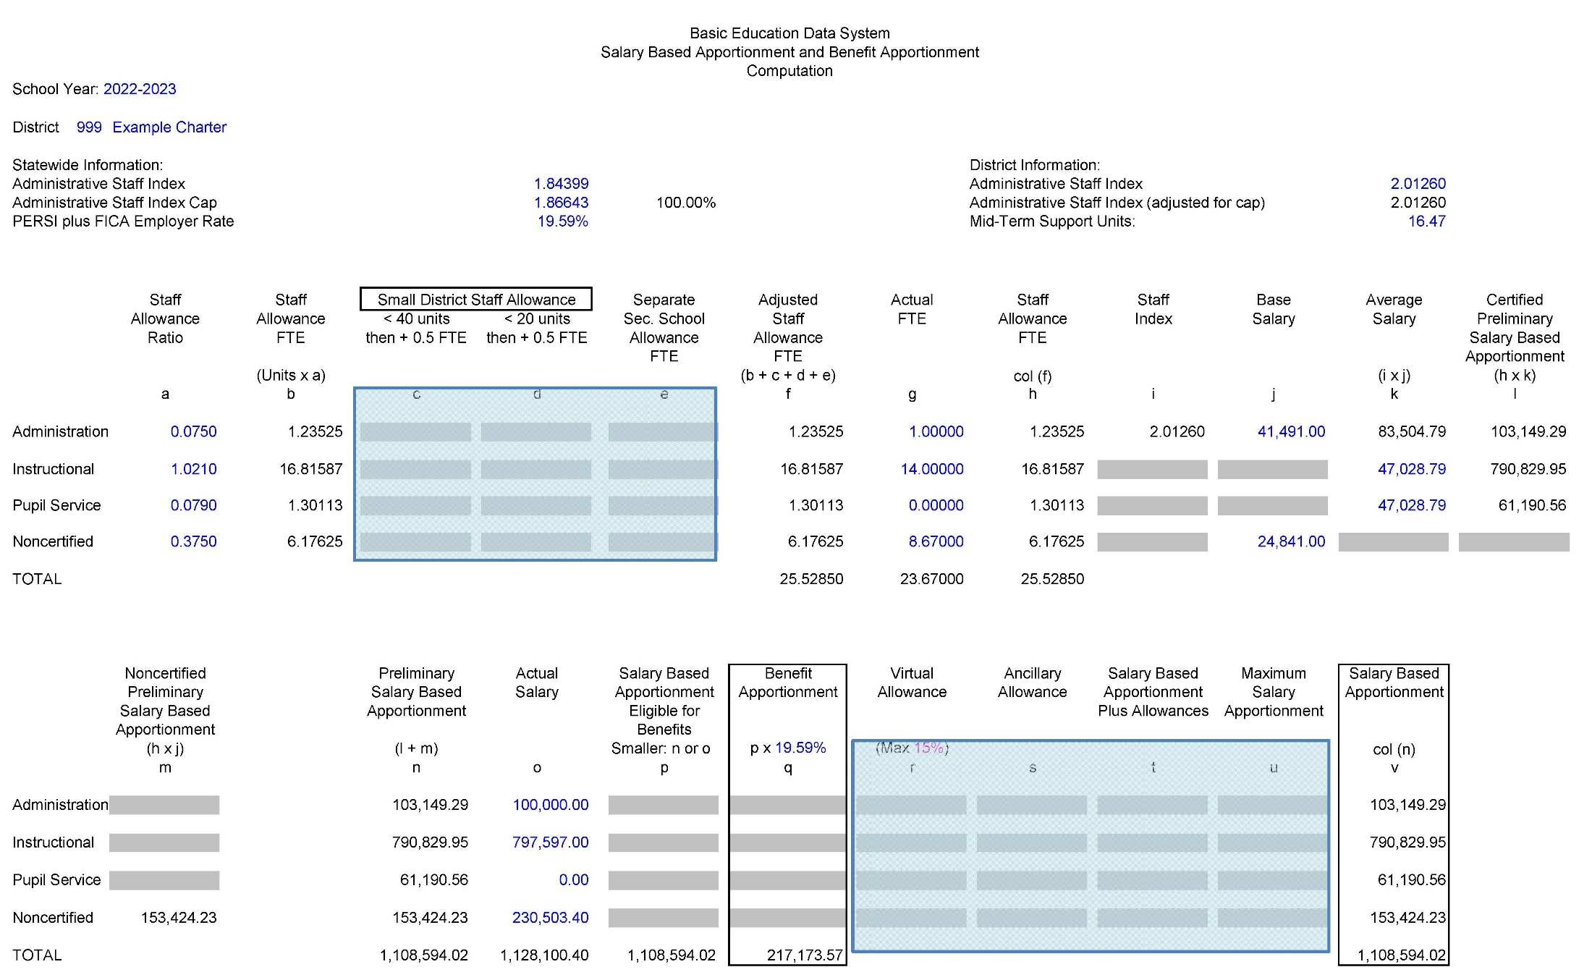
2022-2023 Salary Based & Benefit Apportionment - Charter School
Mid Term Units
Salary Based Apportionment
Benefit Apportionment
Salary Based Apportionment and Benefit Apportionment | 14

Slide 15
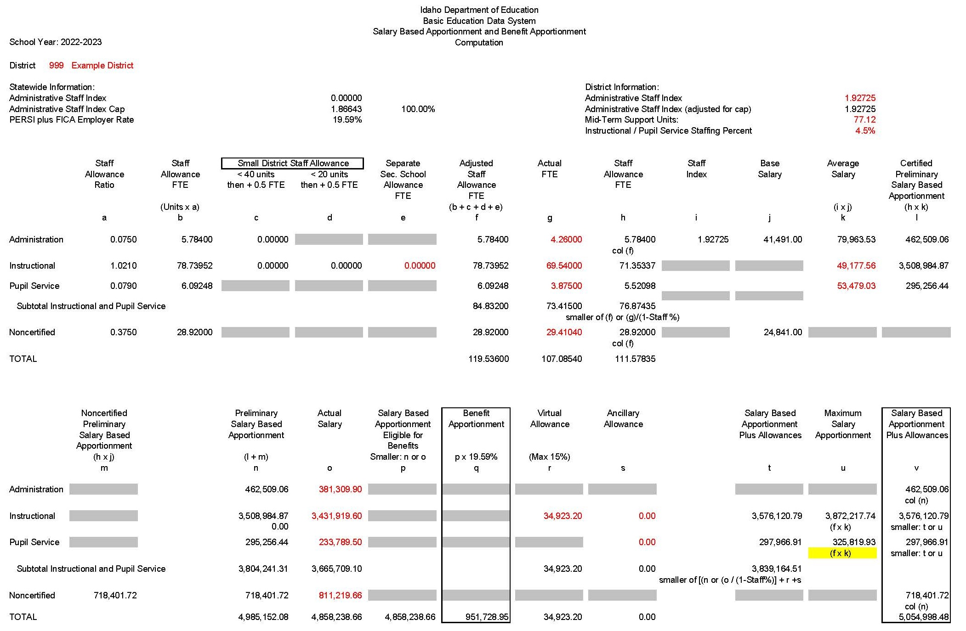
2022-2023 Salary Based & Benefit Apportionment - District
Mid Term Units
Salary Based Apportionment
Benefit Apportionment

Slide 16

2022-2023 Salary Based & Benefit Apportionment - Charter School (Ratio)
Salary Based Apportionment and Benefit Apportionment | 16

Slide 17
2022-2023 Salary Based & Benefit Apportionment – District (Ratio)

Slide 18
Salary Based Apportionment Formula Factors
Staff Allowance Ratios - Ratios for each of the four staff categories. Staff ratios establish the number of staff positions to be funded by each support unit (I.C. 33-1004).
For every one support unit, the state funds to the district/charter:
.075 Administrative Staff (certificated)
Examples: Superintendent, Charter Administrator, Principal, Curriculum Director, Special Education Director, etc. (40000 series assignment codes)
1.021 Instructional Staff (certificated)
Teachers, Librarians (00001 – 31999, 33000, 50000-72999 assignment codes)
.079 Pupil Services Staff (certificated)
Examples: Counselor, School Nurse, School Psychologist (32000 series assignment codes)
.375 Classified Staff (non-certificated)
Examples: Business Managers, Instructional Aides, Office Support, Custodial Care, IT Support, etc. (90000 series assignment codes)
1.1

Slide 19
2022-2023 Salary Based & Benefit Apportionment - Charter School (Allowances)
Mid Term Units
Salary Based Apportionment and Benefit Apportionment | 19

Slide 20
2022-2023 Salary Based & Benefit Apportionment – District (Allowances)
Mid Term Units

Slide 21
2022-2023 Salary Based & Benefit Apportionment – District (Other Allowances)

Slide 22
Other School District Staff Allowances
N/A for Charter Schools
Small District Staff Allowances
  Based on number of Support Units
  < 40 units adds 0.5 instructional FTE and 0.5 administrator FTE
  < 20 units adds an additional 0.5 instructional FTE
Separate Secondary School Allowance FTE
  Applies to School Districts with one or more Separate Secondary Schools (9-12) (I.C. 33-1004 (6)(d))
  Uncommon, contact Public School Finance with questions if applicable

Slide 23
2022-2023 Salary Based & Benefit Apportionment – District (FTE 1)

Slide 24
SBA Staffing Percentage
Staff Allowance (I.C. 33-1004 (6)(g)
  For instructional/pupil services staff only.
  Allows a District to employ up to 9.5% fewer positions than funded without reduction in number of funded positions
  Starting with FY16, this amount has been reduced by 1% each year for each district in which the average class size in the prior year was 1 student or more greater than the average class size of districts with like support unit divisors
    Example: Group average is 17. Those at an average of 18 or more in that group would be affected.
Statewide Average Class Size (IDAPA 08.02.01.803)
Group 1 - Districts with an elementary divisor of 20 for grades 1-3, 23 for grades 4-6, and 18.5 for secondary
Group 2 - Districts with an elementary divisor of 20 for grades 1-3, 23 for grades 4-6, and a secondary less than 18.5
Group 3 - Districts with an elementary divisor of 19 or 20 for grades 1-6, and a secondary less than 18.5
Group 4 - Districts with an elementary divisor less than 19 for grades 1-6, and a secondary less than 18.5
Preliminary Teacher Student Ratios by ADA will be calculated in May.
Districts will receive notification of the final ratios in September, 2023.

Slide 25
2022-2023 Salary Based & Benefit Apportionment – District (FTE 2)
Staffing Percentage

Slide 26
2022-2023 Salary Based & Benefit Apportionment – District (FTE 3)
Staffing Percentage

Slide 27
2022-2023 Salary Based & Benefit Apportionment - Charter School (Index)
Salary Based Apportionment and Benefit Apportionment | 27

Slide 28
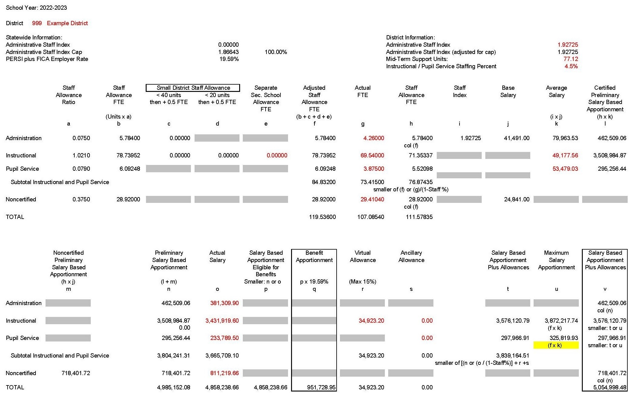
2022-2023 Salary Based & Benefit Apportionment – District (Index)

Slide 29
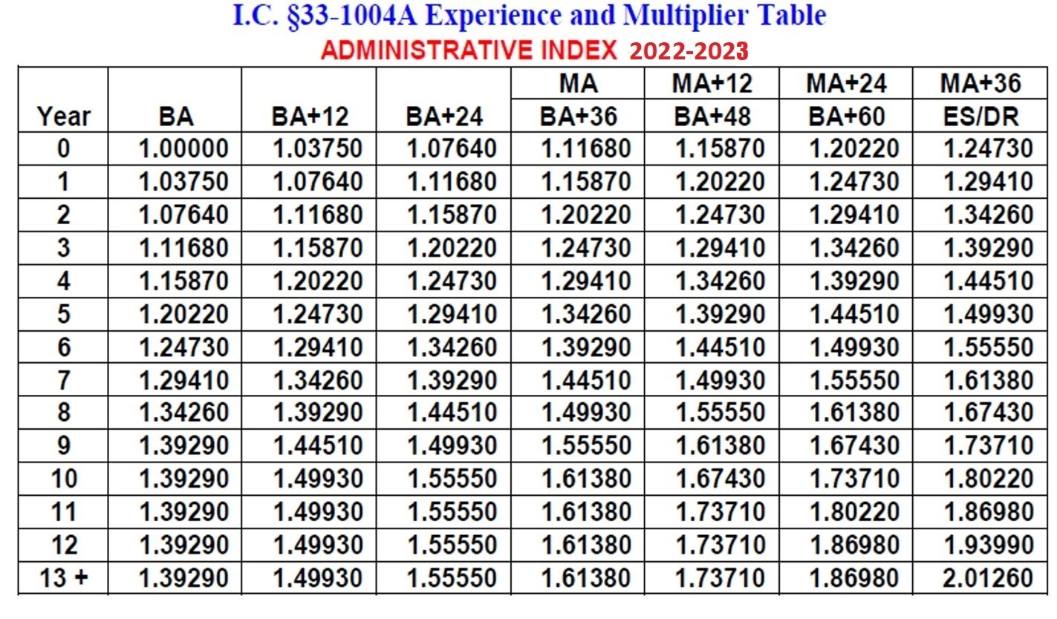
Administrative Index (I.C. 33-1004A)
Only used for administrative staff
Information used is as of last Friday in September
Placement based on education and completed experience
Factored Index = Total Pro-Rated Factor/Total FTE

Slide 30
Index Experience
    Use information as of the last Friday in September
  Prior years of experience are placed in five categories:
        Idaho Public K-12
        Public K-12 Outside Idaho
        Accredited Private or Parochial K-12
        Accredited Idaho College or University (05-06 SY or later)
          Experience must be equivalent to the K-12 instruction environment
        Accredited College or University Outside Idaho (05-06 SY or later)
          Experience must be equivalent to the K-12 instruction environment
      K-12 experience must be under a certificated contract to be counted
        Includes administrative, instructional, and pupil services experience

Slide 31
Admin Index Experience (Cont.)
Uses actual number of prior years of experience
  Do not count the current year
  Experience increases after the school year is over
  Staff in their first year ever holding a certificated contract would report as 0
  Experience is counted in whole years only
    0.50 eligible FTE or more = 1 year
    Less than 0.50 eligible FTE is not counted
      Each year is considered separately
      Partial years cannot be combined
    Be Careful
      Check what you’ve reported in recent years and make sure everything makes sense

Slide 32
Admin Index Education
  Degree
      Highest Degree claimed for funding
      May not be highest degree obtained
  Initial certification
      Issue date of the first certificate (may be outside Idaho or after BA)
  Additional Credits
      Earned beyond the degree reported and after initial certification
      Accredited college transcript credits only
      Must be in a relevant pedagogy or content as determined by Teacher Certification
      Reported in semester credit hours only
      Do not report in-service credits
Education must reflect the last Friday in September
  Do not update degrees and credits earned in the current year in ISEE as this may cause errors

Slide 33
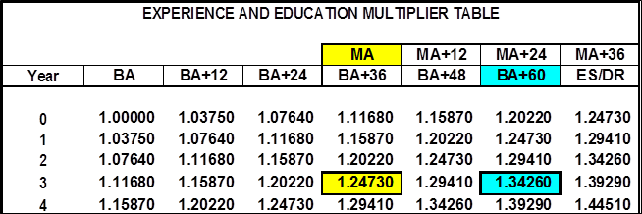
Admin Index Education (Cont.)
The index table has degrees and credits that overlap
  Use the most beneficial multiplier
Example:
  A certificated employee has 5 credits beyond their MA and initial certification
  They also have 62 credits earned after their BA and initial certification
  The index multiplier is higher if reported as BA+60 instead of a MA + 0
  If also instructional or pupil services, MA would be reported as second degree to receive Education Allocations

Slide 34
2022-2023 Salary Based & Benefit Apportionment - Charter School (Base Salaries)
Salary Based Apportionment and Benefit Apportionment | 34

Slide 35
2022-2023 Salary Based & Benefit Apportionment – District (Base Salaries)

Slide 36
Salary Based Apportionment Base Salaries
FY 2023 Base Salaries (I.C. 33-1004E)(4)&(5) - Reviewed and set by the legislature each year.
Administrative - $41,491
  Classified staff - $24,841

Slide 37
2022-2023 Salary Based & Benefit Apportionment - Charter School (Calculated Salaries)
Salary Based Apportionment and Benefit Apportionment | 37

Slide 38
2022-2023 Salary Based & Benefit Apportionment – District (Average Salary)

Slide 39
Salary Based Apportionment Average Salaries
1. Administrative Staff Average Salary
Experience/Education Index x Base Salary = Average Administrative Salary.
2. Instructional Staff Average Salary I.C. 33-1004E (1)
(Education Allocations + CTE Allocations + Career Ladder Amounts) / Total Instructional FTE = Weighted Average Salary
3. Pupil Services Staff Average Salary I.C. 33-1004E (1)
(Education Allocations + Career Ladder Amounts) / Total Pupil Services FTE = Weighted Average Salary

Slide 40
Education Allocation
In order to be eligible for an education allocation, the instructional or pupil services staff member must:
  Hold a Professional Endorsement
    Obtained through Teacher Certification
    Check reports to determine if someone eligible does not have this
    Those who are newer to Idaho public K-12 with prior experience may not be caught automatically
  Have the appropriate educational data reported
    BA + 24 credits in 19-20 = $2,000
    MA in 19-20 = $3,500
Only one education allocation applies at a time (e.g. you cannot have both a BA + 24 and an MA education allocation)
Still report BA + credits if that is more beneficial on the index table
  MA can be reported as additional degree and still count here

Slide 41
Obtaining Professional or Advanced Professional Endorsements
This is a separate process that, where possible should be begun before creating/submitting the Form 10
PE and APE Forms
For staff with in-state experience only
For staff with out-of-state experience only
For staff with in-state and out-of-state experience
https://www.sde.idaho.gov/cert-psc/cert/pe-ape/

Slide 42
Obtaining Professional or Advanced Professional Endorsements (cont.)
Consult Helen Henderson in Teacher Certification, or the Teacher Certification website at:
(208) 332-6879 or hhenderson@sde.idaho.gov
https://www.sde.idaho.gov/cert-psc/

Slide 43
Education Allocation (Cont.)
While similar, the rules on what credits to count are different than those for admin staff
  Additional Credits
      Earned beyond the degree reported and after initial certification
      Accredited college transcript credits only
        Must be in a relevant pedagogy or content as determined by Teacher Certification
      Reported in semester credit hours only
      Do not report in-service credits
This is an ongoing issue from last year
There are several avenues we are looking into to resolve this still
Salary Based Apportionment and Benefit Apportionment | 43

Slide 44
CTE Allocation
Districts and Charters may receive an additional allocation for career technical education (CTE)
  Applies to instructional staff only
  Maximum of $3,000 per individual
  Must hold an occupational specialist certificate (OS) for which they are teaching (NOT a degree based CTE Certificate)
  The allocation is prorated according to contract FTE, funding source codes (Fund 10), and assignment FTE
    An instructor who has 0.25 FTEs with CTE assignments in Fund 10 would only generate $750
  The funds must be past on to the staff member, however how you do that is a local control decision.

Slide 45
When Does Movement Occur?
Movement is again being calculated at the end of each person’s current certificated contract, not at the beginning of their next certificated contract
Questions relating to this have caused many delays on our end and I apologize for all the confusion and inconvenience

Slide 46
Movement into 22-23 (Residency Rung)
I.C. 33-1004B (1)
21-22 R1s and R2s
  Advance one cell if they previously held a certificated contract at that cell
21-22 R3s
  Advance to P1 if they held a certificated contract at that cell and hold a professional endorsement in 22-23
  Those without a professional endorsement remain an R3 at FY23 funding levels (this is different from the Professional Rung below)

Slide 47
22-23 Career Ladder Advancement
(Professional Rung)
Anyone who is issued a PE while on the residency rung automatically becomes a P1 that year
Moving from 21-22 into 22-23
  Those on the Professional Rung with exactly 4 years of experience
    Advance one cell if they held a certificated contract at their prior cell and met all three performance criteria in at least two of the last four years (18-19, 19-20, 20-21 and/or 21-22)
  Others on the Professional Rung with more than 4 years
    Advance one cell if they held a certificated contract at their prior cell and met all three performance criteria in at least three of the last five years (17-18, 18-19, 19-20, 20-21 and/or 21-22)
    One of these years must be within the prior two years.
  Those on the Professional Rung with less than 4 years
    Must wait until after the 4th year, regardless of how many years they met criteria
Salary Based Apportionment and Benefit Apportionment | 47

Slide 48
22-23 Career Ladder Advancement
(Professional Rung, Cont.)
    Individuals who did not meet all three performance criteria in the required number of years will not advance, and will be funded at the prior year funding levels instead of FY23’s (this includes applicable education allocations)
      If an individual was already held and has continued to be held, they would still be at the original funding levels at which they last met criteria
    P5s must also meet these requirements or remain funded at prior year levels

Slide 49
22-23 Career Ladder Advancement
(Advanced Professional Rung)
Moving from 21-22 into 22-23
  Must have met performance criteria for Advanced Professional Rung in the prior year in order to advance.
  Otherwise will remain at prior year placement and funding including education allocations where applicable.
  Individuals cannot move backward on the career ladder unless they were placed incorrectly.
  Criteria for movement on the AP rung is different than those used for the P rung, meaning you may see a higher proportion of individuals held on AP cells than on P cells

Slide 50
Professional Compensation Rung Performance Criteria
Idaho Code 33-1001(20)(a):
  (i) An overall rating of proficient, and no components rated as unsatisfactory on the state framework for teaching evaluation; and
  (ii) Demonstrating the majority of their students have met their measurable student achievement targets or student success indicator targets.

Slide 51
Advanced Professional Compensation Rung Performance Criteria
Idaho Code 33-1001(20)(b):
(i) An overall rating of proficient or higher, no components rated as unsatisfactory or basic, and rated as distinguished overall in domain two — classroom environment, or domain three — instruction and use of assessment, on the state framework for teaching evaluation or equivalent for pupil service staff; and
(ii) Demonstrating seventy-five percent (75%) or more of their students have met their measurable student achievement targets or student success indicator targets.

Slide 52
Career Ladder Data System Application
How Idaho public K-12 evaluation and student achievement data is sent to SDE
Managed by Educator Effectiveness group
Questions on application, evaluations, student data
  Contact Kathy Gauby (208) 332-6891
  KGauby@SDE.idaho.gov

Slide 53
Performance Criteria Notes
Per the Office of the State Board of Education:
  A year without an Idaho evaluation/student data defaults to failed
    Be sure to both enter and certify this data each year in CLDS
    Failure to do so will delay ladder movement both for you and any associated hiring districts, affecting funding
  Evaluations/student data outside Idaho public K-12 may be used where applicable, provided the hiring district/charter certify they believe them to be equivalent to Idaho standards
    District Superintendent/Charter Administrator must sign off that this is accurate when forms requesting placement are submitted

Slide 54
A Note on Exiting Staff and Movement
Exiting staff in the following year has created “phantom placements” in those years
This has caused several downward corrections this year and there will likely be several more as I continue looking for them
Please do not report staff this way going forward
Instead, please do a batch update to your prior June upload once you know who is not returning

Slide 55
Initial Career Ladder Placement for CTE Staff Under an OS Certificate
Idaho Code 33-1004B(6) now allows for OS Certificated CTE staff to be initially placed based on industry experience in fields relevant to what they are teaching
Experience is determined by the Division of CTE as part of their certification process
2-3 years = R2
4-5 Years = R3
6-7 Years = P1
8+ Years = P2
This process does not issue or change the requirements for PEs or APEs
This process does not change the required number of years of experience to advance on the P Rung

Slide 56
First CL Placement with Prior Experience
Non-CTE staff with no prior Idaho Career Ladder placement:
  First work with Teacher Certification on PE/APEs (where applicable)
    Advanced Professional Endorsement (APE) Starts at AP1
    Professional Endorsement (PE) starts at P1
    If neither is obtained, they will be placed as an R1
BUT…

Slide 57
First CL Placement with Prior Experience (Cont.)
HB 656 was passed last session creating Idaho Code a new 33-1004B(7) which:
    Allows for initial placement based on prior certificated K-12 employee experience
    Can be used for prior Idaho employees who have never been on the Idaho Career Ladder yet
    This is not retroactive
        Anyone placed in 20-21 or 21-22 based on the R1, P1, AP1 only model will continue to move normally from that original placement

Slide 58
First CL Placement with Prior Experience (Cont. II)
First, work with Helen Henderson in Teacher Certification to obtain a PE or APE
  This determines which rung an individual will start with
Next, fill out a Form 10 to record any prior years in which they met equivalent Professional Rung performance criteria
  This should be done for anyone who met equivalent professional rung performance criteria outside Idaho public K-12 within the last 5 years, even if they are not yet eligible for a PE/APE or this placement process
    This helps record such data for future movement

Slide 59
New Form 10
Includes automated fields to avoid duplicate data
Has space for 4 people per sheet with 32 possible individuals overall (if significantly more needed, contact me)
Greys out fields until something is entered or selected that will require them
  EDUID must be entered before any other fields are available
    If an EDUID is not available, hold off on the Form 10 until one is
Handles new placement and allowable evaluations as passed under HB 656 in FY22
  Is more detailed (and long) but limits input to hopefully avoid errors/confusion

Slide 60
New Form 10 (Cont. II)
Can estimate placement based on the information provided on the form
  If information is in error, the placement may change
  Estimates for those previously on the Idaho Career Ladder are not possible yet
  This a new feature trying to make a complex process into formulas in the background
    Treat these as VERY preliminary for now while we continue to field test them

Slide 61
Who Doesn’t Need a Form 10?
Anyone in their first year of a certificated position anywhere.
Anyone who was in Idaho public K-12 as a late hire last year, who was their first year anywhere in the prior year
  Due to limitations in reporting, these can be missed in the prior year and show up blank the following year
  I try to catch them as I go, but please feel free to just e-mail who they are and I can fix it without a Form 10
Salary Based Apportionment and Benefit Apportionment | 61

Slide 62
Who Does Need a Form 10?
Anyone new to Idaho public K-12 with prior certificated experience
Anyone with prior Idaho public K-12 experience who has not been on the Career Ladder before
Anyone with prior Idaho public K-12 experience on the Career Ladder, but who has not be active in Idaho public K-12 in at least the past year
Idaho Administrators returning to the classroom (even if only one assignment)
Individuals who may need to have past instructional/pupil service assignments recorded
District Superintendent/Charter Administrator must sign off on forms including performance criteria or involving placement
Salary Based Apportionment and Benefit Apportionment | 62

Slide 63
Feedback is Appreciated!
Please let me know if something is missing, too complex, seems broken/inaccurate, is rejected by your version of Excel, etc.
I want this to be something helpful for everyone that decreases common errors and records things more precisely to cover current code as well as hopefully future changes
I do not want to make something that looks flashy, but is more of a pain to use than it’s worth, or which doesn’t work for less than the vast majority of locations
While the presentation/layout of the form can be changed by me, the requirements behind the data fields cannot
Salary Based Apportionment and Benefit Apportionment | 63

Slide 64
This is a Lot of New Data Right?!
Most of the information on the Form 10 is not new and much has been part of it since 18-19 or earlier including:
  Certifying all 3 performance criteria in cases where it was met outside Idaho public K-12
  Years of experience (removed in 20-21 and 21-22 due to changes in code, but returning this year)
  Initial certification date and location
Formatting was changed and single line items broken out or expanded in an attempt to clarify what is being asked and certified, and to decrease the number of extra e-mail conversations needed
Salary Based Apportionment and Benefit Apportionment | 64

Slide 65
Still, Why Do We Have to Do This?!
There is not, nor has there been previously, a legal requirement to submit a Form 10
A district or Charter School can choose not to submit one
If blank placements are left alone, they will eventually get a defaulted placement
It’s preferred you send a list of those you’re not submitting for so I know and can go forward not expecting one
However…
Salary Based Apportionment and Benefit Apportionment | 65

Slide 66
Still, Why Do We Have to Do This?! (cont.)
This affects placements, movement and funding
This allows me to find areas where additional information can help your funding, or explain why someone has the placement they do
It ensures we have documentation to justify placements and movement, or lack there of
It documents what was sent in on your end if I missed something or made an error
Those placed on the P Rung without any documented performance criteria will end up frozen at that initial placement and funding year level for at least 3 years
Salary Based Apportionment and Benefit Apportionment | 66

Slide 67
Still, Why Do We Have to Do This?! (cont. II)
This affects funding for other locations later if the person moves
This can have a real and permanent affect on a person’s salary
  About 2/3s of Idaho’s districts and charter schools use the Career Ladder for their salary schedule determinations, or something that relies heavily on it
  Corrections to placements/movement have time limits
  A person may leave on good terms to go elsewhere, only to see their salary permanently decrease because of a lack of a Form 10 submission
Salary Based Apportionment and Benefit Apportionment | 67

Slide 68
2022-2023 Salary Based & Benefit Apportionment - Charter School (Average Salaries)

Slide 69
2022-2023 Salary Based & Benefit Apportionment – District (Average Salaries)

Slide 70
2022-2023 Salary Based & Benefit Apportionment - Charter School (Salary Funding)
Salary Based Apportionment

Slide 71
2022-2023 Salary Based & Benefit Apportionment – District (Preliminary SBA)

Slide 72
2022-2023 Salary Based & Benefit Apportionment – District (Recovering FTE)

Slide 73
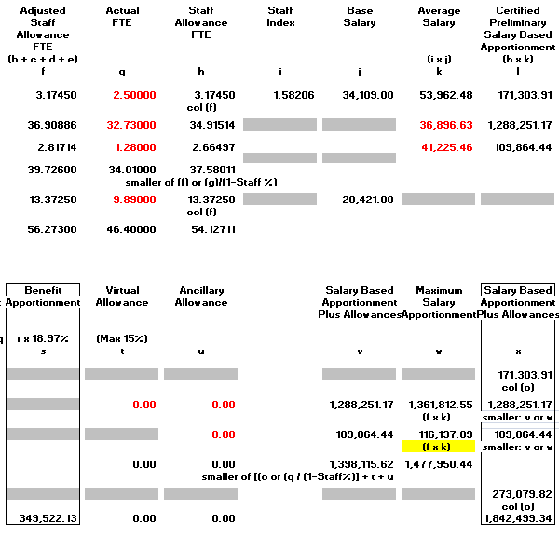
Unutilized FTE (Use it or Lose It)
N/A for Charter Schools
Actual FTE 34.01
Divided by (1 - 9.5%)
Staff Allow 37.58
Adjusted Staff Allow 39.72
Less Staff Allow 37.58
Unutilized fte 2.14
$ 1,477,950.44
- $ 1,398,115.62
$ 79,834.82

Slide 74
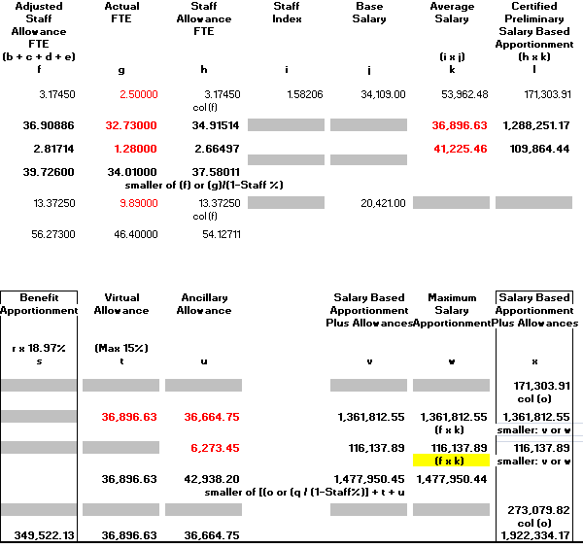
Recovering Unutilized FTEs
N/A for Charter Schools

Slide 75
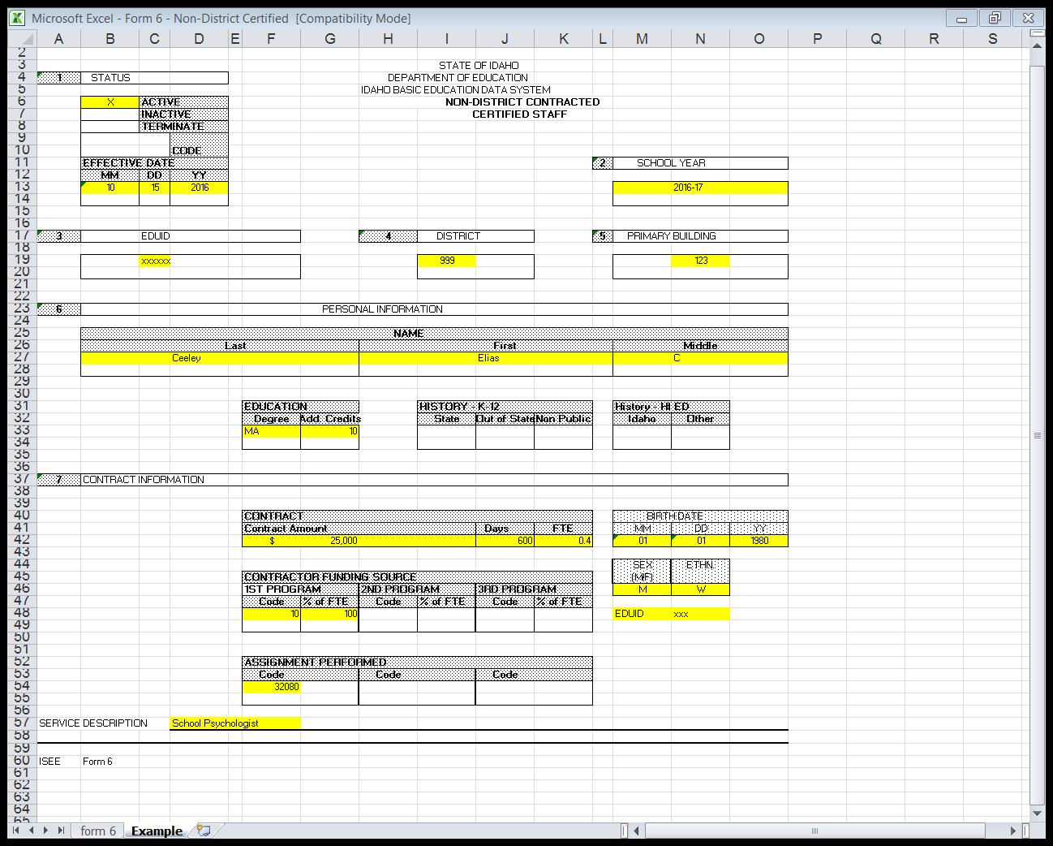
ISEE Form 6 (Non District Contracted Staff)
ISEE Form 6 can be used to recover funding due to unutilized FTEs (otherwise not required)
Can be used for contracted non-district instructional or pupil services positions
Must be properly certificated and endorsed in Idaho
Due January 10, 2023, but can be submitted for later payments if necessary
Not applicable to Charter Schools

Slide 76
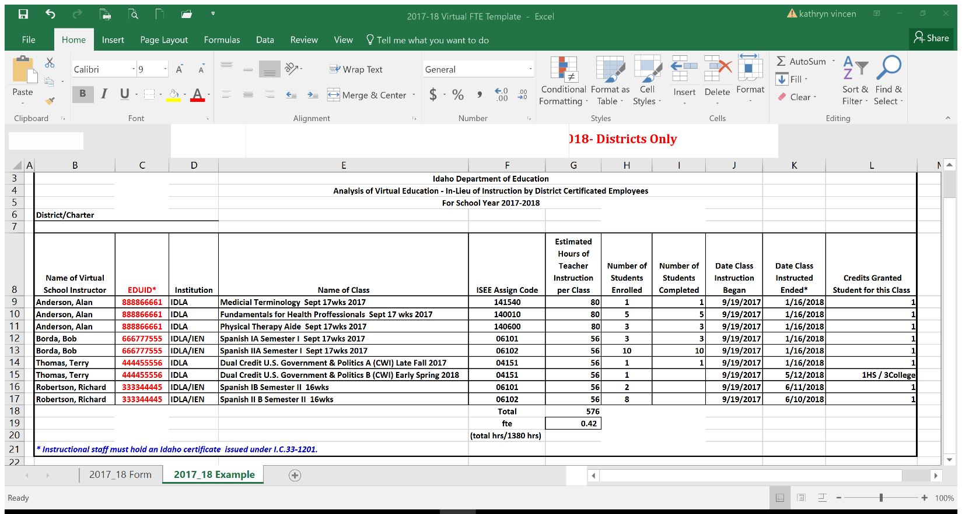
Virtual Template
Virtual Template can be used to recover funding due to unutilized FTEs (otherwise not required)
EDUID required for each virtual instructor (limited exception with dual credit)
All staff must be appropriately certificated and endorsed in Idaho (limited exception with dual credit)
Due January 10, 2023, but can be submitted for later payments if necessary
Not applicable to Charter Schools

Slide 77
2022-2023 Salary Based & Benefit Apportionment – District (Final SBA)
Salary Based Apportionment

Slide 78
2022-2023 Salary Based & Benefit Apportionment - Charter School (Final SBA)

Slide 79
2022-2023 Salary Based & Benefit Apportionment – District (Actual Salaries)

Slide 80
Minimum Salaries for FY23
Minimum salary:
33-1004E (1)
  (1) Minimum salary for a full time instructional/pupil services staff member on the residency rung cannot be less than the minimum dollar amount on the residency rung
  For 22-23 this is $40,742

Slide 81
Minimum Salaries for FY23 (Cont.)
Second Minimum added starting in FY23:
33-1004E (2)
  Minimum salary for a full time instructional/pupil services staff member on the professional or advanced professional rungs cannot be less than the minimum dollar amount on the professional rung
  For 22-23 this is $43,488

Slide 82
Minimum Salaries for FY26
Third Minimum added starting in FY26:
33-1004E (3)
  Minimum salary for a full time instructional/pupil services staff member on the advanced professional rung cannot be less than the minimum dollar amount on the advanced professional rung
  For 25-26 this amount is not yet defined

Slide 83
2022-2023 Salary Based & Benefit Apportionment - Charter School (Benefits)
Benefit Apportionment

Slide 84
2022-2023 Salary Based & Benefit Apportionment – District (Benefit Apportionment)
Benefit Apportionment

Slide 85
2022-2023 Salary Based & Benefit Apportionment - Charter School (Summary)
Mid Term Units
Salary Based Apportionment
Benefit Apportionment

Slide 86
2022-2023 Salary Based & Benefit Apportionment – District (Summary)
Mid Term Units
Salary Based Apportionment
Benefit Apportionment

Slide 87
Certification Misassignment Withholdings

Slide 88

Certification Misassignments Withholdings
Idaho Code 33-1201 requires all administrative, instructional, and pupil service staff to be properly certificated regardless of fund source
Idaho Code 33-1002(6)(d) requires that the actual contract salary or those who are not properly certificated be removed from the Foundation Payment
This is outside the SBA calculations and taken “off the top” at the end of the process
For questions on why a withholding has occurred and what if anything can be done to reverse them, please contact Teacher Certification through either:
  Cina Lackey - clackey@sde.idaho.gov, (208) 332-6936
  Mandy Fulbright - mfulbright@sde.idaho.gov, (208) 332-6885

Slide 89
ISEE Reports
What are they and what can they tell you?

Slide 90
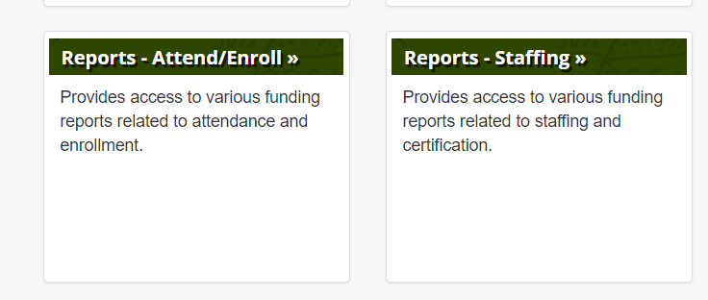
Getting to Your ISEE Reports

Slide 91
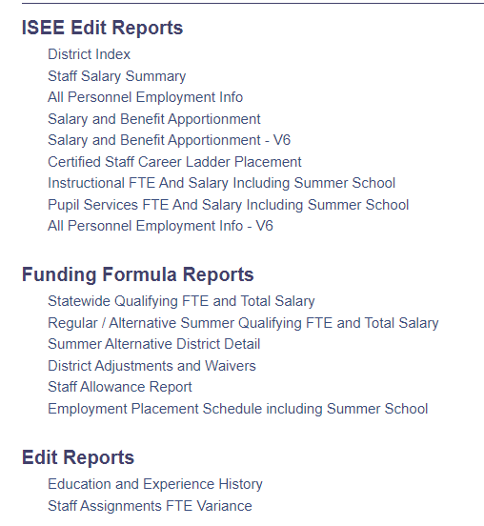
All Personnel Employment V-6 Report - I
Can be run on demand a few days after your first upload
A copy of the report as the data appeared for the February 15th, May 15th, and July 15th payments is included with payment documentation on the secure FTP website

Slide 92
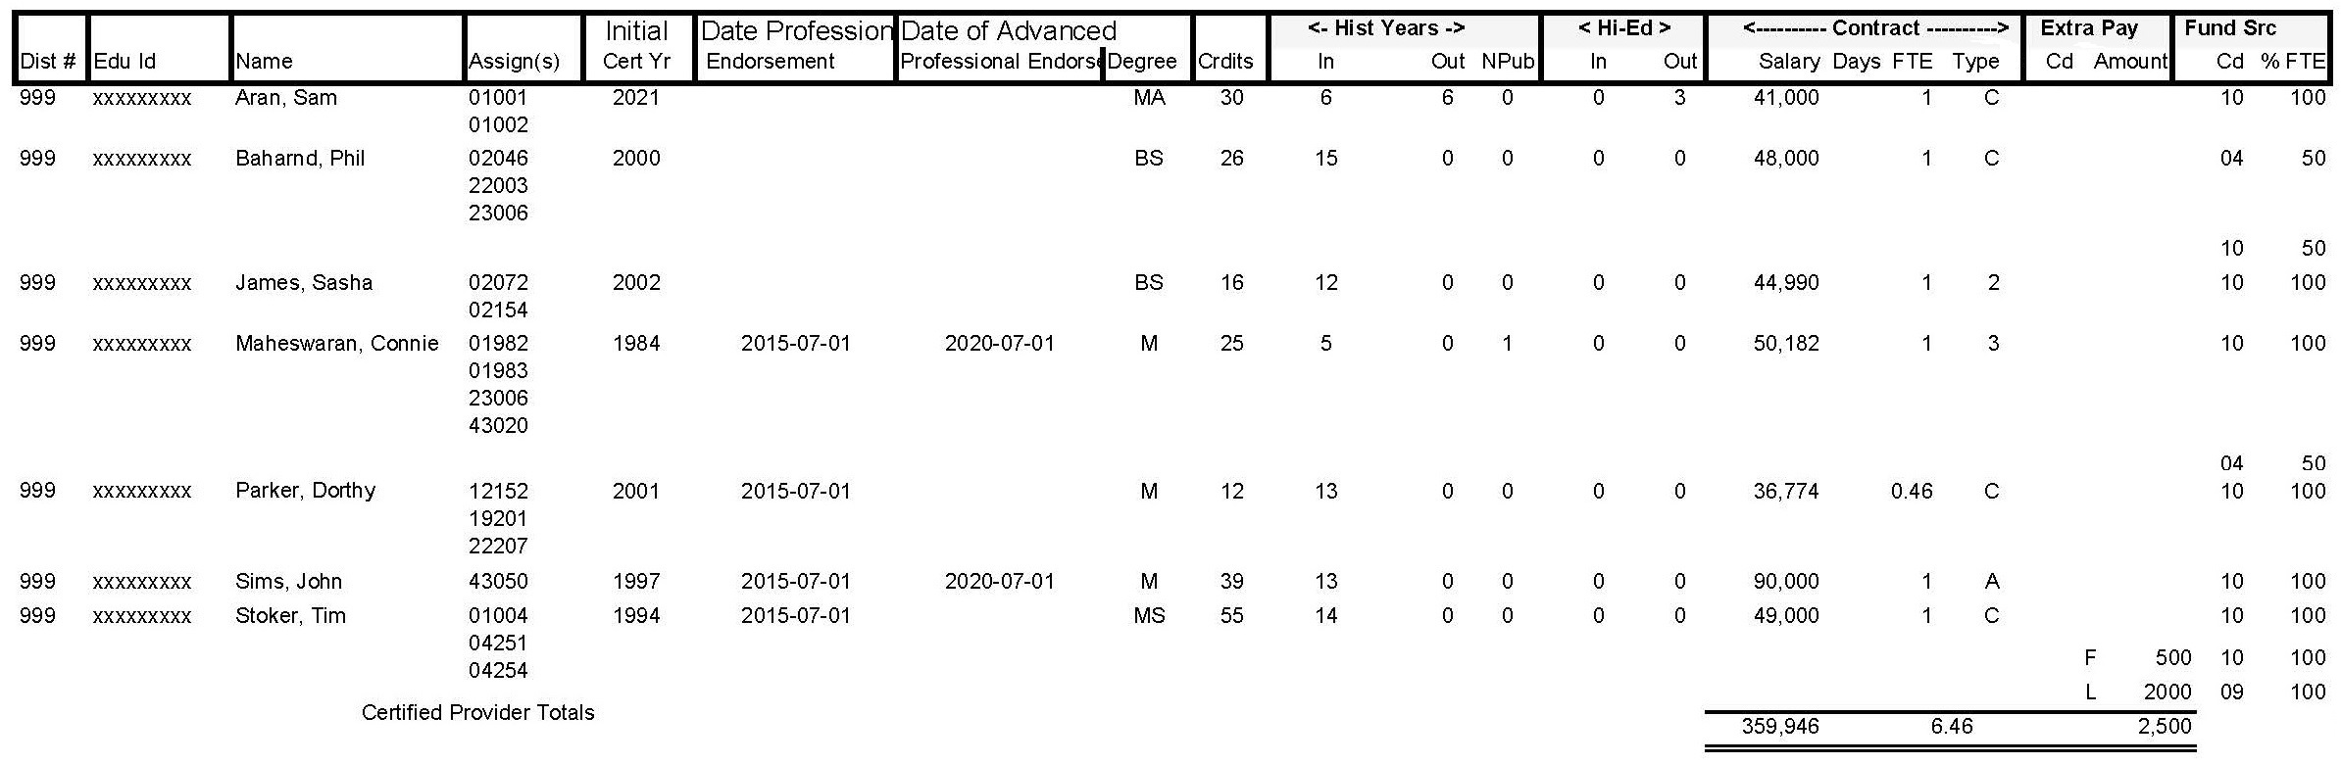
All Personnel Employment V-6 Report - II
Tab 1 shows all certificated staff in all funds as of snapshot date (including summer school)
Review all data fields for accuracy
  Ensure staff assignments and funding codes are correct
  Ensure employees paid from multiple funds total 100 (%)
If data is incorrect or missing:
  Check assignments on Staff Assignments FTE report
  Correct your records and resubmit files
Make sure any blank professional endorsements are correct

Slide 93
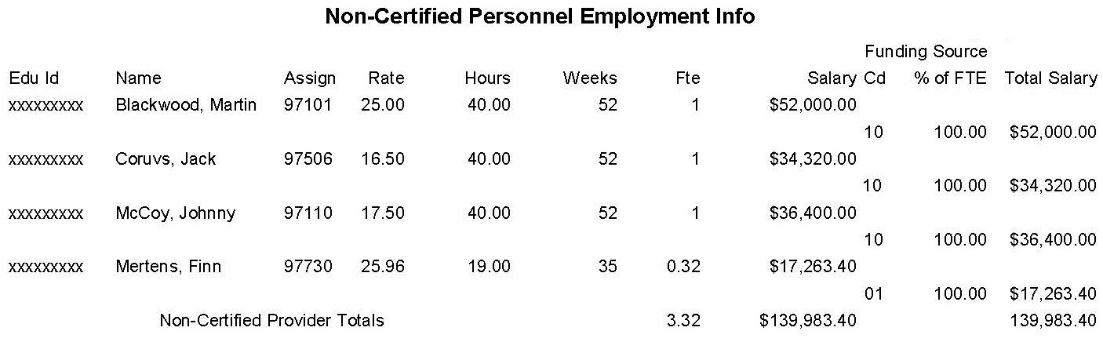
All Personnel Employment V-6 Report - III
Tab 2 shows all non-certificated staff in all funds as of snapshot date (including summer school)
Review all data fields for accuracy as in Tab 1
Non-certificated FTE:
  (hours per week x weeks per years) / 2080 hours
  If the employee's total FTE shows as greater than 1.0, correct the errors and resubmit the files
Employee with more than one assignment, check the data for reasonableness
  E.g. the person would not likely work more than 40 hours per week total or more than 52 weeks during the year

Slide 94
Employment Placement Report - I
Can be run on demand a few days after your first upload
A copy of the report as the data appeared for the February 15th, May 15th, and July 15th payments is included with payment documentation on the secure FTP website

Slide 95
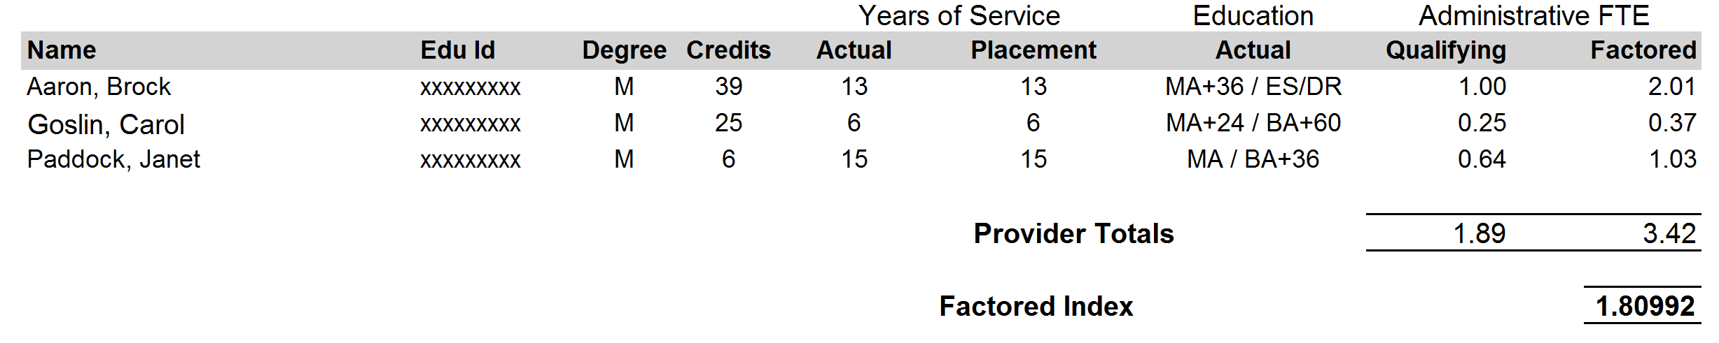
Employment Placement Report - II
Shows data for Salary Based Apportionment calculations for administrative staff only (including summer school)
Only certificated administrative employees, paid from the general fund code 10 with administrative assignments active on the last Friday in September will populate this report
Review all data elements for accuracy
  Ensure all relevant staff are listed on this report
  Check for accurate education, years of experience, and index placement
If data is incorrect or missing
  Review the All Personnel Employment V-6 Report for possible discrepancies
  Review the Staff Assignments FTE report to ensure all assignments are entered correctly
  Make corrections in your system and resubmit the files

Slide 96
Instructional FTE & Salary Report - I
Can be run on demand a few days after your first upload
A copy of the report as the data appeared for the February 15th, May 15th, and July 15th payments is included with payment documentation on the secure FTP website

Slide 97
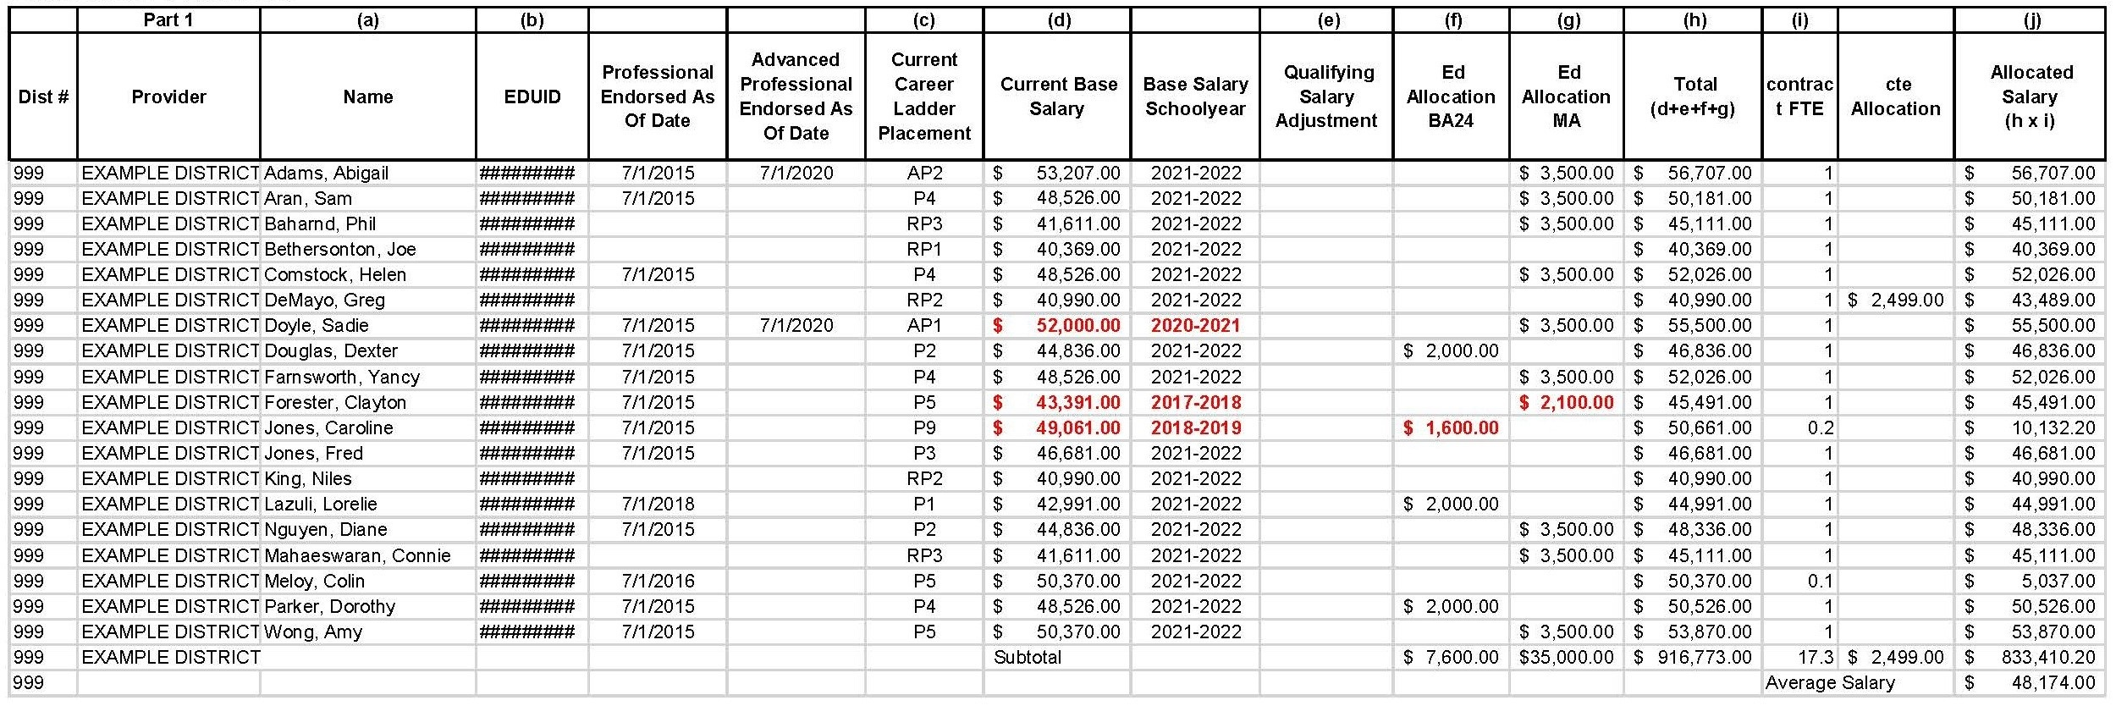
Instructional FTE & Salary Report - II
Shows details of the instructional staff under fund 10
Shows individual’s funding Fiscal Year
Career ladder base, allocations, and FTEs derive the weighted average instructional salary for SBA calculations

Slide 98
Pupil Services FTE & Salary Report – I
Not applicable unless employing Pupil Service Staff
Can be run on demand a few days after your first upload
A copy of the report as the data appeared for the February 15th, May 15th, and July 15th payments is included with payment documentation on the secure FTP website

Slide 99
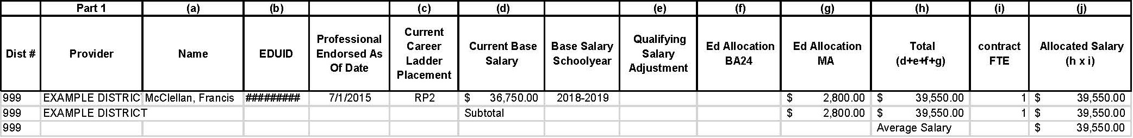
Pupil Services FTE & Salary Report – II
Shows details of the pupil services staff under fund 10
Career ladder base, allocations, and FTEs derive the weighted average pupil services salary for SBA calculations

Slide 100
Education and Experience Report - I
Can be run on demand a few days after your first upload

Slide 101
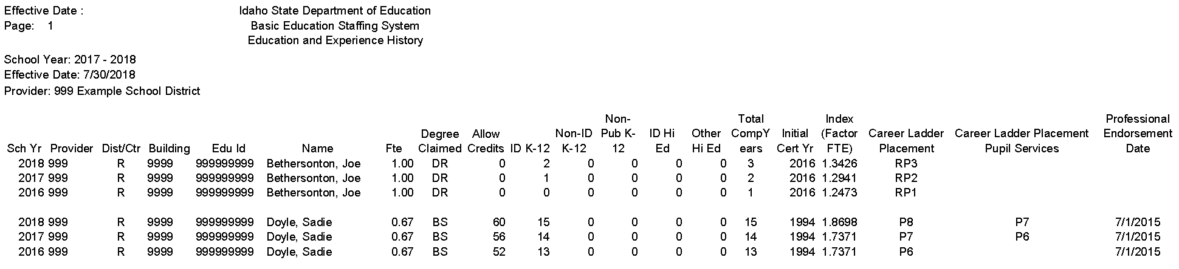
Education and Experience Report - II
Run for all funds
Includes all certificated staff

Slide 102
Salary Based Apportionment Sheet - I
Only updated and calculated as when the calculations are updated for payments
A copy of the report as the data appeared for the February 15th, May 15th, and July 15th payments is included with payment documentation on the secure FTP website

Slide 103
Salary Based Apportionment Sheet – Charter School
Mid Term Units
Salary Based Apportionment
Benefit Apportionment

Slide 104
Salary Based Apportionment Sheet - District
Mid Term Units
Salary Based Apportionment
Benefit Apportionment

Slide 105
Other Items

Slide 106
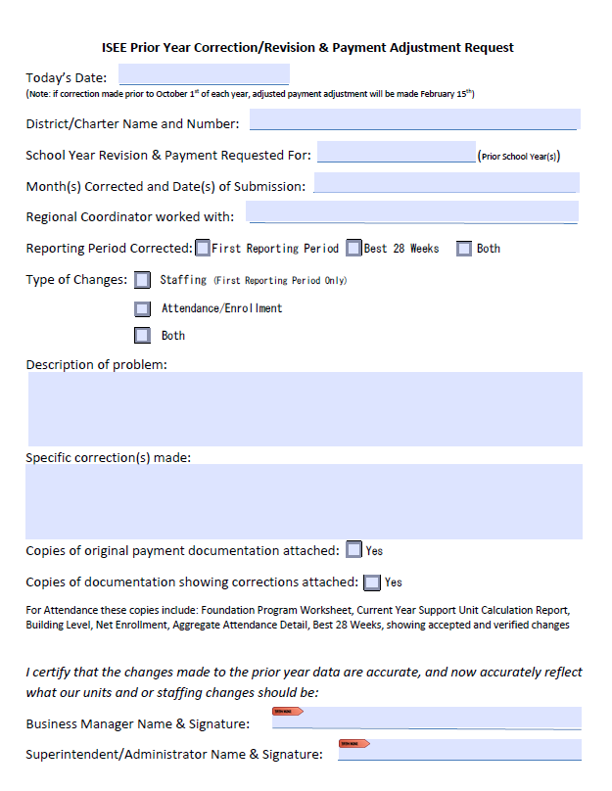
Prior Year Correction / Payment Adjustment Request
Available on Public School Finance Website
Currently can only be used for the 3 years prior to current (this may decrease)
Corrections to prior year ISEE data without this form will not result in corrected payments

Slide 107
There Was No 10% Career Ladder Acceleration
There are and have been documents circulating stating it was passed into law last session
It was included in the Governor’s recommendations
The legislature did not directly take this up and used those Federal funds to instead pass:
  The $1,000 per FTE all positions, all funds extra pay last year and the
  The additional compensation for instructional/pupil service staff all funds this year (a but more than $1,500 per FTE, plus 19.59% benefits)
Salary Based Apportionment and Benefit Apportionment | 107

Slide 108
Staffing Summary
Data gets uploaded in ISEE
Attendance data is used to generate support units, which are the foundation for your funding
Support units and staffing data uploaded in ISEE are used in calculating the Salary Based & Benefits Apportionments
Staff Demographic and Staff Assignment data files derive FTE, categorize staff, and determine averages salaries (as of the last Friday in September)
Contact public school finance for assistance when placing staff on career ladder
Staffing data is used to generate several staffing reports, which should be reviewed for accuracy
Uploads impacting staff funding:
  August Alternative Summer School
  October 15 staff data (first “snapshot”)
  November upload contains the October’s “snapshot” data will override the files
  Subsequent cumulative uploads do not affect the snapshot data unless requested
Remember: staffing data “snapshot” is as of the last Friday in September

Slide 109

Staffing Resources
Public School Finance Site
  Resource Files:
    ISEE Staff Data Guidance Manual
    Staff Data Guidance – Summer Alternative School
  Budget Forms & Information/Budget Forms
    Salary Based Apportionment Templates – District & Charter
  Other Forms
    ISEE Form 10 – Record of Performance Criteria outside Idaho
    Public K-12
    ISEE Form 6 – Contracted Non-District FTE Recovery
    Virtual Template
    Prior Year Correction
ISEE General Files Site
  Program Information
  2022-23 ISEE Manuals
    ISEE Staff Data Guidance
    ISEE Staff Summer School Guidance
    SDE Assignment Credential Manual
  2022-23 Other Forms
  Required Data Collection Elements & Templates
    ID Unit Record Collection items and Option Sets
    Other Templates
Certification & Professional Standards Site
  Professional and Advanced Professional Endorsement Forms
  Professional Endorsement District/Charter Guidance

Slide 110
Questions
Branwyn Phillips | Financial Specialist, Sr.
BCPhillips@SDE.idaho.gov
Idaho State Department of Education
650 W State Street, Boise, ID 83702
208 332 6840
WWW.SDE.idaho.gov

